Slide 1
A First Course on Kinetics and Reaction Engineering
Class 40

Slide 2
Where We’ve Been & Where We’re Going
Part I - Chemical Reactions
Part II - Chemical Reaction Kinetics
Part III - Chemical Reaction Engineering
Part IV - Non-Ideal Reactions and Reactors
A. Alternatives to the Ideal Reactor Models
B. Coupled Chemical and Physical Kinetics
38. Heterogeneous Catalytic Reactions
39. Gas-Liquid Reactions
40. Gas-Solid Reactions

Slide 3
Non-catalytic Gas - Solid Reactions
Very similar to heterogeneous catalytic reactions
Big difference is that the solid is changing with time
Often results in changing pore structure with time
Start with solid that has very low porosity
Porous ash layer may be generated as the reactive component is consumed
Shrinking core model
If reaction rate is very fast, there is a narrow zone where reaction takes place
This zone starts at the exterior of the particle and moves inward radially (for a spherical particle) as reaction proceeds
It results in two different diffusion layers
Gas film surrounding the particle
Ash layer where there isn’t any solid reactant left, but reactants must diffuse through the porous ash layer to reach the reaction zone
General isothermal model, more like heterogeneous catalyst
diffusion through exterior gas film
diffusion plus reaction within the solid
difference here is the evolution of the pore structure as the reaction proceeds
Use effective diffusivity linked to the pore structure and generally a function of time
Pseudo-continuum model for pores

Slide 4
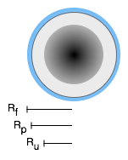
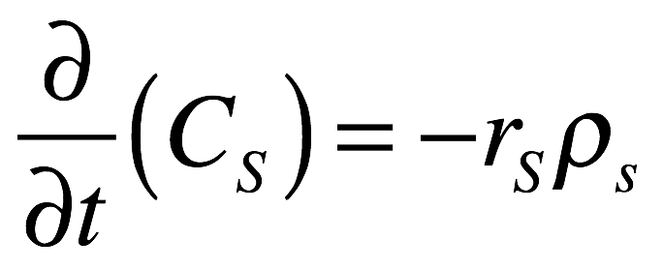
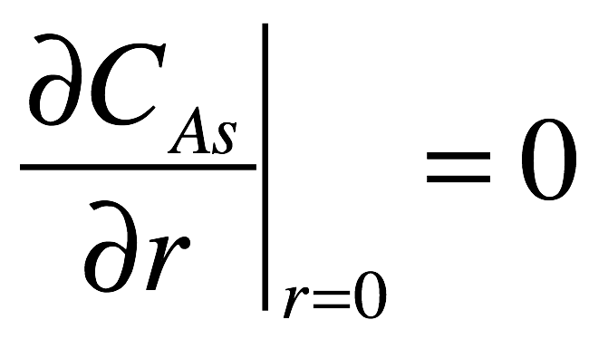
General Isothermal Model
Mole balance on gas phase reactant, A
Pseudo-steady state assumption sets the time derivative equal to zero
Mole balance for the solid, S
Solid is not diffusing, therefore no input/output term
There will be a gradient in the concentration of S, i. e. Cs = f(r,t)
Rates here are assumed to be per mass of solid particle
Boundary conditions
Initial conditions

Slide 5
Questions?

Slide 6
Activity 40.1
Suppose that pure gas phase A reacts with a solid, non-porous, spherical particle of B (radius 0.5 cm, 0.3 mol cm⁻³), yielding porous solid product Z, as in equation (1). Further assume that the porosity of Z and the effective diffusion coefficient for diffusion of A through Z are constants. If the gas phase concentration of A is 0.01 mol L⁻¹ and its effective diffusion coefficient in Z is 3 x 10⁻⁷ cm² s⁻¹, show how to calculate the radius of the unreacted core of B as a function of time if the reaction is effectively instantaneous and the pseudo steady state assumption applies.
A(g) + B(s) → Z(s) (1)
Read through the problem statement and assign each specified quantity to the appropriate variable

Slide 7
Where We’ve Been
Part I - Chemical Reactions
Part II - Chemical Reaction Kinetics
A. Rate Expressions
B. Kinetics Experiments
C. Analysis of Kinetics Data
Part III - Chemical Reaction Engineering
A. Ideal Reactors
B. Perfectly Mixed Batch Reactors
C. Continuous Flow Stirred Tank Reactors
D. Plug Flow Reactors
E. Matching Reactors to Reactions
Part IV - Non-Ideal Reactions and Reactors
A. Alternatives to the Ideal Reactor Models
B. Coupled Chemical and Physical Kinetics

