Slide 1
A First Course on Kinetics and Reaction Engineering
Class 40

Slide 2
Where We’ve Been & Where We’re Going
Part I - Chemical Reactions
Part II - Chemical Reaction Kinetics
Part III - Chemical Reaction Engineering
Part IV - Non-Ideal Reactions and Reactors
A. Alternatives to the Ideal Reactor Models
B. Coupled Chemical and Physical Kinetics
38. Heterogeneous Catalytic Reactions
39. Gas-Liquid Reactions
40. Gas-Solid Reactions

Slide 3
Non-catalytic Gas - Solid Reactions
Very similar to heterogeneous catalytic reactions
Big difference is that the solid is changing with time
Often results in changing pore structure with time
Start with solid that has very low porosity
Porous ash layer may be generated as the reactive component is consumed
Shrinking core model
If reaction rate is very fast, there is a narrow zone where reaction takes place
This zone starts at the exterior of the particle and moves inward radially (for a spherical particle) as reaction proceeds
It results in two different diffusion layers
Gas film surrounding the particle
Ash layer where there isn’t any solid reactant left, but reactants must diffuse through the porous ash layer to reach the reaction zone
General isothermal model, more like heterogeneous catalyst
diffusion through exterior gas film
diffusion plus reaction within the solid
difference here is the evolution of the pore structure as the reaction proceeds
Use effective diffusivity linked to the pore structure and generally a function of time
Pseudo-continuum model for pores

Slide 4
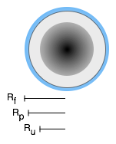
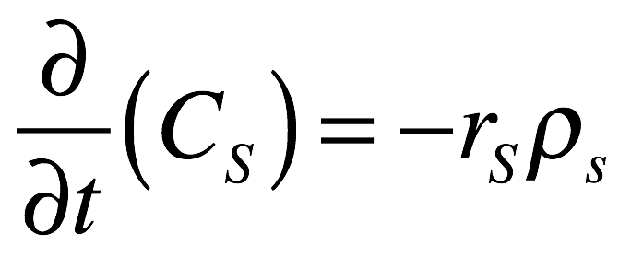
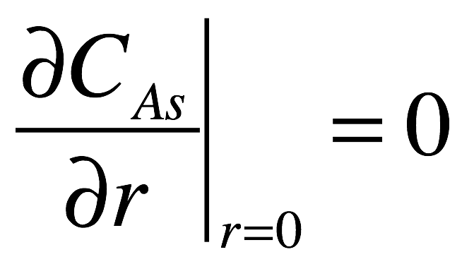
General Isothermal Model
Mole balance on gas phase reactant, A
Pseudo-steady state assumption sets the time derivative equal to zero
Mole balance for the solid, S
Solid is not diffusing, therefore no input/output term
There will be a gradient in the concentration of S, i. e. Cs = f(r,t)
Rates here are assumed to be per mass of solid particle
Boundary conditions
Initial conditions

Slide 5
Questions?

Slide 6
Activity 40.1
Suppose that pure gas phase A reacts with a solid, non-porous, spherical particle of B (radius 0.5 cm, 0.3 mol cm⁻³), yielding porous solid product Z, as in equation (1). Further assume that the porosity of Z and the effective diffusion coefficient for diffusion of A through Z are constants. If the gas phase concentration of A is 0.01 mol L⁻¹ and its effective diffusion coefficient in Z is 3 x 10⁻⁷ cm² s⁻¹, show how to calculate the radius of the unreacted core of B as a function of time if the reaction is effectively instantaneous and the pseudo steady state assumption applies.
A(g) + B(s) → Z(s) (1)
Read through the problem statement and assign each specified quantity to the appropriate variable

Slide 7
Activity 40.1
Suppose that pure gas phase A reacts with a solid, non-porous, spherical particle of B (radius 0.5 cm, 0.3 mol cm⁻³), yielding porous solid product Z, as in equation (1). Further assume that the porosity of Z and the effective diffusion coefficient for diffusion of A through Z are constants. If the gas phase concentration of A is 0.01 mol L⁻¹ and its effective diffusion coefficient in Z is 3 x 10⁻⁷ cm² s⁻¹, show how to calculate the radius of the unreacted core of B as a function of time if the reaction is effectively instantaneous and the pseudo steady state assumption applies.
A(g) + B(s) → Z(s) (1)
Read through the problem statement and assign each specified quantity to the appropriate variable
Rp = 0.5 cm, CB = 0.3 mol cm⁻³, CA,gas = 0.01 mol L⁻¹, DA = 3.7 x 10⁻⁷ cm² s⁻¹
Will the concentration of B in the core change over time? Why (not)?

Slide 8
Activity 40.1
Suppose that pure gas phase A reacts with a solid, non-porous, spherical particle of B (radius 0.5 cm, 0.3 mol cm⁻³), yielding porous solid product Z, as in equation (1). Further assume that the porosity of Z and the effective diffusion coefficient for diffusion of A through Z are constants. If the gas phase concentration of A is 0.01 mol L⁻¹ and its effective diffusion coefficient in Z is 3 x 10⁻⁷ cm² s⁻¹, show how to calculate the radius of the unreacted core of B as a function of time if the reaction is effectively instantaneous and the pseudo steady state assumption applies.
A(g) + B(s) → Z(s) (1)
Read through the problem statement and assign each specified quantity to the appropriate variable
Rp = 0.5 cm, CB = 0.3 mol cm⁻³, CA,gas = 0.01 mol L⁻¹, DA = 3.7 x 10⁻⁷ cm² s⁻¹
Will the concentration of B in the core change over time? Why (not)?
It will not change; a mole balance shows no B enters the core, no B leaves the core and no B reacts in the core so the accumulation of B is zero (the concentration is constant)
Knowing that the concentration of B in the core is constant, use geometry to relate the total moles of B in the core to the radius of the core

Slide 9
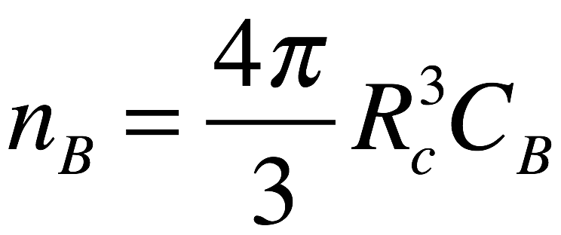
Activity 40.1
Suppose that pure gas phase A reacts with a solid, non-porous, spherical particle of B (radius 0.5 cm, 0.3 mol cm⁻³), yielding porous solid product Z, as in equation (1). Further assume that the porosity of Z and the effective diffusion coefficient for diffusion of A through Z are constants. If the gas phase concentration of A is 0.01 mol L⁻¹ and its effective diffusion coefficient in Z is 3 x 10⁻⁷ cm² s⁻¹, show how to calculate the radius of the unreacted core of B as a function of time if the reaction is effectively instantaneous and the pseudo steady state assumption applies.
A(g) + B(s) → Z(s) (1)
Read through the problem statement and assign each specified quantity to the appropriate variable
Rp = 0.5 cm, CB = 0.3 mol cm⁻³, CA,gas = 0.01 mol L⁻¹, DA = 3.7 x 10⁻⁷ cm² s⁻¹
Will the concentration of B in the core change over time? Why (not)?
It will not change; a mole balance shows no B enters the core, no B leaves the core and no B reacts in the core so the accumulation of B is zero (the concentration is constant)
Knowing that the concentration of B in the core is constant, use geometry to relate the total moles of B in the core to the radius of the core

Slide 10
Use that relationship to relate the rate of change in the total moles of B in the core to the rate of change in the core radius

Slide 11
Use that relationship to relate the rate of change in the total moles of B in the core to the rate of change in the core radius
What initial condition is needed to solve this equation?

Slide 12
Use that relationship to relate the rate of change in the total moles of B in the core to the rate of change in the core radius
What initial condition is needed to solve this equation?
Rc(t=0) = Rp
What quantities are needed in order to solve the equation and are they available?

Slide 13
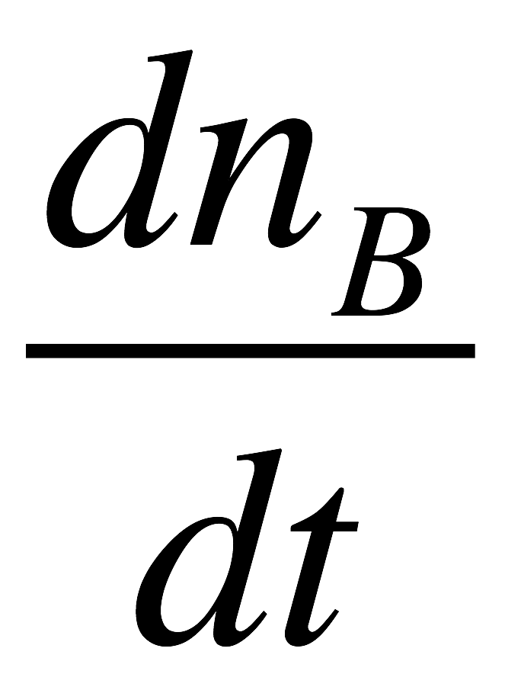
Use that relationship to relate the rate of change in the total moles of B in the core to the rate of change in the core radius
What initial condition is needed to solve this equation?
Rc(t=0) = Rp
What quantities are needed in order to solve the equation and are they available?
CB, Rp and are needed to solve the equation
All but are available
How can the values of the missing quantities be calculated?

Slide 14
Use that relationship to relate the rate of change in the total moles of B in the core to the rate of change in the core radius
What initial condition is needed to solve this equation?
Rc(t=0) = Rp
What quantities are needed in order to solve the equation and are they available?
CB, Rp and are needed to solve the equation
All but are available
How can the values of the missing quantities be calculated?
According to the shrinking core model
the only place B reacts is at the surface of the core
all of the A arriving at the surface of the core reacts instantaneously with B
how can the amount of A arriving at the surface of the core be calculated?

Slide 15
Use that relationship to relate the rate of change in the total moles of B in the core to the rate of change in the core radius
What initial condition is needed to solve this equation?
Rc(t=0) = Rp
What quantities are needed in order to solve the equation and are they available?
CB, Rp and are needed to solve the equation
All but are available
How can the values of the missing quantities be calculated?
According to the shrinking core model
the only place B reacts is at the surface of the core
all of the A arriving at the surface of the core reacts instantaneously with B
how can the amount of A arriving at the surface of the core be calculated?
The flux of A, or equivalently the radial gradient in the concentration of A within the shell, can be found using a mole balance on A within the shell; write that mole balance making the pseudo steady state assumption

Slide 16
Use that relationship to relate the rate of change in the total moles of B in the core to the rate of change in the core radius
What initial condition is needed to solve this equation?
Rc(t=0) = Rp
What quantities are needed in order to solve the equation and are they available?
CB, Rp and are needed to solve the equation
All but are available
How can the values of the missing quantities be calculated?
According to the shrinking core model
the only place B reacts is at the surface of the core
all of the A arriving at the surface of the core reacts instantaneously with B
how can the amount of A arriving at the surface of the core be calculated?
The flux of A, or equivalently the radial gradient in the concentration of A within the shell, can be found using a mole balance on A within the shell; write that mole balance making the pseudo steady state assumption

Slide 17
What are the boundary conditions needed to solve the mole balance on A in the shell?

Slide 18
What are the boundary conditions needed to solve the mole balance on A in the shell?
What is needed to solve this equation, and is that information available?

Slide 19
What are the boundary conditions needed to solve the mole balance on A in the shell?
What is needed to solve this equation, and is that information available?
DA, Rp and Rc are needed
All but Rc are available
If the mole balance on A in the shell cannot be solved independently, can it be solved simultaneously with the equation for the core radius?

Slide 20
What are the boundary conditions needed to solve the mole balance on A in the shell?
What is needed to solve this equation, and is that information available?
DA, Rp and Rc are needed
All but Rc are available
If the mole balance on A in the shell cannot be solved independently, can it be solved simultaneously with the equation for the core radius? If so, describe how.
Yes, these two equations can be solved simultaneously
Analytical solution
Solve the shell mole balance by separation of variables to obtain an expression for CA(r)
Take the derivative of that expression evaluated at r = Rc and substitute in the core radius expression

Slide 21
Solve the resulting core radius expression by separation of variables to obtain and expression for Rc as a function of t
Numerically
To solve the core radius expression provide
The initial value of Rc at t = 0
The desired time time for which Rc is desired as the final or stopping condition
Code that is given Rc and t and evaluates the right hand side of the core radius expression
That code must solve the shell mole balance numerically by
providing the two boundary conditions
providing code that is given CA versus r and evaluates the right hand side of the shell mole balance
Once that code has solved the shell mole balance to find CA vs. r, evaluate
Then evaluate the right hand side of the core radius expression

Slide 22
Where We’ve Been
Part I - Chemical Reactions
Part II - Chemical Reaction Kinetics
A. Rate Expressions
B. Kinetics Experiments
C. Analysis of Kinetics Data
Part III - Chemical Reaction Engineering
A. Ideal Reactors
B. Perfectly Mixed Batch Reactors
C. Continuous Flow Stirred Tank Reactors
D. Plug Flow Reactors
E. Matching Reactors to Reactions
Part IV - Non-Ideal Reactions and Reactors
A. Alternatives to the Ideal Reactor Models
B. Coupled Chemical and Physical Kinetics

