Slide 1
A First Course on Kinetics and Reaction Engineering
Class 39

Slide 2
Where We’ve Been & Where We’re Going
Part I - Chemical Reactions
Part II - Chemical Reaction Kinetics
Part III - Chemical Reaction Engineering
Part IV - Non-Ideal Reactions and Reactors
A. Alternatives to the Ideal Reactor Models
B. Coupled Chemical and Physical Kinetics
38. Heterogeneous Catalytic Reactions
39. Gas-Liquid Reactions
40. Gas-Solid Reactions

Slide 3
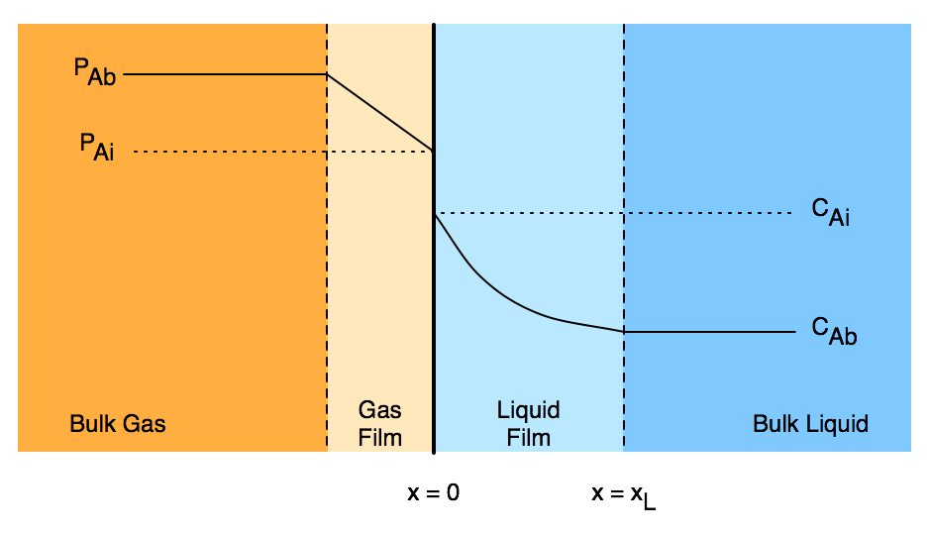
Two Film Model for Gas-Liquid Reactions
Thin films between the bulk fluid and the interface exist in each phase
In these films mass transport occurs only by diffusion
At the interface, x = 0, phase equilibrium is established
PAi = hA CAi (Henry’s law)
Hatta number, γ, represents rate of reaction relative to rate of diffusion
Liquid effectiveness factor, ηL, is ratio of actual rate to rate if there were no concentration gradients
Liquid enhancement factor, ζ, is ratio of actual gas absorption rate to gas absorption rate if no chemical reaction occurred
Definitions of γ, ηL and ζ depend upon geometry, form of rate expression and other assumptions
Expressions at right for geometry shown, reaction first order in A only, non-volatile liquid reactant B, and comparable rates of reaction and diffusion
Change if these conditions change
Often requires numerical solution

Slide 4
Questions?

Slide 5
Activity 39.1
Pure gas phase A and a liquid solution containing B at a feed concentration of 2.5 mol L⁻¹ react isothermally at 35 ºC in a steady state CSTR according to reaction (1). At that temperature, the rate coefficient in equation (2) is equal to 5.1 x 10⁸ cm³ mol⁻¹ min⁻¹. None of the solution components are volatile, and the reactor has been designed so that the liquid phase is perfectly mixed, the interfacial area is constant and equal to 3 cm² per cm³ of liquid, and the gas pressure is constant and equal to 5 atm. The liquid volume may be assumed to be constant and equal to 250 cm³. The Henry’s law constant for A is equal to 40 L atm mol⁻¹, its diffusion coefficient in the liquid is equal to 1.7 x 10⁻⁵ cm² s⁻¹, the liquid mass transfer coefficient for A is 6.7 x 10⁻² cm s⁻¹, and the diffusion coefficient of B in the liquid is 8 x 10⁻⁶ cm² s⁻¹. At what liquid flow rate will 99% of the B be converted? What fraction of that conversion will take place in the liquid film? What will the liquid phase concentration of A equal? You may assume a planar interface between the gas and the liquid.
A + B → Z (1)
(2)

Slide 6
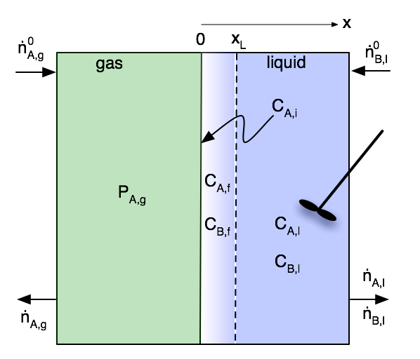
Problem Analysis
The liquid volume and the interfacial area are constant
The gas is pure A
There is no boundary layer because there can’t be a concentration gradient
The partial pressure at the interface is equal to the (known) bulk gas pressure
PA,i = PA,g
CA,i = PA,i/hA
There is a liquid film between the interface and the bulk liquid
Schematic is not to scale
The system is isothermal
Mole balances can be solved independently of energy balances
Approach
Write mole balances on the bulk liquid and on the liquid film
They will be coupled and will need to be solved simultaneously

Slide 7
Where We’ve Been & Where We’re Going
Part I - Chemical Reactions
Part II - Chemical Reaction Kinetics
Part III - Chemical Reaction Engineering
Part IV - Non-Ideal Reactions and Reactors
A. Alternatives to the Ideal Reactor Models
B. Coupled Chemical and Physical Kinetics
38. Heterogeneous Catalytic Reactions
39. Gas-Liquid Reactions
40. Gas-Solid Reactions

