Slide 1
A First Course on Kinetics and Reaction Engineering
Class 39

Slide 2
Where We’ve Been & Where We’re Going
Part I - Chemical Reactions
Part II - Chemical Reaction Kinetics
Part III - Chemical Reaction Engineering
Part IV - Non-Ideal Reactions and Reactors
A. Alternatives to the Ideal Reactor Models
B. Coupled Chemical and Physical Kinetics
38. Heterogeneous Catalytic Reactions
39. Gas-Liquid Reactions
40. Gas-Solid Reactions

Slide 3
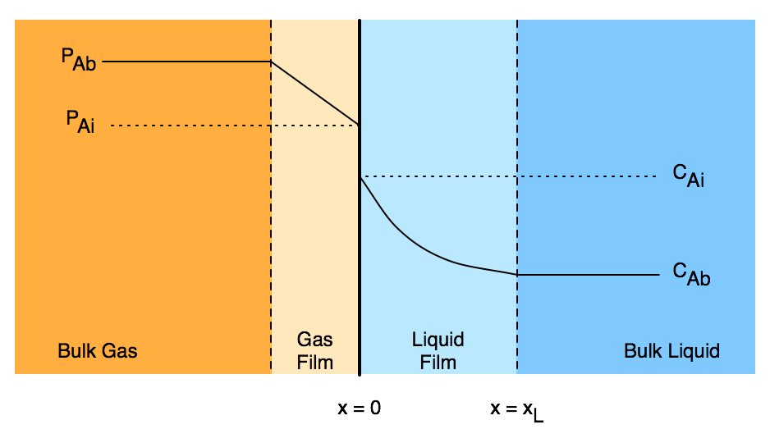
Two Film Model for Gas-Liquid Reactions
Thin films between the bulk fluid and the interface exist in each phase
In these films mass transport occurs only by diffusion
At the interface, x = 0, phase equilibrium is established
PAi = hA CAi (Henry’s law)
Hatta number, γ, represents rate of reaction relative to rate of diffusion
Liquid effectiveness factor, ηL, is ratio of actual rate to rate if there were no concentration gradients
Liquid enhancement factor, ζ, is ratio of actual gas absorption rate to gas absorption rate if no chemical reaction occurred
Definitions of γ, ηL and ζ depend upon geometry, form of rate expression and other assumptions
Expressions at right for geometry shown, reaction first order in A only, non-volatile liquid reactant B, and comparable rates of reaction and diffusion
Change if these conditions change
Often requires numerical solution

Slide 4
Questions?

Slide 5
Activity 39.1
Pure gas phase A and a liquid solution containing B at a feed concentration of 2.5 mol L⁻¹ react isothermally at 35 ºC in a steady state CSTR according to reaction (1). At that temperature, the rate coefficient in equation (2) is equal to 5.1 x 10⁸ cm³ mol⁻¹ min⁻¹. None of the solution components are volatile, and the reactor has been designed so that the liquid phase is perfectly mixed, the interfacial area is constant and equal to 3 cm² per cm³ of liquid, and the gas pressure is constant and equal to 5 atm. The liquid volume may be assumed to be constant and equal to 250 cm³. The Henry’s law constant for A is equal to 40 L atm mol⁻¹, its diffusion coefficient in the liquid is equal to 1.7 x 10⁻⁵ cm² s⁻¹, the liquid mass transfer coefficient for A is 6.7 x 10⁻² cm s⁻¹, and the diffusion coefficient of B in the liquid is 8 x 10⁻⁶ cm² s⁻¹. At what liquid flow rate will 99% of the B be converted? What fraction of that conversion will take place in the liquid film? What will the liquid phase concentration of A equal? You may assume a planar interface between the gas and the liquid.
A + B → Z (1)
(2)

Slide 6
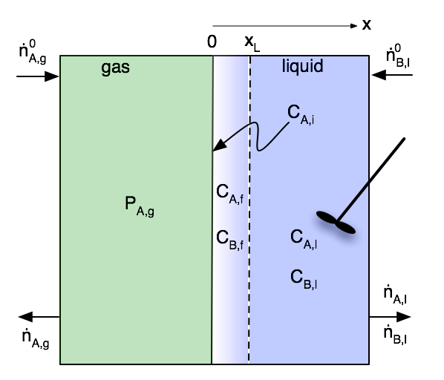
Problem Analysis
The liquid volume and the interfacial area are constant
The gas is pure A
There is no boundary layer because there can’t be a concentration gradient
The partial pressure at the interface is equal to the (known) bulk gas pressure
PA,i = PA,g
CA,i = PA,i/hA
There is a liquid film between the interface and the bulk liquid
Schematic is not to scale
The system is isothermal
Mole balances can be solved independently of energy balances
Approach
Write mole balances on the bulk liquid and on the liquid film
They will be coupled and will need to be solved simultaneously

Slide 7
Activity 39.1 Solution
Read through the problem statement
each time you encounter a quantity, assign it to the appropriate variable
show how to calculate any other necessary constants

Slide 8
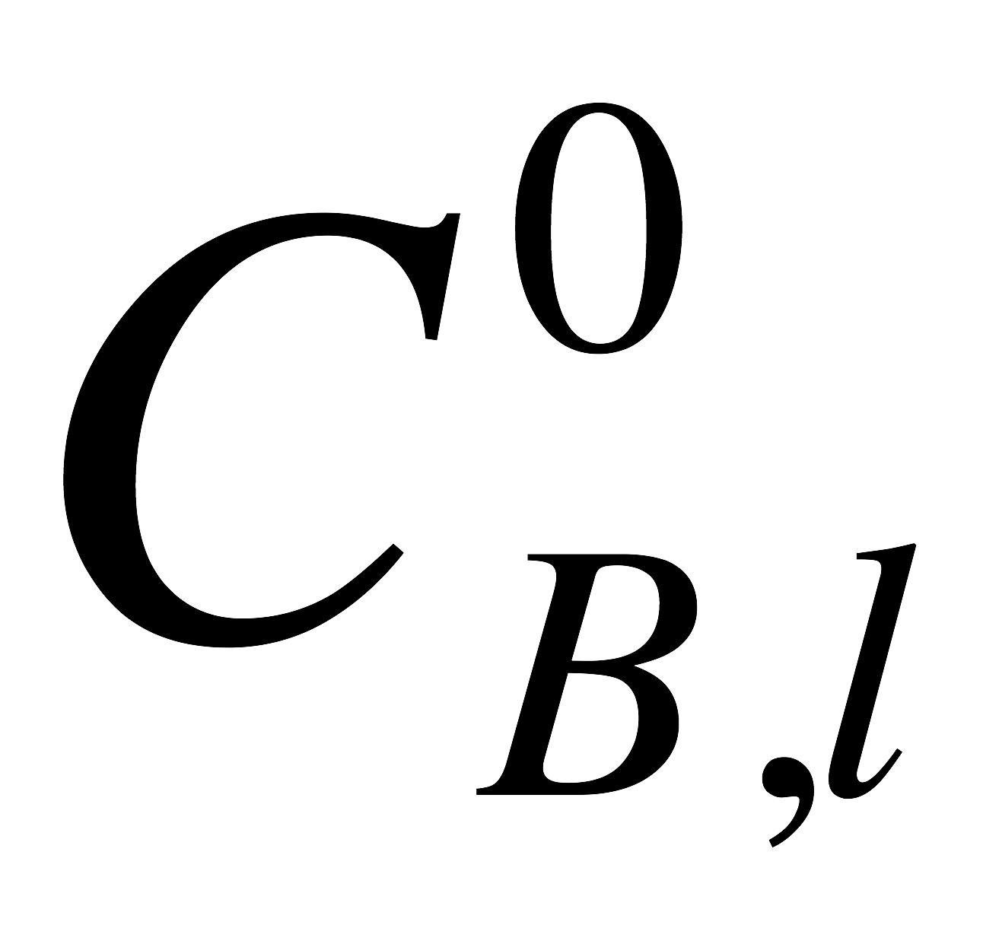
Activity 39.1 Solution
Read through the problem statement
each time you encounter a quantity, assign it to the appropriate variable
show how to calculate any other necessary constants
= 2.5 mol L⁻¹, T = 35 ºC, k = 5.1 x 10⁸ cm³ mol⁻¹ min⁻¹, SV = 3 cm⁻¹, P = 1.2 atm, Vl = 250 cm³, hA = 40 L atm mol⁻¹, DA = 1.7 x 10⁻⁵ cm² s⁻¹, DB = 8 x 10⁻⁶ cm² s⁻¹ and CB,l = 1.0 mol L⁻¹
CA,i = PA,i/hA, xL = DA/kL
Write bulk liquid phase mole balances for A and B
Let NA and NB represent the fluxes of A and B into the bulk liquid from the liquid film
Assume that the liquid film volume is negligible compared to the bulk liquid film volume (i. e. the bulk liquid volume is equal to Vl above)

Slide 9
Activity 39.1 Solution
Read through the problem statement
each time you encounter a quantity, assign it to the appropriate variable
show how to calculate any other necessary constants.
= 2.5 mol L⁻¹, T = 35 ºC, k = 5.1 x 10⁸ cm³ mol⁻¹ min⁻¹, SV = 3 cm⁻¹, P = 1.2 atm, Vl = 250 cm³, hA = 40 L atm mol⁻¹, DA = 1.7 x 10⁻⁵ cm² s⁻¹, DB = 8 x 10⁻⁶ cm² s⁻¹ and CB,l = 1.0 mol L⁻¹
CA,i = PA,i/hA
Write bulk liquid phase mole balances for A and B
Let NA and NB represent the fluxes of A and B into the bulk liquid from the liquid film
Assume that the liquid film volume is negligible compared to the bulk liquid film volume (i. e. the bulk liquid volume is equal to Vl above)
What type of equations are the liquid phase mole balances?

Slide 10
Activity 39.1 Solution
Read through the problem statement
each time you encounter a quantity, assign it to the appropriate variable
show how to calculate any other necessary constants.
= 2.5 mol L⁻¹, T = 35 ºC, k = 5.1 x 10⁸ cm³ mol⁻¹ min⁻¹, SV = 3 cm⁻¹, P = 1.2 atm, Vl = 250 cm³, hA = 40 L atm mol⁻¹, DA = 1.7 x 10⁻⁵ cm² s⁻¹, DB = 8 x 10⁻⁶ cm² s⁻¹ and CB,l = 1.0 mol L⁻¹
CA,i = PA,i/hA
Write bulk liquid phase mole balances for A and B
Let NA and NB represent the fluxes of A and B into the bulk liquid from the liquid film
Assume that the liquid film volume is negligible compared to the bulk liquid film volume (i. e. the bulk liquid volume is equal to Vl above)
What type of equations are the liquid phase mole balances?
Non-linear algebraic equations
There are two equations, so they can be solved to find the values of two unknown quantities
Identify the unknown quantities in the liquid phase mole balances

Slide 11
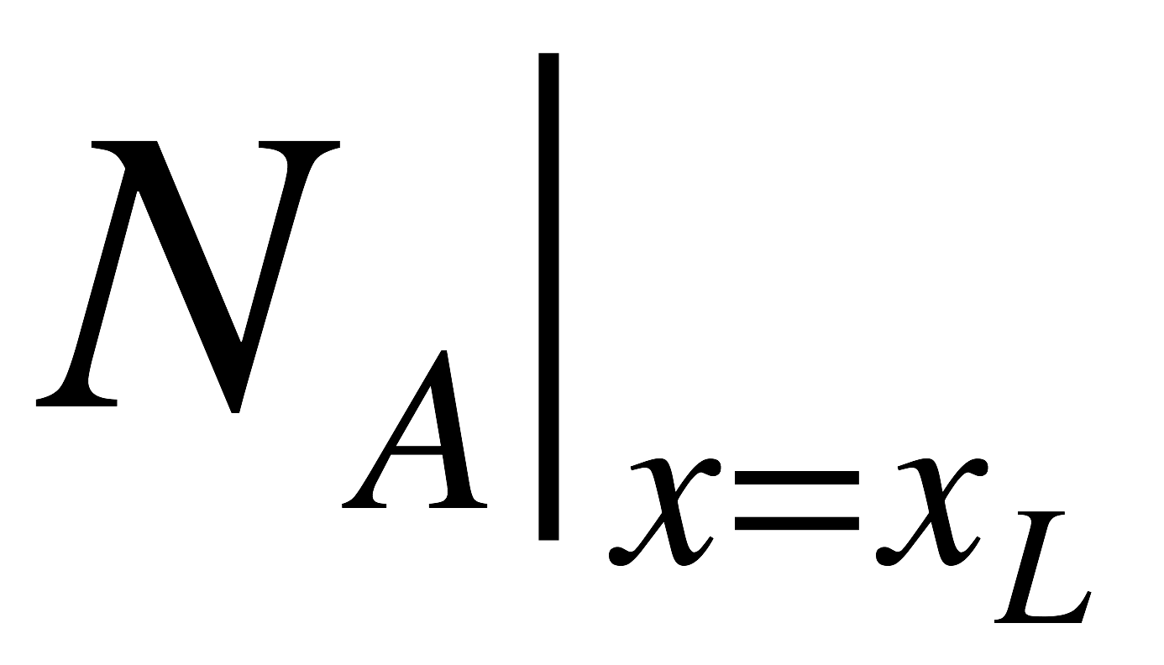
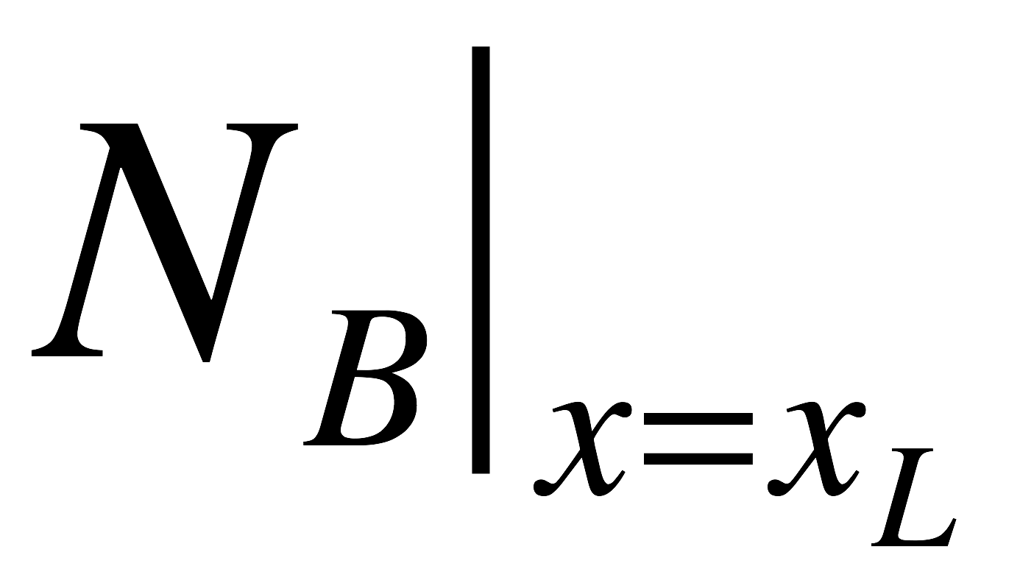
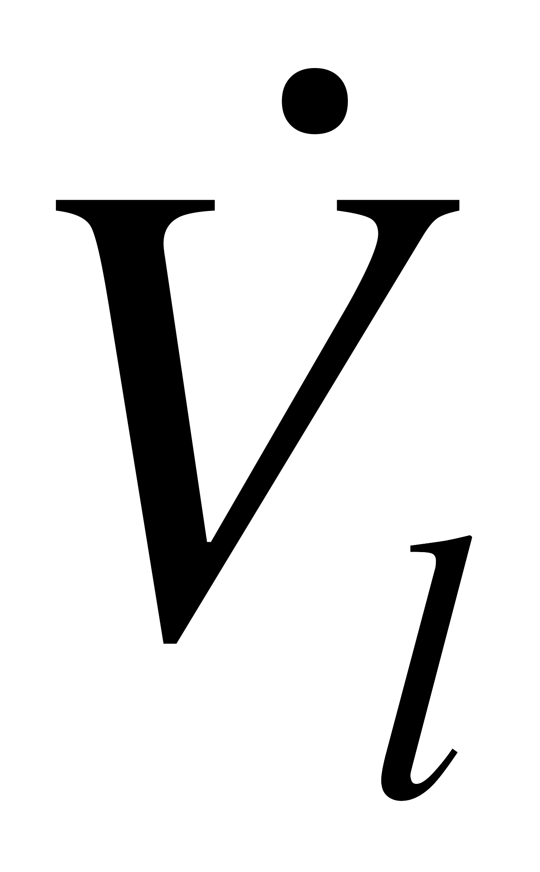
Activity 39.1 Solution
Read through the problem statement
each time you encounter a quantity, assign it to the appropriate variable
show how to calculate any other necessary constants.
= 2.5 mol L⁻¹, T = 35 ºC, k = 5.1 x 10⁸ cm³ mol⁻¹ min⁻¹, SV = 3 cm⁻¹, P = 1.2 atm, Vl = 250 cm³, hA = 40 L atm mol⁻¹, DA = 1.7 x 10⁻⁵ cm² s⁻¹, DB = 8 x 10⁻⁶ cm² s⁻¹ and CB,l = 1.0 mol L⁻¹
CA,i = PA,i/hA
Write bulk liquid phase mole balances for A and B
Let NA and NB represent the fluxes of A and B into the bulk liquid from the liquid film
Assume that the liquid film volume is negligible compared to the bulk liquid film volume (i. e. the bulk liquid volume is equal to Vl above)
What type of equations are the liquid phase mole balances?
Non-linear algebraic equations
There are two equations, so they can be solved to find the values of two unknown quantities
Identify the unknown quantities in the liquid phase mole balances
, , CA,l and

Slide 12
The two fluxes can be calculated by solving the mole balances on the liquid film
Write the mole balances on the liquid film, neglecting curvature of the interface, along with the boundary conditions needed to solve them

Slide 13
The two fluxes can be calculated by solving the mole balances on the liquid film
Write the mole balances on the liquid film, neglecting curvature of the interface, along with the boundary conditions needed to solve them
What unknown quantities are needed in order to solve the liquid film mole balances?

Slide 14
The two fluxes can be calculated by solving the mole balances on the liquid film
Write the mole balances on the liquid film, neglecting curvature of the interface, along with the boundary conditions needed to solve them
What unknown quantities are needed in order to solve the liquid film mole balances?
CA,l
How are the fluxes calculated once the liquid film mole balances have been solved?

Slide 15
The two fluxes can be calculated by solving the mole balances on the liquid film
Write the mole balances on the liquid film, neglecting curvature of the interface, along with the boundary conditions needed to solve them
What unknown quantities are needed in order to solve the liquid film mole balances?
CA,l
How are the fluxes calculated once the liquid film mole balances have been solved?
Solving the liquid film mole balances gives CA,f and CB,f as a function of x between x = 0 and x = xL
From the concentrations of CA,f and CB,f as a function of x, the derivatives of CA,f and CB,f can be calculated at any value of x
The derivatives of CA,f and CB,f at x = xL can be used to calculate the fluxes
Returning to the bulk liquid mole balances, we now have 2 equations, and two unknowns
CA,l and

Slide 16
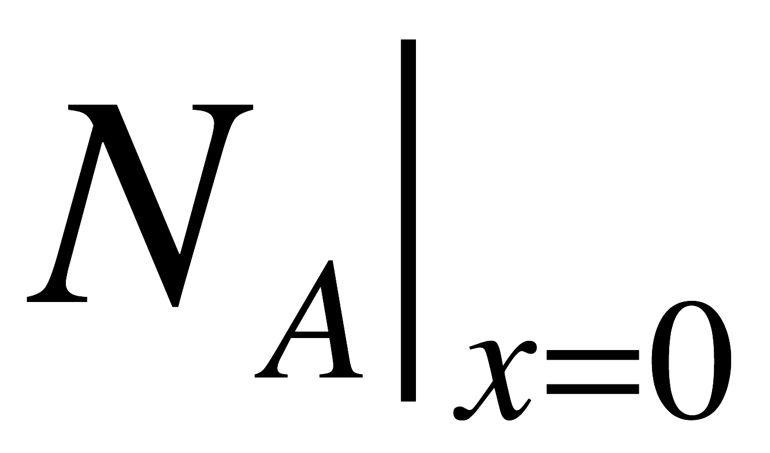
To implement this numerically
There are two bulk liquid mole balances
These mole balances can be solved numerically for xL and CA,l; to do so one must provide
guesses for xL and CA,l
code that is given xL and CA,l, and that evaluates the left hand sides of the bulk liquid mole balances (as written)
The code that is given xL and CA,l, and that evaluates the left hand sides of the bulk liquid mole balances
Must first solve the liquid film mole balances
Then must use the result to calculate the fluxes, , and
After which the left-hand sides of the bulk liquid mole balances (above) can be evaluated
Upon doing this, CA,l and can be calculated
To calculate the fraction of the conversion that occurs in the liquid film
The calculations can be implemented using the AFCoKaRE template files SolvNonDif.m and SolvBVDif.m
CA,l = 1.0 x 10⁻⁴ mol L⁻¹
= 163.5 cm³ min⁻¹
12.4% of the conversion occurs in the liquid film (which is only 0.076% of the liquid volume)

Slide 17
Where We’ve Been & Where We’re Going
Part I - Chemical Reactions
Part II - Chemical Reaction Kinetics
Part III - Chemical Reaction Engineering
Part IV - Non-Ideal Reactions and Reactors
A. Alternatives to the Ideal Reactor Models
B. Coupled Chemical and Physical Kinetics
38. Heterogeneous Catalytic Reactions
39. Gas-Liquid Reactions
40. Gas-Solid Reactions

