Slide 1
A First Course on Kinetics and Reaction Engineering
Class 38

Slide 2
Where We’re Going
Part I - Chemical Reactions
Part II - Chemical Reaction Kinetics
Part III - Chemical Reaction Engineering
Part IV - Non-Ideal Reactions and Reactors
A. Alternatives to the Ideal Reactor Models
B. Coupled Chemical and Physical Kinetics
38. Heterogeneous Catalytic Reactions
39. Gas-Liquid Reactions
40. Gas-Solid Reactions

Slide 3
Heterogeneous Catalysis with Gradients
Modify the Ideal Reactor Design Equations
External gradients only
kc found from correlations, e. g. jD vs NRe
At steady state, -rA = AVNA; combining with above gives CA,surf in terms of CA,bulk
Internal gradients only
Pseudo-continuum model for the catalyst phase
Mole balance on reactant within the catalyst phase
Solve for CA(r) and -NA at particle surface
The Thiele modulus, dimensionless ratio of reaction to diffusion rate, appears as a parameter in the expressions
At steady state, -rA = -AVNA
Define effectiveness factor, η, as actual rate divided by rate if there were no gradients
Actual rate is η times the rate evaluated at the bulk fluid composition
Correct the ideal reactor design equations by multiplying the rate by η
In most cases, η varies within the reactor; some form of averaging is required
Internal and external gradients
Two analyses above are combined
A global effectiveness factor, ηG, is defined as actual rate divided by rate if there were no internal and no external gradients

Slide 4
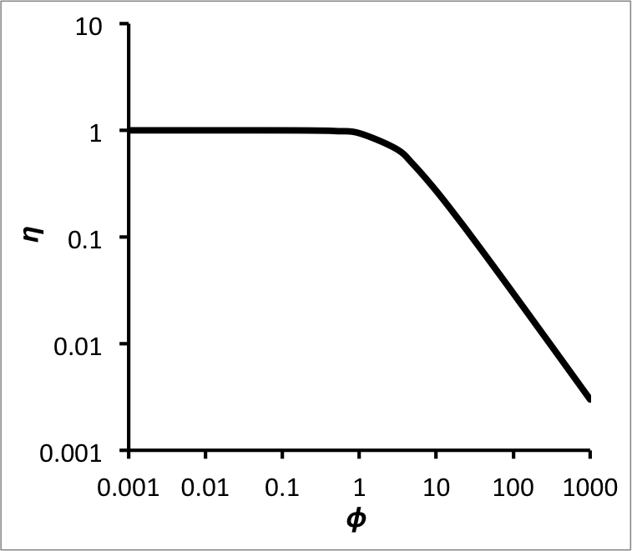
The definition of the Thiele modulus will change for different particle shapes and for different reaction orders
For isothermal catalyst particles the effectiveness factor will vary with the Thiele modulus in a manner like that shown at the right
Generally one prefers to operate at a Thiele modulus less than 1
For a first order reaction in a spherical particle
Alternative approach is to simultaneously solve fluid phase mole and energy balances and catalyst phase mole and energy balances
For a plug flow reactor, spherical particle, no total mole change upon reaction

Slide 5
Questions?

Slide 6
Activity 38.1
Consider the situation where a gas stream flows over a flat solid whereupon a 0.5 mm thick porous, catalytic layer has been applied. The system is isothermal (no temperature gradients anywhere) and within the porous layer the first order catalytic reaction A → B takes place with a rate coefficient equal to 1.5 x 10⁻³ min⁻¹. There are no concentration gradients in the gas phase, but they may exist within the porous layer. If the effective diffusion coefficient for the Fickian diffusion of A within the porous layer is 1.8 x 10⁻⁷ cm² s⁻¹ and the gas phase concentration is 1 mol L⁻¹, calculate the effectiveness factor using a pseudo-homogeneous model for the porous layer.
Let S represent the surface area of the flat solid and L the thickness of the porous overlayer. Define the z direction as perpendicular to the solid surface with z = 0 being the interface between the solid and the porous layer and z = L being the interface between the porous layer and the gas phase.
Write a mole balance on a differentially thick section of the porous layer (parallel to the solid surface) and take the limit as its thickness goes to zero to generate a mole balance for the catalyst phase

Slide 7
Where We’re Going
Part I - Chemical Reactions
Part II - Chemical Reaction Kinetics
Part III - Chemical Reaction Engineering
Part IV - Non-Ideal Reactions and Reactors
A. Alternatives to the Ideal Reactor Models
B. Coupled Chemical and Physical Kinetics
38. Heterogeneous Catalytic Reactions
39. Gas-Liquid Reactions
40. Gas-Solid Reactions

