Slide 1
A First Course on Kinetics and Reaction Engineering
Class 38

Slide 2
Where We’re Going
Part I - Chemical Reactions
Part II - Chemical Reaction Kinetics
Part III - Chemical Reaction Engineering
Part IV - Non-Ideal Reactions and Reactors
  A. Alternatives to the Ideal Reactor Models
  B. Coupled Chemical and Physical Kinetics
    38. Heterogeneous Catalytic Reactions
    39. Gas-Liquid Reactions
    40. Gas-Solid Reactions

Slide 3
Heterogeneous Catalysis with Gradients
Modify the Ideal Reactor Design Equations
  External gradients only
      kc found from correlations, e. g. jD vs NRe
    At steady state, -rA = AVNA; combining with above gives CA,surf in terms of CA,bulk
  Internal gradients only
    Pseudo-continuum model for the catalyst phase
    Mole balance on reactant within the catalyst phase
    Solve for CA(r) and -NA at particle surface
      The Thiele modulus, dimensionless ratio of reaction to diffusion rate, appears as a parameter in the expressions
    At steady state, -rA = -AVNA
    Define effectiveness factor, η, as actual rate divided by rate if there were no gradients
    Actual rate is η times the rate evaluated at the bulk fluid composition
      Correct the ideal reactor design equations by multiplying the rate by η
      In most cases, η varies within the reactor; some form of averaging is required
  Internal and external gradients
    Two analyses above are combined
    A global effectiveness factor, ηG, is defined as actual rate divided by rate if there were no internal and no external gradients

Slide 4
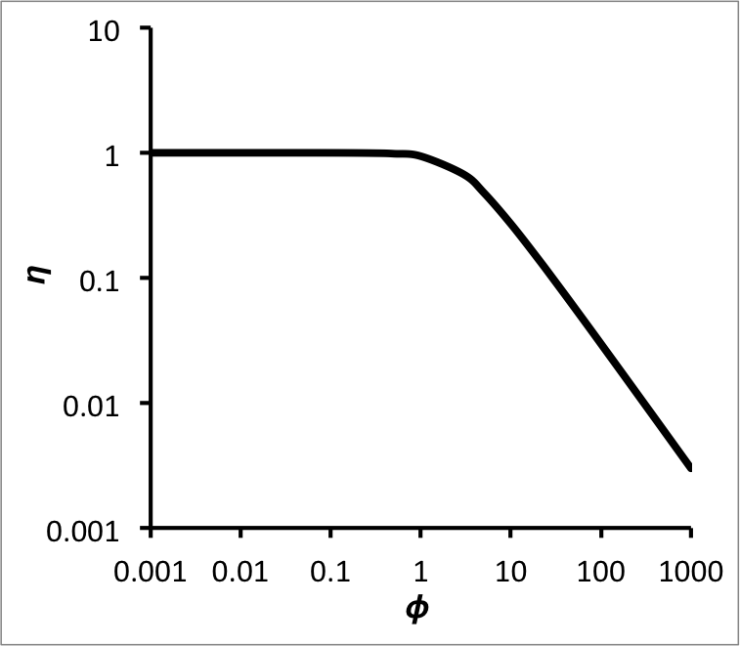
  The definition of the Thiele modulus will change
  for different particle shapes and for different
  reaction orders
    For isothermal catalyst particles the effectiveness
    factor will vary with the Thiele modulus in a
    manner like that shown at the right
    Generally one prefers to operate at a Thiele
    modulus less than 1
    For a first order reaction in a spherical particle
Alternative approach is to simultaneously solve fluid phase mole and energy balances and catalyst phase mole and energy balances
  For a plug flow reactor, spherical particle, no total mole change upon reaction

Slide 5
Questions?

Slide 6
Activity 38.1
Consider the situation where a gas stream flows over a flat solid whereupon a 0.5 mm thick porous, catalytic layer has been applied. The system is isothermal (no temperature gradients anywhere) and within the porous layer the first order catalytic reaction A → B takes place with a rate coefficient equal to 1.5 x 10⁻³ min⁻¹. There are no concentration gradients in the gas phase, but they may exist within the porous layer. If the effective diffusion coefficient for the Fickian diffusion of A within the porous layer is 1.8 x 10⁻⁷ cm² s⁻¹ and the gas phase concentration is 1 mol L⁻¹, calculate the effectiveness factor using a pseudo-homogeneous model for the porous layer.
Let S represent the surface area of the flat solid and L the thickness of the porous overlayer. Define the z direction as perpendicular to the solid surface with z = 0 being the interface between the solid and the porous layer and z = L being the interface between the porous layer and the gas phase.
Write a mole balance on a differentially thick section of the porous layer (parallel to the solid surface) and take the limit as its thickness goes to zero to generate a mole balance for the catalyst phase

Slide 7
Substitute the rate expression into the mole balance

Slide 8
Substitute the rate expression into the mole balance
The mole balance is a second order ordinary differential equation
  Write two boundary conditions that can be used to solve it

Slide 9
Substitute the rate expression into the mole balance
The mole balance is a second order ordinary differential equation
  Write two boundary conditions that can be used to solve it
  What type of ODE is the mole balance, initial value or boundary value?

Slide 10
Substitute the rate expression into the mole balance
The mole balance is a second order ordinary differential equation
  Write two boundary conditions that can be used to solve it
  What type of ODE is the mole balance, initial value or boundary value?
    It is a boundary value ODE
  Is there a singularity within the range of z where the ODE is valid?

Slide 11
Substitute the rate expression into the mole balance
The mole balance is a second order ordinary differential equation
  Write two boundary conditions that can be used to solve it
  What type of ODE is the mole balance, initial value or boundary value?
    It is a boundary value ODE
  Is there a singularity within the range of z where the ODE is valid? No

Slide 12
In order to use MATLAB to solve this second order, boundary value ODE, it must be converted into an equivalent set of 2 first order ODEs
  Define 2 new dependent variables for this purpose

Slide 13
In order to use MATLAB to solve this second order, boundary value ODE, it must be converted into an equivalent set of 2 first order ODEs
  Define 2 new dependent variables for this purpose
  Generate 2 equivalent first order ODEs in terms of these new dependent variables

Slide 14
In order to use MATLAB to solve this second order, boundary value ODE, it must be converted into an equivalent set of 2 first order ODEs
  Define 2 new dependent variables for this purpose
  Generate 2 equivalent first order ODEs in terms of these new dependent variables
  Re-write the boundary conditions in terms of these new dependent variables

Slide 15
In order to use MATLAB to solve this second order, boundary value ODE, it must be converted into an equivalent set of 2 first order ODEs
  Define 2 new dependent variables for this purpose
  Generate 2 equivalent first order ODEs in terms of these new dependent variables
  Re-write the boundary conditions in terms of these new dependent variables
  What else will you need to provide in order to solve these new equations numerically?

Slide 16
In order to use MATLAB to solve this second order, boundary value ODE, it must be converted into an equivalent set of 2 first order ODEs
  Define 2 new dependent variables for this purpose
  Generate 2 equivalent first order ODEs in terms of these new dependent variables
  Re-write the boundary conditions in terms of these new dependent variables
  What else will you need to provide in order to solve these new equations numerically?
    Code that is given z, y1 and y2 and returns the right hand sides of the two ODEs
      Nothing else needs to be calculated
    Guesses for the values of y1 and y2
  What new information would you obtain by solving these 2 ODEs numerically?

Slide 17
In order to use MATLAB to solve this second order, boundary value ODE, it must be converted into an equivalent set of 2 first order ODEs
  Define 2 new dependent variables for this purpose
  Generate 2 equivalent first order ODEs in terms of these new dependent variables
  Re-write the boundary conditions in terms of these new dependent variables
  What else will you need to provide in order to solve these new equations numerically?
    Code that is given z, y1 and y2 and returns the right hand sides of the two ODEs
      Nothing else needs to be calculated
    Guesses for the values of y1 and y2
  What new information would you obtain by solving these 2 ODEs numerically?
    Values of y1 (CA) and y2 (dCA/dz) at several values of z between 0 and L
Show how to use the results of solving the ODEs to calculate the effectiveness factor

Slide 18
  Flux of A from the gas phase into the surface of the porous layer
  Equivalent rate of consumption of A per unit catalyst volume
  Rate of consumption of A if there were no gradients in the porous solid
  Effectiveness factor is the ratio of these rates
Go back and solve the mole balance analytically

Slide 19
  Flux of A from the gas phase into the surface of the porous layer
  Equivalent rate of consumption of A per unit catalyst volume
  Rate of consumption of A if there were no gradients in the porous solid
  Effectiveness factor is the ratio of these rates
Go back and solve the mole balance analytically
Result (numerically or analytically): φ = 0.59 and η = 0.90

Slide 20
Where We’re Going
Part I - Chemical Reactions
Part II - Chemical Reaction Kinetics
Part III - Chemical Reaction Engineering
Part IV - Non-Ideal Reactions and Reactors
  A. Alternatives to the Ideal Reactor Models
  B. Coupled Chemical and Physical Kinetics
    38. Heterogeneous Catalytic Reactions
    39. Gas-Liquid Reactions
    40. Gas-Solid Reactions

