Slide 1
A First Course on Kinetics and Reaction Engineering
Class 36

Slide 2
Where We’re Going
Part I - Chemical Reactions
Part II - Chemical Reaction Kinetics
Part III - Chemical Reaction Engineering
Part IV - Non-Ideal Reactions and Reactors
A. Alternatives to the Ideal Reactor Models
33. Axial Dispersion Model
34. 2-D and 3-D Tubular Reactor Models
35. Zoned Reactor Models
36. Segregated Flow Models
37. Overview of Multi-Phase Reactors
B. Coupled Chemical and Physical Kinetics
38. Heterogeneous Catalytic Reactions
39. Gas-Liquid Reactions
40. Gas-Solid Reactions

Slide 3
Segregated Flow Model
Segregated flow models may be useful when the flow in a reactor does not conform to the assumptions of an ideal PFR or CSTR
They are most easily formulated if the reactor being modeled is isothermal
They require knowledge or measurement of the age function or the age distribution function
See Unit 11
Assumptions of the segregated flow models
The fluid flowing through the reactor is assumed to be composed of very small fluid elements
The mixing within the fluid elements is referred to as micro-mixing
Perfect micro-mixing is assumed
Mixing between fluid elements only occurs at certain times
Mixing between fluid elements is referred to as macro-mixing
Two different segregated flow models can be formulated depending upon when the macro-mixing occurs
The residence times of the fluid elements are not all the same; they are distributed according to the residence time distribution for the reactor being modeled
In the late-mixing segregated flow model, the average conversion is found by integrating over the age distribution function
Any intensive reactor property, other than the conversion, that depends on the fluid element residence time can be computed in an analogous manner

Slide 4
Variations on the Segregated Flow Model
Late-mixing segregated flow model
All of the fluid elements enter the reactor at the same time
The fluid elements exit the reactor at different times, according to the residence time distribution for the reactor being modeled
After the fluid elements have all exited the reactor, they macro-mix to yield a uniform composition
It is equivalent to a PFR with the product removed along its length so that the distribution of fluid element residence times matches the age distribution function
Early-mixing segregated flow model
All of the fluid elements leave the reactor at the same time
The fluid elements enter the reactor at different times according to the residence time distribution function for the reactor being modeled
As soon as a fluid element enters the reactor, it macro-mixes with the fluid elements that are already in the reactor
It is equivalent to a PFR with the feed distributed along its length so that the distribution of fluid element residence times matches the age distribution function

Slide 5
Questions?

Slide 6
Activity 36.1
In Example 36.1, the irreversible elementary reaction in equation (1) occurred isothermally in a non-ideal reactor. At the reactor temperature the reaction was second order in A, and the rate coefficient was equal to 0.5 L mol⁻¹ min⁻¹. The reactor volume was 25 L, and the feed consisted of 4 L min⁻¹ of a solution containing A at a concentration of 2.3 mol L⁻¹. The age function for this reactor had been measured and is given in equation (2). Suppose, instead that reaction (1) is first order with a rate coefficient of 0.7 min⁻¹. Use a late-mixing segregated flow model to compute the conversion in the reactor and compare it to the conversion predicted by the ideal CSTR model.
A → Z (1)
(2)

Slide 7
Read through the problem statement and each time you encounter a quantity, assign it to the appropriate variable symbol

Slide 8
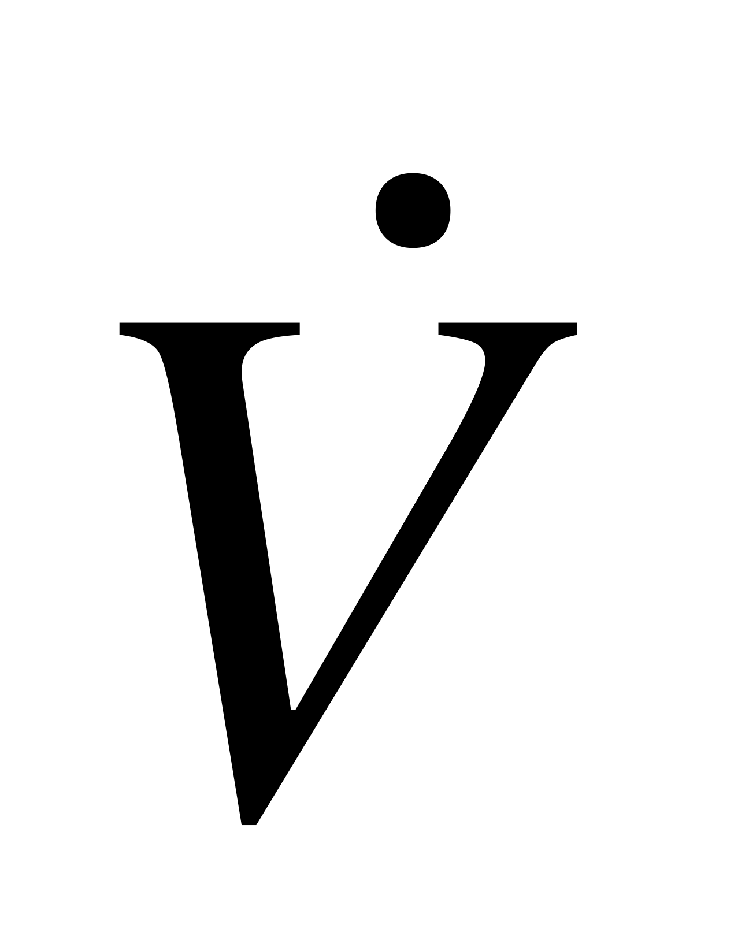
Read through the problem statement and each time you encounter a quantity, assign it to the appropriate variable symbol
k = 0.7 min⁻¹, V = 25 L, = 4 L min⁻¹ and CA,feed = 2.3 mol L⁻¹
Read through the problem statement and write down any relationships it provides

Slide 9
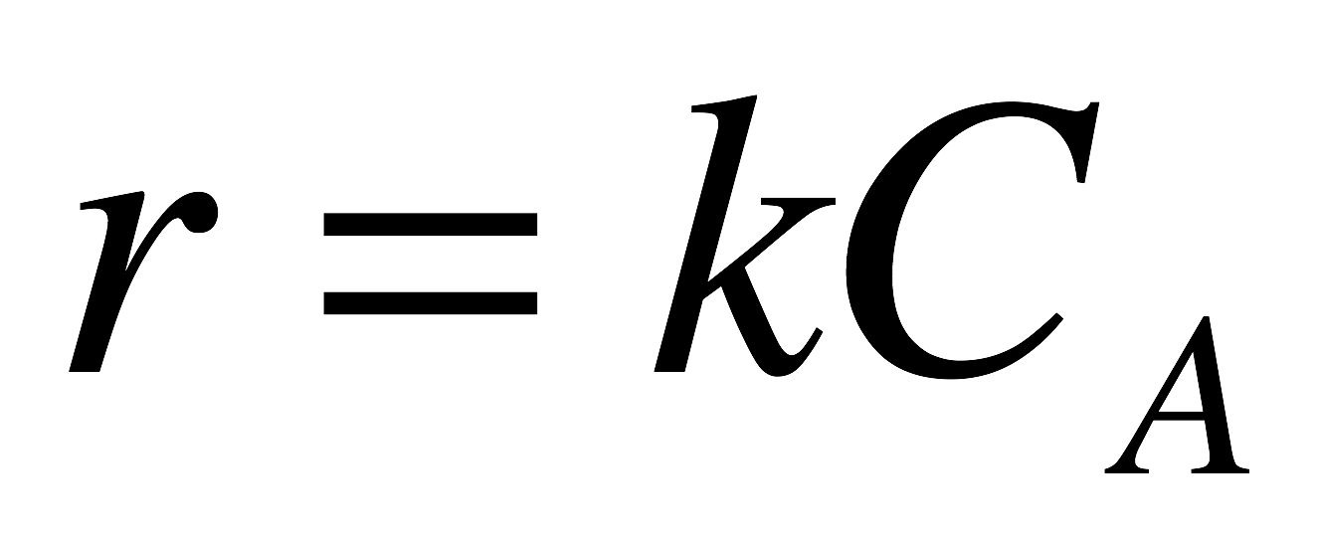
Read through the problem statement and each time you encounter a quantity, assign it to the appropriate variable symbol
k = 0.7 min⁻¹, V = 25 L, = 4 L min⁻¹ and CA,feed = 2.3 mol L⁻¹
Read through the problem statement and write down any relationships it provides
Write the equation you will use to model the reactor

Slide 10
Read through the problem statement and each time you encounter a quantity, assign it to the appropriate variable symbol
k = 0.7 min⁻¹, V = 25 L, = 4 L min⁻¹ and CA,feed = 2.3 mol L⁻¹
Read through the problem statement and write down any relationships it provides
Write the equation you will use to model the reactor
Decide how you will solve that equation and determine what you need in order to do so

Slide 11
Read through the problem statement and each time you encounter a quantity, assign it to the appropriate variable symbol
k = 0.7 min⁻¹, V = 25 L, = 4 L min⁻¹ and CA,feed = 2.3 mol L⁻¹
Read through the problem statement and write down any relationships it provides
Write the equation you will use to model the reactor
Decide how you will solve that equation and determine what you need in order to do so
The equation can be integrated numerically
An expression for the conversion in a fluid element as a function of its reaction time is needed
The age distribution function is needed
Generate an expression for the conversion in a fluid element as a function of its residence (reaction) time

Slide 12
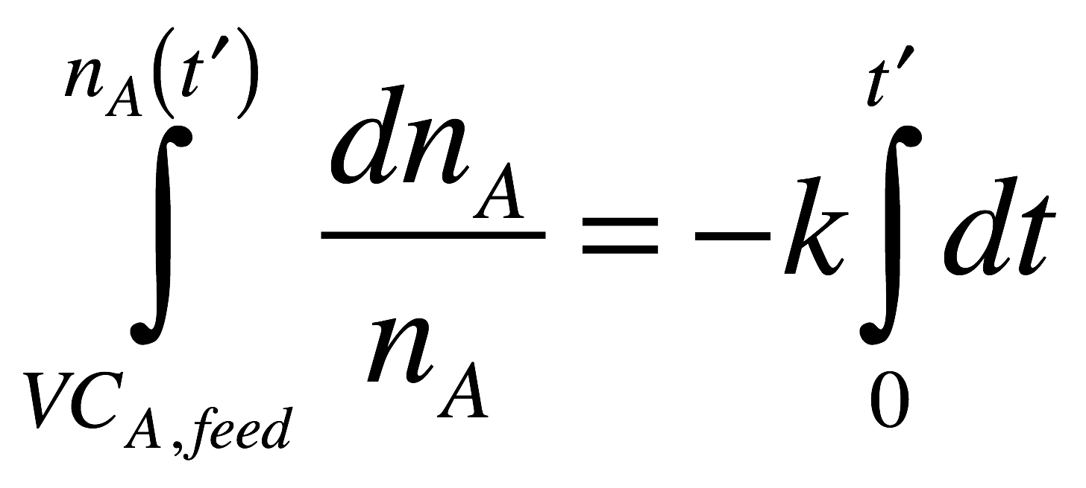
Read through the problem statement and each time you encounter a quantity, assign it to the appropriate variable symbol
k = 0.7 min⁻¹, V = 25 L, = 4 L min⁻¹ and CA,feed = 2.3 mol L⁻¹
Read through the problem statement and write down any relationships it provides
Write the equation you will use to model the reactor
Decide how you will solve that equation and determine what you need in order to do so
The equation can be integrated numerically
An expression for the conversion in a fluid element as a function of its reaction time is needed
The age distribution function is needed
Generate an expression for the conversion in a fluid element as a function of its residence (reaction) time

Slide 13
Generate the age distribution function

Slide 14
Generate the age distribution function
Check that the age distribution function is properly normalized

Slide 15
Generate the age distribution function
Check that the age distribution function is properly normalized
it is
Substitute in the late-mixing segregated flow model equation and solve for the conversion

Slide 16
Generate the age distribution function
Check that the age distribution function is properly normalized
it is
Substitute in the late-mixing segregated flow model equation and solve for the conversion
The conversion is 81.4%
Compare to the conversion predicted by the ideal CSTR model and comment

Slide 17
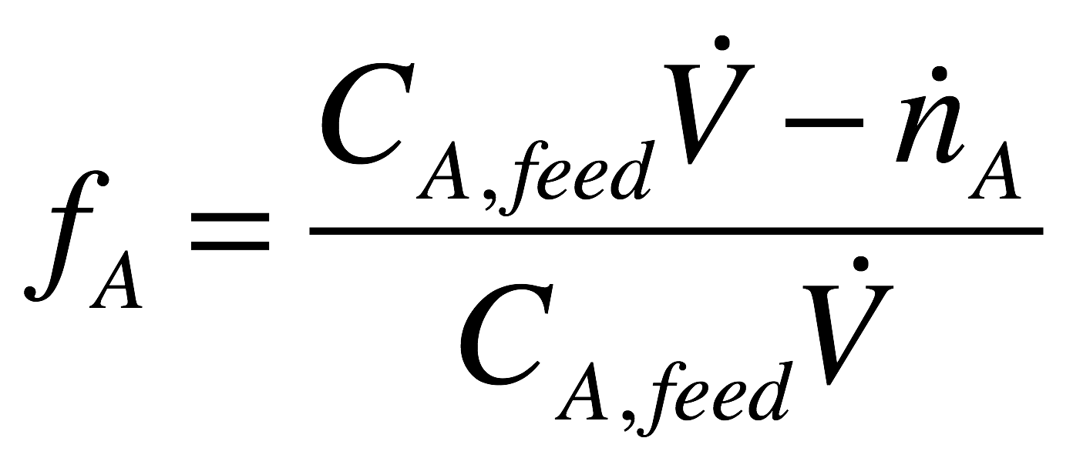
Generate the age distribution function
Check that the age distribution function is properly normalized
it is
Substitute in the late-mixing segregated flow model equation and solve for the conversion
The conversion is 81.4%
Compare to the conversion predicted by the ideal CSTR model and comment
The conversion is 81.4%
Using the segregated flow model with an ideal CSTR age function leads to a different conversion than using the ideal CSTR model except when the kinetics are first order

Slide 18
Where We’re Going
Part I - Chemical Reactions
Part II - Chemical Reaction Kinetics
Part III - Chemical Reaction Engineering
Part IV - Non-Ideal Reactions and Reactors
A. Alternatives to the Ideal Reactor Models
33. Axial Dispersion Model
34. 2-D and 3-D Tubular Reactor Models
35. Zoned Reactor Models
36. Segregated Flow Models
37. Overview of Multi-Phase Reactors
B. Coupled Chemical and Physical Kinetics
38. Heterogeneous Catalytic Reactions
39. Gas-Liquid Reactions
40. Gas-Solid Reactions

