Slide 1
A First Course on Kinetics and Reaction Engineering
Class 35

Slide 2
Where We’re Going
Part I - Chemical Reactions
Part II - Chemical Reaction Kinetics
Part III - Chemical Reaction Engineering
Part IV - Non-Ideal Reactions and Reactors
A. Alternatives to the Ideal Reactor Models
33. Axial Dispersion Model
34. 2-D and 3-D Tubular Reactor Models
35. Zoned Reactor Models
36. Segregated Flow Models
37. Overview of Multi-Phase Reactors
B. Coupled Chemical and Physical Kinetics
38. Heterogeneous Catalytic Reactions
39. Gas-Liquid Reactions
40. Gas-Solid Reactions

Slide 3
Zoned Reactor Models
Used when a reactor does not quite satisfy the assumptions of an ideal reactor model
Treat that reactor as if it contains different zones
Each zone behaves like an ideal reactor
The zones are connected to form a network
Adjustable parameters associated with the network can be used to adjust the performance of the zoned model to best match the performance of the actual reactor.
number of zones
relative sizes of zones
fractional splits of network streams
Useful types of zones
PFR zone
just like a PFR
CSTR zone
just like a CSTR
Well-mixed stagnant CSTR zone
like a CSTR except its inlet and outlet are connected at the same point in the zone network
it draws its feed and returns its product at the same point in the network

Slide 4
Questions?

Slide 5
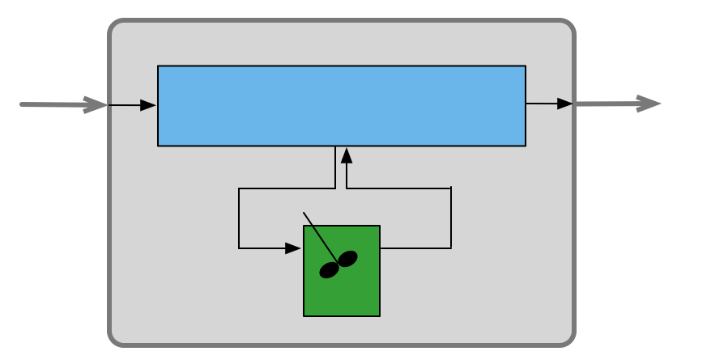
A tube that is 6 m long with an inside diameter of 7 cm is packed with pellets of solid catalyst. Reaction (1) takes place within this reactor at a constant temperature of 450 ºC and a constant pressure of 5 atm. The reactor will be fed 200 ft³ h⁻¹ of a gas containing 15% A, 15% B and 70% I (an inert gas). Reaction (1) is one-half order in A and first order in B. Suppose that the packing in the tube is not uniform, and as a consequence 5% of the bed has a lower density (leading to a rate coefficient of 59.5 mol h⁻¹ atm^{-0.5} m⁻³), while the remainder has a higher density (with a rate coefficient of 72 mol h⁻¹ atm^{-0.5} m⁻³). Using a zoned reactor model with a well-mixed stagnant zone 3 m into the reactor representing the lower density region and modeling the remainder of the reactor as a PFR, calculate the conversion if 15% of the flow in the PFR is diverted to the well-mixed stagnant zone.
2 A + B → 2 Z (1)

Slide 6
General Approach to Reactor Network Problems
Read through the problem statement and make a sketch of the network in which each flow stream, reactor, stream split and stream merge is labeled
Read through the problem statement a second time and (a) assign each quantity given in the problem statement to the appropriate variable symbol (b) choose a basis, if necessary and (c) determine what quantities the problem asks for and assign appropriate variable symbols to them
Write the design equations for each reactor in the network following the General Approach to Solving Quantitative Reaction Engineering Problems
If the design equations for any of the individual reactors can be solved at this point, do so and then repeat this step
Write mole and energy balances for each stream split and for each stream merge and solve any that can be solved
If the design equations for any of the individual reactors can be solved at this point, do so and then repeat this step
Solve all of the remaining equations simultaneously or, if possible, group them into sets that can be solved independently and solve each set
After the all of the equations have been solved, use the results to calculate any other requested quantities or plots

Slide 7
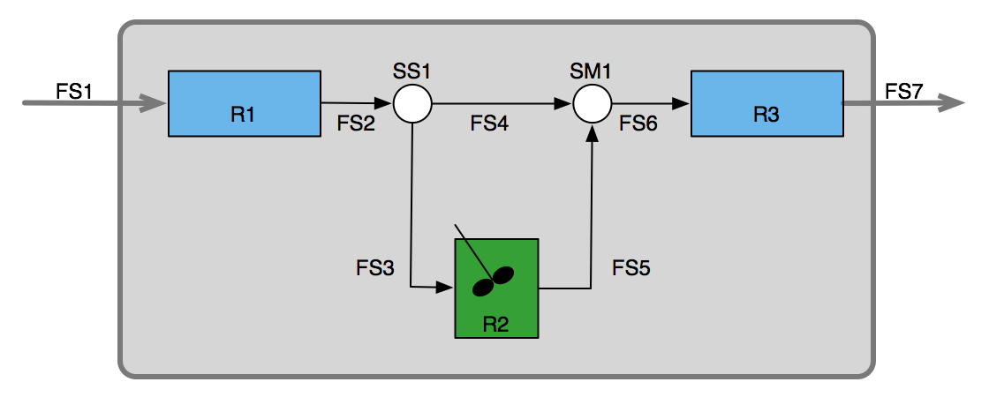
General Approach to Reactor Network Problems
Read through the problem statement and make a sketch of the network in which each flow stream, reactor, stream split and stream merge is labeled
Recall from today’s informational reading, these two diagrams are completely equivalent
I’ve labeled the flow streams, stream split and stream merge so everyone will have the same notation

Slide 8
Where We’re Going
Part I - Chemical Reactions
Part II - Chemical Reaction Kinetics
Part III - Chemical Reaction Engineering
Part IV - Non-Ideal Reactions and Reactors
A. Alternatives to the Ideal Reactor Models
33. Axial Dispersion Model
34. 2-D and 3-D Tubular Reactor Models
35. Zoned Reactor Models
36. Segregated Flow Models
37. Overview of Multi-Phase Reactors
B. Coupled Chemical and Physical Kinetics
38. Heterogeneous Catalytic Reactions
39. Gas-Liquid Reactions
40. Gas-Solid Reactions

