Slide 1
A First Course on Kinetics and Reaction Engineering
Class 34

Slide 2
Where We’re Going
Part I - Chemical Reactions
Part II - Chemical Reaction Kinetics
Part III - Chemical Reaction Engineering
Part IV - Non-Ideal Reactions and Reactors
  A. Alternatives to the Ideal Reactor Models
    33. Axial Dispersion Model
    34. 2-D and 3-D Tubular Reactor Models
    35. Zoned Reactor Models
    36. Segregated Flow Models
    37. Overview of Multi-Phase Reactors
  B. Coupled Chemical and Physical Kinetics

Slide 3
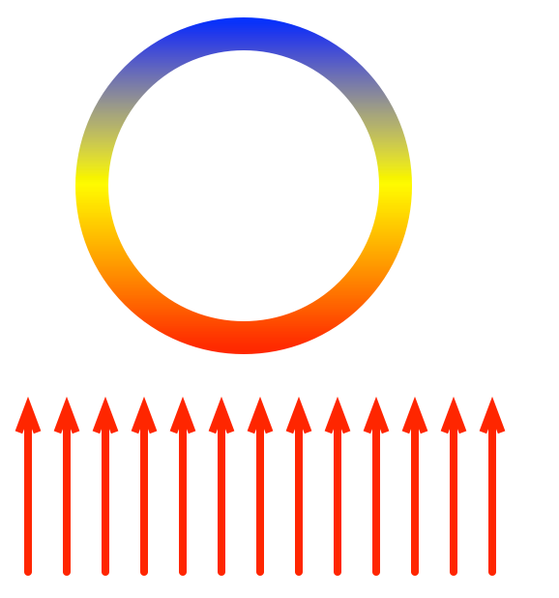
2-D and 3-D Tubular Reactor Models
The PFR model assumes
  No mixing in the axial direction
    Unit 33 showed how axial mixing could be added using the axial dispersion model
    Axial mixing is usually negligible except for very short reactors
  Perfect radial mixing
    Now consider the possibility that mixing is not perfect in the radial direction
    Often there can be temperature gradients in the radial, and sometimes azimuthal, direction
Radial gradients
  When heat is being added or removed through its walls, a radial temperature gradient can develop in a tubular reactor if heat transfer from the centerline to the wall is not sufficiently rapid
  If the temperature is not uniform in the radial direction, then the rate will vary in the radial direction, leading to concentration gradients
Azimuthal gradients
  When heat is added or removed unevenly around
  the circumference of the tube, azimuthal temperature
  gradients can occur
    For example, when a reactor tube passes through
    a furnace, the radiant heat flux is only on one half
    of the tube
  Temperature gradient can cause a concentration gradient

Slide 4
2-D Design Equations and Boundary Conditions
Steady state mole balance:
Steady state energy balance:
Steady state momentum balance:
Boundary conditions
  At z = 0
  At r = 0
  At r = R

Slide 5
Questions?

Slide 6
Activity 34.1*
The partial oxidation of o-xylene to phthalic anhydride, reaction (1), is an exothermic reaction (ΔH = -307 kcal mol⁻¹). A heterogeneous catalyst for this reaction might consist of 3 mm particles with a bulk density of 1.3 g cm⁻³, however this catalyst is sometimes mixed with an inert solid leading to an effective density of 0.87 g cm⁻³. In either case, the catalyst is not perfectly selective, so that some of the o-xylene and some of the phthalic anhydride undergo total combustion to produce carbon oxides, reactions (2) and (3); the heat reaction (2) is -1090 kcal mol⁻¹. (The heat of reaction (3) equals the difference between the heats of reactions (1) and (2).) Letting A represent o-xylene, B represent phthalic anhydride and O represent oxygen, the rates for reactions (1) through (3) may be modeled using equations (4) through (6).
C8H10 + 3 O2 → C8H4O3 + 3 H2O (1)
C8H10 COx (2)
C8H4O3 COx (3)
(4)
(5)
(6)
* This activity is based upon a case study from H. Rase, “Chemical Reactor Design for Process Plants,” Vol. II. Wiley, New York, 1977.

Slide 7
Consider a tubular reactor with an inside diameter of 1 inch and a length of 3 m that is cooled by perfectly mixed molten salts circulating outside the tube at a temperature equal to the feed temperature, 370 ºC. The mass velocity of the feed is 4684 kg m⁻² h⁻¹; it consists of 0.93 mol% o-xylene in air which leads to a feed molecular weight of 29.48, a feed mole fraction of O2 of 0.208 and a mass specific heat capacity of 0.25 kcal kg⁻¹ K⁻¹, which may be assumed to be constant. Set up 2-D mole balances for o-xylene, phthalic anhydride and carbon oxides and a 2-D heat balance for this reactor assuming the superficial velocity to be constant, the wall heat transfer coefficient to equal 134 kcal m⁻² h⁻¹ K⁻¹, the effective radial conductivity to equal 0.67 kcal m⁻¹ h⁻¹ K⁻¹ and the radial Peclet number for mass transfer (based on the superficial velocity and the catalyst particle diameter) to be constant and equal to 10. The first 75 cm of the tube is packed with the diluted catalyst, while the remainder contains the undiluted catalyst.
Rase states that solution of the 2-D model equations reveals maximum temperatures of 400 ºC (about two-thirds of the way into the part of the bed containing the diluted catalyst) and 410 ºC (about 25 cm after entering the part of the bed containing undiluted catalyst). Model this reactor as an ideal PFR with an overall heat transfer coefficient of 82.7 kcal m⁻² h⁻¹ K⁻¹ (which is equivalent to the wall heat transfer coefficient and effective radial conductivity of the 2-D model) and compare the temperature maxima predicted by the PFR model to those reported for the 2-D model.

Slide 8
Solution
Read through the problem statement. Each time you encounter a quantity, write it down and equate it to the appropriate variable. When you have completed doing so, if there are any additional constant quantities that you know will be needed and that can be calculated from the values you found, write the equations needed for doing so.

Slide 9
Use the 2-D tubular reactor design equations found in Unit 34 or on the AFCoKaRE Exam Handout to generate an energy balance and mole balances on o-xylene, phthalic anhydride and carbon oxides.

Slide 10
Write the boundary conditions needed to solve the 2-D tubular reactor design equations and show how to calculate any new quantities they contain.

Slide 11
Using the PFR design equations from Unit 17 or the AFCoKaRE Exam Handout, generate the design equations needed to model this reactor as a PFR. Identify the specific set of equations that needs to be solved and within those equations identify the independent and dependent variables, if appropriate, and the unknown quantities to be found by solving the equations.

Slide 12
Assuming that the PFR design equations will be solved numerically, specify the information that must be provided and show how to calculate any unknown values.

Slide 13
Identify what variables will become known upon solving the design equations and show how those variables can be used to answer the questions that were asked in the problem.

Slide 14
Where We’re Going
Part I - Chemical Reactions
Part II - Chemical Reaction Kinetics
Part III - Chemical Reaction Engineering
Part IV - Non-Ideal Reactions and Reactors
  A. Alternatives to the Ideal Reactor Models
    33. Axial Dispersion Model
    34. 2-D and 3-D Tubular Reactor Models
    35. Zoned Reactor Models
    36. Segregated Flow Models
    37. Overview of Multi-Phase Reactors
  B. Coupled Chemical and Physical Kinetics

