Slide 1
A First Course on Kinetics and Reaction Engineering
Class 34

Slide 2
Where We’re Going
Part I - Chemical Reactions
Part II - Chemical Reaction Kinetics
Part III - Chemical Reaction Engineering
Part IV - Non-Ideal Reactions and Reactors
  A. Alternatives to the Ideal Reactor Models
    33. Axial Dispersion Model
    34. 2-D and 3-D Tubular Reactor Models
    35. Zoned Reactor Models
    36. Segregated Flow Models
    37. Overview of Multi-Phase Reactors
  B. Coupled Chemical and Physical Kinetics

Slide 3
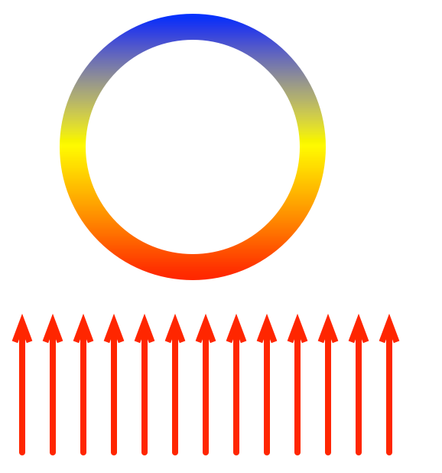
2-D and 3-D Tubular Reactor Models
The PFR model assumes
  No mixing in the axial direction
    Unit 33 showed how axial mixing could be added using the axial dispersion model
    Axial mixing is usually negligible except for very short reactors
  Perfect radial mixing
    Now consider the possibility that mixing is not perfect in the radial direction
    Often there can be temperature gradients in the radial, and sometimes azimuthal, direction
Radial gradients
  When heat is being added or removed through its walls, a radial temperature gradient can develop in a tubular reactor if heat transfer from the centerline to the wall is not sufficiently rapid
  If the temperature is not uniform in the radial direction, then the rate will vary in the radial direction, leading to concentration gradients
Azimuthal gradients
  When heat is added or removed unevenly around
  the circumference of the tube, azimuthal temperature
  gradients can occur
    For example, when a reactor tube passes through
    a furnace, the radiant heat flux is only on one half
    of the tube
  Temperature gradient can cause a concentration gradient

Slide 4
2-D Design Equations and Boundary Conditions
Steady state mole balance:
Steady state energy balance:
Steady state momentum balance:
Boundary conditions
  At z = 0
  At r = 0
  At r = R

Slide 5
Questions?

Slide 6
Activity 34.1*
The partial oxidation of o-xylene to phthalic anhydride, reaction (1), is an exothermic reaction (ΔH = -307 kcal mol⁻¹). A heterogeneous catalyst for this reaction might consist of 3 mm particles with a bulk density of 1.3 g cm⁻³, however this catalyst is sometimes mixed with an inert solid leading to an effective density of 0.87 g cm⁻³. In either case, the catalyst is not perfectly selective, so that some of the o-xylene and some of the phthalic anhydride undergo total combustion to produce carbon oxides, reactions (2) and (3); the heat reaction (2) is -1090 kcal mol⁻¹. (The heat of reaction (3) equals the difference between the heats of reactions (1) and (2).) Letting A represent o-xylene, B represent phthalic anhydride and O represent oxygen, the rates for reactions (1) through (3) may be modeled using equations (4) through (6).
C8H10 + 3 O2 → C8H4O3 + 3 H2O (1)
C8H10 COx (2)
C8H4O3 COx (3)
(4)
(5)
(6)
* This activity is based upon a case study from H. Rase, “Chemical Reactor Design for Process Plants,” Vol. II. Wiley, New York, 1977.

Slide 7
Consider a tubular reactor with an inside diameter of 1 inch and a length of 3 m that is cooled by perfectly mixed molten salts circulating outside the tube at a temperature equal to the feed temperature, 370 ºC. The mass velocity of the feed is 4684 kg m⁻² h⁻¹; it consists of 0.93 mol% o-xylene in air which leads to a feed molecular weight of 29.48, a feed mole fraction of O2 of 0.208 and a mass specific heat capacity of 0.25 kcal kg⁻¹ K⁻¹, which may be assumed to be constant. Set up 2-D mole balances for o-xylene, phthalic anhydride and carbon oxides and a 2-D heat balance for this reactor assuming the superficial velocity to be constant, the wall heat transfer coefficient to equal 134 kcal m⁻² h⁻¹ K⁻¹, the effective radial conductivity to equal 0.67 kcal m⁻¹ h⁻¹ K⁻¹ and the radial Peclet number for mass transfer (based on the superficial velocity and the catalyst particle diameter) to be constant and equal to 10. The first 75 cm of the tube is packed with the diluted catalyst, while the remainder contains the undiluted catalyst. The pressure is constant and equal to 1 atm.
Rase states that solution of the 2-D model equations reveals maximum temperatures of 400 ºC (about two-thirds of the way into the part of the bed containing the diluted catalyst) and 410 ºC (about 25 cm after entering the part of the bed containing undiluted catalyst). Model this reactor as an ideal PFR with an overall heat transfer coefficient of 82.7 kcal m⁻² h⁻¹ K⁻¹ (which is equivalent to the wall heat transfer coefficient and effective radial conductivity of the 2-D model) and compare the temperature maxima predicted by the PFR model to those reported for the 2-D model.

Slide 8
Solution
Read through the problem statement. Each time you encounter a quantity, write it down and equate it to the appropriate variable. When you have completed doing so, if there are any additional constant quantities that you know will be needed and that can be calculated from the values you found, write the equations needed for doing so.

Slide 9
Solution
Read through the problem statement. Each time you encounter a quantity, write it down and equate it to the appropriate variable. When you have completed doing so, if there are any additional constant quantities that you know will be needed and that can be calculated from the values you found, write the equations needed for doing so.
  ΔH1 = -307 kcal mol⁻¹, ΔH3 = -1090 kcal mol⁻¹, dp = 3 mm, P = 1 atm, ρcat = 1.3 g cm⁻³, ρdilcat =
  0.87 g cm⁻³, k0,1 = 4.122 x 10¹¹ mol kg⁻¹ h⁻¹, E1 = 27 kcal mol⁻¹, k0,2 = 1.15 x 10¹² mol kg⁻¹ h⁻¹,
  E2 = 31 kcal mol⁻¹, k0,3 = 1.73 x 10¹¹ mol kg⁻¹ h⁻¹, E3 = 28.6 kcal mol⁻¹, D = 1 in, L = 3 m, Tfeed = 370 ºC, Tw = 370 ºC, G = 4684 kg m⁻² h⁻¹, yA,feed = 0.0093, Mfeed = 29.48 g mol⁻¹, yO,feed = 0.208, α = 134 kcal m⁻² h⁻¹ K⁻¹, λer = 0.67 kcal m⁻¹ h⁻¹ K⁻¹, Per = 10, UPFR = 82.7 kcal m⁻² h⁻¹ K⁻¹
  and = 0.25 kcal kg⁻¹
  ΔH2 = ΔH3 - ΔH1, A = πD²/4, ṁfeed = A⋅G, ṅfeed = ṁfeed/Mfeed, = ṅfeedRT/P, us = / A,
  Der = usdp/Per, ρfluid = G/us, CA,feed = yA,feedṅfeed / , CO,feed = yO,feedṅfeed / , CB,feed = 0 and
  R = D/2
Use the 2-D tubular reactor design equations found in Unit 34 or on the AFCoKaRE Exam Handout to generate an energy balance and mole balances on o-xylene, phthalic anhydride and carbon oxides. (Assume the stoichiometric coefficient of O2 to equal -8.5 in reaction (2) and -5.5 in reaction (3).)

Slide 10
Use the 2-D tubular reactor design equations found in Unit 34 or on the AFCoKaRE Exam Handout to generate an energy balance and mole balances on o-xylene, phthalic anhydride and carbon oxides. (Assume the stoichiometric coefficient of O2 to equal -8.5 in reaction (2) and -5.5 in reaction (3).)
For calculation of the rates

Slide 11
Write the boundary conditions needed to solve the 2-D tubular reactor design equations and show how to calculate any new quantities they contain.

Slide 12
Write the boundary conditions needed to solve the 2-D tubular reactor design equations and show how to calculate any new quantities they contain.
Using the PFR design equations from Unit 17 or the AFCoKaRE Exam Handout, generate the design equations needed to model this reactor as a PFR. Identify the specific set of equations that needs to be solved and within those equations identify the independent and dependent variables, if appropriate, and the unknown quantities to be found by solving the equations.

Slide 13
Using the PFR design equations from Unit 17 or the AFCoKaRE Exam Handout, generate the design equations needed to model this reactor as a PFR. Identify the specific set of equations that needs to be solved and within those equations identify the independent and dependent variables, if appropriate, and the unknown quantities to be found by solving the equations.
Dependent vars: ṅA, ṅB, ṅO and T; independent var: z
Solve for dependent vars at z = L

Slide 14
Assuming that the PFR design equations will be solved numerically, specify the information that must be provided and show how to calculate any unknown values.

Slide 15
Assuming that the PFR design equations will be solved numerically, specify the information that must be provided and show how to calculate any unknown values.
  The 3 rates must be calculated using the expressions given in the problem statement; all other quantities (other than dependent and independent variables) are known constants
    Need PA, PB and PO, given values for dependent and independent variables
    Since the fluid density is assumed constant:

Slide 16
Identify what variables will become known upon solving the design equations and show how those variables can be used to answer the questions that were asked in the problem.

Slide 17
Identify what variables will become known upon solving the design equations and show how those variables can be used to answer the questions that were asked in the problem.
  Solving the design equations allows calculation of the dependent variables (which include T) at any value of z.
  Do this for many values between z = 0 and z = 0.75 cm and find the maximum temperature in the zone where the catalyst is diluted
  Then repeat for values between z = 0.75 cm and z = L and find the maximum temperature in the zone where the catalyst is not diluted
Note, for both models, the design equations must first be solved for 0 < z < 75 cm using the density of the diluted catalyst
  The resulting values of the dependent variables at z = 75 cm become the initial conditions (PFR) or boundary conditions (2-D tubular reactor) for the second part of the reactor (75 cm < z < L) where the equations are solved using the density of the undiluted catalyst
Results
  The PFR model under-predicts temperature maxima by ca. 3 and 7 K
    This can be critical in some cases

Slide 18
Where We’re Going
Part I - Chemical Reactions
Part II - Chemical Reaction Kinetics
Part III - Chemical Reaction Engineering
Part IV - Non-Ideal Reactions and Reactors
  A. Alternatives to the Ideal Reactor Models
    33. Axial Dispersion Model
    34. 2-D and 3-D Tubular Reactor Models
    35. Zoned Reactor Models
    36. Segregated Flow Models
    37. Overview of Multi-Phase Reactors
  B. Coupled Chemical and Physical Kinetics

