Slide 1
A First Course on Kinetics and Reaction Engineering
Class 33

Slide 2
Where We’re Going
Part I - Chemical Reactions
Part II - Chemical Reaction Kinetics
Part III - Chemical Reaction Engineering
Part IV - Non-Ideal Reactions and Reactors
  A. Alternatives to the Ideal Reactor Models
    33. Axial Dispersion Model
    34. 2-D and 3-D Tubular Reactor Models
    35. Zoned Reactor Models
    36. Segregated Flow Models
    37. Overview of Multi-Phase Reactors
  B. Coupled Chemical and Physical Kinetics
    38. Heterogeneous Catalytic Reactions
    39. Gas-Liquid Reactions
    40. Gas-Solid Reactions

Slide 3
Axial Dispersion Model
The axial dispersion model is a modified form of the plug flow reactor model
  it adds a diffusion-like term that accounts for mixing in the axial direction
  the quantity Dax is not a diffusion coefficient
    it is called the dispersion coefficient
    it has one value that is used for all species being modeled
    it can be found
      from correlations of the axial Peclet number (or its inverse, the dispersion number) as a function of the Reynolds number
      experimentally, for example using stimulus and response measurements involving a tracer (as is done when measuring the age function
In commercial scale packed bed reactors, including axial dispersion doesn’t affect conversion as long as the reactor length is greater than ca. 50 catalyst particle diameters
  The axial dispersion model can still be used to empirically model a reactor
  When Dax = 0, it is a PFR; as Dax becomes very large, it approaches a CSTR

Slide 4
Boundary Conditions and Numerical Solution
The axial dispersion model is a second order differential equation
  There are several ways the boundary conditions could be formulated
  Danckwerts boundary conditions are very common
First Danckwerts boundary condition recognizes that as soon as the feed enters the reactor, it will be diluted by axial mixing
  Much like what happens to feed entering a CSTR
  It requires that the flow of A upstream of the reactor entrance (where no mixing has occurred) must be equal to the net flow of A (due to convection and mixing) at the inlet to the reactor
Second Danckwerts boundary condition simply requires that the concentration stops changing at the point where the flow leaves the reactor.
The axial dispersion model involves mixed boundary value ordinary differential equations
  Numerical solution requires different methods than are used for initial value problems
  Discussed in Supplemental Unit S6

Slide 5
Questions?

Slide 6
Activity 33.1
Suppose liquid phase reaction (1) is second order in the concentration of A. The reaction proceeds isothermally with a rate coefficient equal to 0.05 dm³ mol⁻¹ min⁻¹. The liquid density is constant. The feed to the process is taken from a tank containing A at a concentration of 1 M and enters the reactor with a superficial velocity of 6.0 dm min⁻¹. Plot the concentration of A versus axial position within a tubular reactor for axial dispersion coefficients of 0.1, 1, 10, 100 and 1000 dm² min⁻¹.
A → B (1)
Read through the problem statement. Each time you encounter a quantity, write it down and equate it to the appropriate variable. When you have completed doing so, if there are any additional constant quantities that you know will be needed and that can be calculated from the values you found, write the equations needed for doing so.

Slide 7
Suppose liquid phase reaction (1) is second order in the concentration of A. The reaction proceeds isothermally with a rate coefficient equal to 0.05 dm³ mol⁻¹ min⁻¹. The liquid density is constant. The feed to the process is taken from a tank containing A at a concentration of 1 M and enters the reactor with a superficial velocity of 6.0 dm min⁻¹. Plot the concentration of A versus axial position within a tubular reactor for axial dispersion coefficients of 0.1, 1, 10, 100 and 1000 dm² min⁻¹.
A → B (1)
Read through the problem statement. Each time you encounter a quantity, write it down and equate it to the appropriate variable. When you have completed doing so, if there are any additional constant quantities that you know will be needed and that can be calculated from the values you found, write the equations needed for doing so.
k = 0.05 dm³ mol⁻¹ min⁻¹
CA,feed = 1 mol L⁻¹
us = 6.0 dm min⁻¹
Dax = 0.1, 1, 10, 100 or 1000 dm² min⁻¹

Slide 8
Suppose liquid phase reaction (1) is second order in the concentration of A. The reaction proceeds isothermally with a rate coefficient equal to 0.05 dm³ mol⁻¹ min⁻¹. The liquid density is constant. The feed to the process is taken from a tank containing A at a concentration of 1 M and enters the reactor with a superficial velocity of 6.0 dm min⁻¹. Plot the concentration of A versus axial position within a tubular reactor for axial dispersion coefficients of 0.1, 1, 10, 100 and 1000 dm² min⁻¹.
A → B (1)
Generate the mole balance design equations needed to model the axially-dispersed tubular reactor by simplification of the general design equations found in Unit 33 or on the AFCoKaRE Exam Handout.

Slide 9
Suppose liquid phase reaction (1) is second order in the concentration of A. The reaction proceeds isothermally with a rate coefficient equal to 0.05 dm³ mol⁻¹ min⁻¹. The liquid density is constant. The feed to the process is taken from a tank containing A at a concentration of 1 M and enters the reactor with a superficial velocity of 6.0 dm min⁻¹. Plot the concentration of A versus axial position within a tubular reactor for axial dispersion coefficients of 0.1, 1, 10, 100 and 1000 dm² min⁻¹.
A → B (1)
Generate the mole balance design equations needed to model the axially-dispersed tubular reactor by simplification of the general design equations found in Unit 33 or on the AFCoKaRE Exam Handout.

Slide 10
Identify the independent and dependent variables, if appropriate, and the unknown quantities to be found by solving the equations

Slide 11
Identify the independent and dependent variables, if appropriate, and the unknown quantities to be found by solving the equations
  Independent variable: z
  Dependent variable: CA
  Solution will give CA(z) between z = 0 and z = L
Assuming that the equations will be solved numerically, specify the information that must be provided and show how to calculate any unknown values

Slide 12
Identify the independent and dependent variables, if appropriate, and the unknown quantities to be found by solving the equations
  Independent variable: z
  Dependent variable: CA
  Solution will give CA(z) between z = 0 and z = L
Assuming that the equations will be solved numerically, specify the information that must be provided and show how to calculate any unknown values
  Must supply code that is given CA and its derivatives as a function of z and uses them to evaluate the ODEs
    Dax and us are known constants
    r = k(CA)²
      k is a known constant
  Must supply code that evaluates the boundary conditions given values of CA, z and the derivatives at z = 0 and z = L
    Dax, CA,feed, us and L are known constants
Identify what variables will become known upon solving the design equations and show how those variables can be used to answer the questions that were asked in the problem

Slide 13
Identify the independent and dependent variables, if appropriate, and the unknown quantities to be found by solving the equations
  Independent variable: z
  Dependent variable: CA
  Solution will give CA(z) between z = 0 and z = L
Assuming that the equations will be solved numerically, specify the information that must be provided and show how to calculate any unknown values
  Must supply code that is given CA and z and uses them to evaluate all other quantities in the ODE except derivatives
    Dax and us are known constants
    r = k(CA)²
      k is a known constant
  Must supply code that evaluates the boundary conditions given values of CA, z and the derivatives at z = 0 and z = L
    Dax, CA,feed, and us are known constants
Identify what variables will become known upon solving the design equations and show how those variables can be used to answer the questions that were asked in the problem
  CA(z) between z = 0 and z = L will be known, can use it to make the requested plot

Slide 14
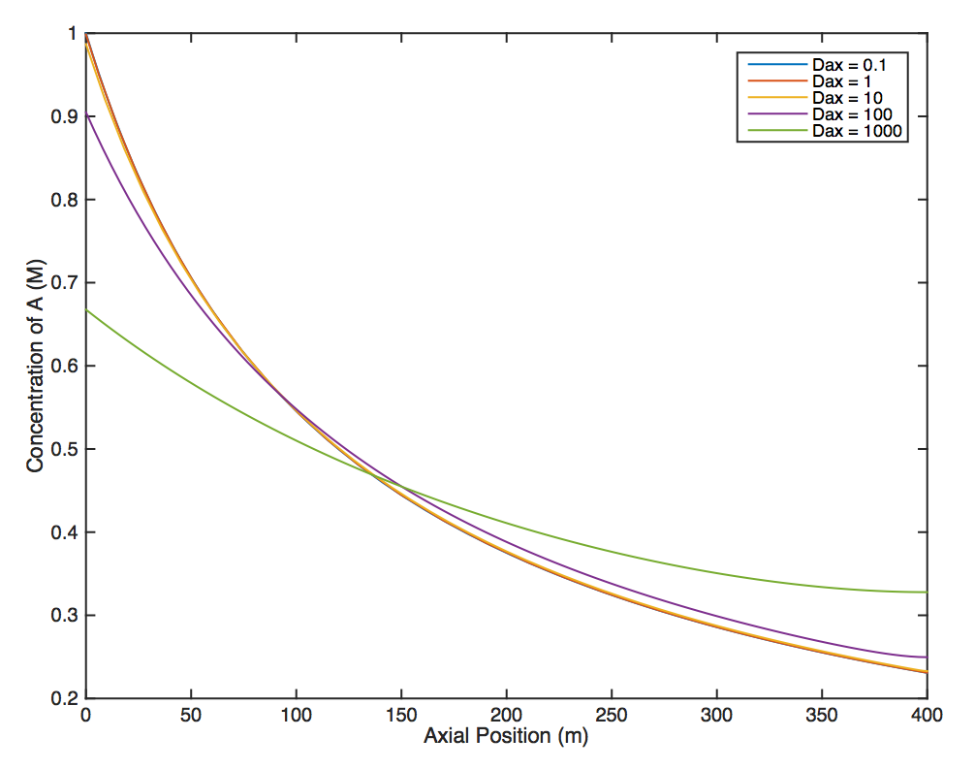
The results are shown in this plot
If Dax = 0, the reactor is a PFR
  What would the plot look like?
If Dax = ∞, the reactor is a CSTR
  What would the plot look like?
Do the results at intermediate Dax make sense physically?

Slide 15
Where We’re Going
Part I - Chemical Reactions
Part II - Chemical Reaction Kinetics
Part III - Chemical Reaction Engineering
Part IV - Non-Ideal Reactions and Reactors
  A. Alternatives to the Ideal Reactor Models
    33. Axial Dispersion Model
    34. 2-D and 3-D Tubular Reactor Models
    35. Zoned Reactor Models
    36. Segregated Flow Models
    37. Overview of Multi-Phase Reactors

