Slide 1
A First Course on Kinetics and Reaction Engineering
Class 29

Slide 2
Where We’re Going
Part I - Chemical Reactions
Part II - Chemical Reaction Kinetics
Part III - Chemical Reaction Engineering
A. Ideal Reactors
B. Perfectly Mixed Batch Reactors
C. Continuous Flow Stirred Tank Reactors
D. Plug Flow Reactors
25. Reaction Engineering of PFRs
26. Analysis of Steady State PFRs
27. Analysis of Transient PFRs
E. Matching Reactors to Reactions
28. Choosing a Reactor Type
29. Multiple Reactor Networks
30. Thermal Back-Mixing in a PFR
31. Back-Mixing in a PFR via Recycle
32. Ideal Semi-Batch Reactors
Part IV - Non-Ideal Reactions and Reactors

Slide 3
Reactor Networks
Reasons for using multiple reactors
Add capacity to an existing process
Performance Advantages
Heat management
More favorable composition vs. space time
No difference in model for an individual reactor
Equations may become coupled with those for another reactor
May need additional mole and energy balances at splitting and mixing points
General behavior
Two PFRs (of equal diameter) connected in series are equivalent to a single PFR with their combined length provided no heating, cooling or fluid exchange takes place between them
Mixing two streams of unequal conversion generally decreases the performance of a parallel reactor network compared to networks where such mixing does not occur
CSTR cascades (CSTRs in series)
As the number of CSTRs in the cascade increases, keeping total volume constant, the cascade performs more and more like a PFR
Series
Parallel

Slide 4
Advantage of a CSTR Cascade over a Single CSTR
Inlet composition
and temperatures
are equal
Outlet composition
and temperatures
are equal
Rates are
Equal
Rate is
Higher
Since some of the reaction occurs
at a higher rate with 2 reactors
the total volume is smaller

Slide 5
Questions?

Slide 6
Activity 29
Consider the irreversible, liquid phase reaction A → B which occurs at constant density. Reactant A is supplied at a rate of 4 L min⁻¹ in a concentration of 2 mol L⁻¹ and at a temperature of 43 ºC. The heat capacity of the fluid is 0.87 cal mL⁻¹ K⁻¹ and the heat of reaction is -27.2 kcal mol⁻¹. The reaction is second order in the concentration of A, and the rate coefficient obeys Arrhenius’ law with a pre-exponential factor of 6.37 x 10⁹ L mol⁻¹ min⁻¹ and an activation energy of 14.3 kcal mol⁻¹. It is desired to convert 90% of the reactant to product adiabatically. Consider the following reactor networks: (a) a single CSTR, (b) a single PFR, (c) two CSTRs in series, (d) a CSTR followed in series by a PFR, and (e) a PFR followed in series by a CSTR. Determine which reactor network requires the smallest total reactor volume. (In each of the reactor networks, the two reactors are not required to have equal volumes.)

Slide 7
Activity 29
Consider the irreversible, liquid phase reaction A → B which occurs at constant density. Reactant A is supplied at a rate of 4 L min⁻¹ in a concentration of 2 mol L⁻¹ and at a temperature of 43 ºC. The heat capacity of the fluid is 0.87 cal mL⁻¹ K⁻¹ and the heat of reaction is -27.2 kcal mol⁻¹. The reaction is second order in the concentration of A, and the rate coefficient obeys Arrhenius’ law with a pre-exponential factor of 6.37 x 10⁹ L mol⁻¹ min⁻¹ and an activation energy of 14.3 kcal mol⁻¹. It is desired to convert 90% of the reactant to product adiabatically. Consider the following reactor networks: (a) a single CSTR, (b) a single PFR, (c) two CSTRs in series, (d) a CSTR followed in series by a PFR, and (e) a PFR followed in series by a CSTR. Determine which reactor network requires the smallest total reactor volume. (In each of the reactor networks, the two reactors are not required to have equal volumes.)
Start with a qualitative analysis
How will the rate change as the space time increases?
Which of the reactors or reactor networks is better suited to the rate versus conversion profile
When the rate is larger, the required volume is smaller

Slide 8
Qualitative Analysis
The reaction is exothermic and irreversible
As conversion increases, the rate will increase, pass through a maximum and then decrease
You can’t say for sure which reactor or network is preferred because you don’t know what conversion corresponds to the maximum rate
If the maximum rate occurs near 90% conversion, a single CSTR would probably be best because throughout the reactor, the rate would be high, leading to a smaller volume
If the maximum rate occurs at conversions well below 90%, a CSTR sized to operate at near the maximum rate followed by a PFR would probably be best
Note, a PFR always operates right on the rate versus space time (or conversion) curve
In a conversion range where the rate is continually increasing, a CSTR will be smaller
In a conversion range where the rate is continually decreasing, a PFR will be smaller
Now proceed to the quantitative analysis of the five cases
Write design equations for each reactor in the network
Identify each flow stream (a, b, c, etc.) and determine whether the molar flows and the temperature are known
Solve the design equations to find the reactor volume or volumes
When there are two reactors, pick the volume of the first reactor, solve the equations for the total volume and repeat
Plot the total volume versus the volume of the first reactor to find the minimum

Slide 9
Design Equations
Write design equations that can be used to analyze any of the CSTRs

Slide 10
Design Equations
Write design equations that can be used to analyze any of the CSTRs
3 equations, so 3 unknowns
ṅB,out and Tout in all cases
ṅA,out when CSTR is the first reactor
V when CSTR is the second reactor
Write design equations that can be used to analyze any of the PFRs
Final condition
V when PFR is the first reactor
ṅA,out when PFR is the second reactor

Slide 11
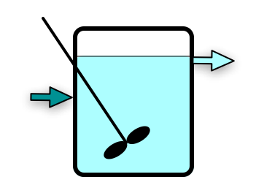
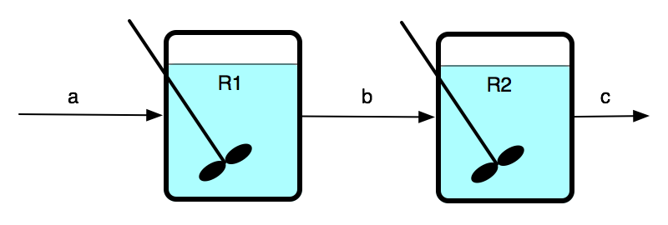
Individual Reactors
For every CSTR
Design equations from previous slide
ṅB,out and Tout are unknown
For first CSTR if there are 2 reactors
ṅA,out is unknown
For last CSTR
V is unknown
For every PFR
Design equations and initial conditions from previous slide
For first PFR if there are 2 reactors
Final value is V
For last PFR
Final value is ṅA,out

Slide 12
Numerical Solution
For the single reactors, simply solve the design equations to find V
For each reactor network
Pick a range of values for the first reactor volume between zero and the volume of the single reactor found above
For each volume in that range
Solve the design equations for the first reactor to get molar flow rates of A and B and temperature for stream b in diagrams
Use those results to solve the design equations for the second reactor to get its volume
Calculate the total volume and plot it versus the volume of the first reactor
Find the minimum in the plot and from it, read the minimum volume for that reactor network
Solving the CSTR design equations requires a guess for the solution
It may be difficult or impossible to find a single guess that works over the whole range of volumes
Either solve over smaller ranges of volume
Or write the code so the guesses are varied appropriately

Slide 13
Numerical Solution
For the single reactors, simply solve the design equations to find V
For each reactor network
Pick a range of values for the first reactor volume between zero and the volume of the single reactor found above
For each volume in that range
Solve the design equations for the first reactor to get molar flow rates of A and B and temperature for stream b in diagrams
Use those results to solve the design equations for the second reactor to get its volume
Calculate the total volume and plot it versus the volume of the first reactor
Find the minimum in the plot and from it, read the minimum volume for that reactor network
Solving the CSTR design equations requires a guess for the solution
It may be difficult or impossible to find a single guess that works over the whole range of volumes
Either solve over smaller ranges of volume
Or write the code so the guesses are varied appropriately
Results from smallest to largest
Single CSTR (7.0 L) > 2 CSTRs (2.7 L) > single PFR = PFR before CSTR (1.7 L) > CSTR before PFR (1.5 L)

Slide 14
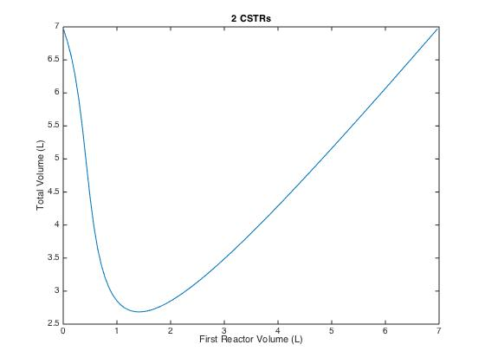
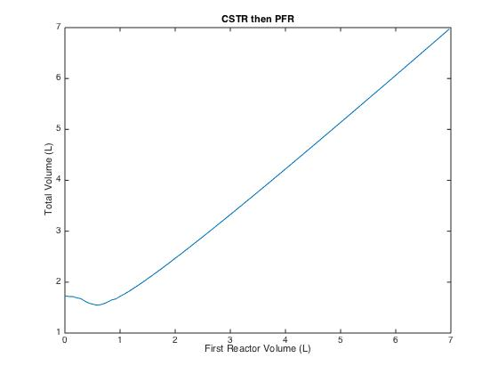
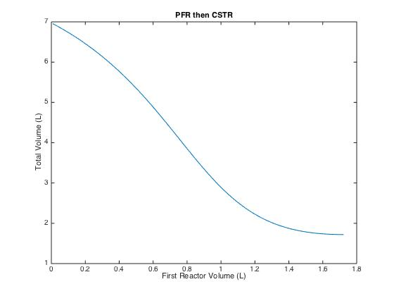
Volume Plots

Slide 15
Where We’re Going
Part I - Chemical Reactions
Part II - Chemical Reaction Kinetics
Part III - Chemical Reaction Engineering
A. Ideal Reactors
B. Perfectly Mixed Batch Reactors
C. Continuous Flow Stirred Tank Reactors
D. Plug Flow Reactors
25. Reaction Engineering of PFRs
26. Analysis of Steady State PFRs
27. Analysis of Transient PFRs
E. Matching Reactors to Reactions
28. Choosing a Reactor Type
29. Multiple Reactor Networks
30. Thermal Back-Mixing in a PFR
31. Back-Mixing in a PFR via Recycle
32. Ideal Semi-Batch Reactors
Part IV - Non-Ideal Reactions and Reactors

