Slide 1
A First Course on Kinetics and Reaction Engineering
Class 25

Slide 2
Where We’re Going
Part I - Chemical Reactions
Part II - Chemical Reaction Kinetics
Part III - Chemical Reaction Engineering
  A. Ideal Reactors
  B. Perfectly Mixed Batch Reactors
  C. Continuous Flow Stirred Tank Reactors
  D. Plug Flow Reactors
    25. Reaction Engineering of PFRs
    26. Analysis of Steady State PFRs
    27. Analysis of Transient PFRs
  E. Matching Reactors to Reactions
Part IV - Non-Ideal Reactions and Reactors

Slide 3
PFR Characteristics
Environmental variables change along length of reactor
Heat transfer area is limited to the reactor wall
Area to Volume is more limited than a CSTR
  Can’t add a coil inside the fluid
Only option for increasing area is to use smaller diameter tube
  Eventually leads to large pressure drop through reactor
Sometimes can break reactor into segments with some form of heating/cooling between them
Heat/Cool
Here

Slide 4
PFR Advantages & Disadvantages
Distinguishing Features
  No agitation
    Equally well-suited to gases and liquids
    Preferred if a solid catalyst is being used because less abrasion
  Reactant concentration decreases continually and product concentration increases continually from inlet to outlet
  Temperature may vary over the length of the reactor
Preferred Uses
  Reactions that require a solid catalyst
  Large quantities of reactant to be processed
  Reactions that will be run adiabatically or with little heating/cooling
  Reactions with “typical” kinetics
    High rate or selectivity is favored by high reactant concentration and low product concentration
    Same kinds of reactions as are favored in a batch reactor
  Reversible reactions

Slide 5
Analogy between
Batch Reactors and PFRs
Fluid element within a PFR is like a batch reactor
  perfectly mixed radially
  differentially thick so negligible axial differences
  no fluid enters the element or leaves it during process
Starts reacting when fluid element enters the reactor and stops when it leaves
  processing time is equal to the residence time (space time)
Qualitatively, PFR performance as a function of space time is the same as the qualitative performance of a batch reactor as a function of processing time
dz

Slide 6
Questions?

Slide 7
Activity 25.1
Suppose reaction (1) and reaction (2) are typical irreversible reactions and further assume that they have exactly the same rate expression (same reaction orders, same pre-exponential factor and same activation energy). In fact, the only difference between them is that reaction (1) is exothermic and reaction (2) is endothermic. Make a single graph showing conversion of A versus space time, and on that graph sketch what the plot would look like (a) for reaction (1) taking place in an adiabatic PFR, (b) for reaction (1) taking place in an isothermal PFR, (c) reaction (2) taking place in an adiabatic PFR and (d) reaction (2) taking place in an isothermal PFR. For each plot explain why it has the shape it does, and then explain why the plots differ from each other in the way they do.
A → B (1)
A → C (2)

Slide 8
Key Features to Determine
For each curve
  Initial value
  Initial slope
  Initial curvature
    Can it persist?
  Competing effects
    Minimum, maximum or inflection point
  Asymptotic final value
Comparing curves
  Always above, always below or cross at some point

Slide 9
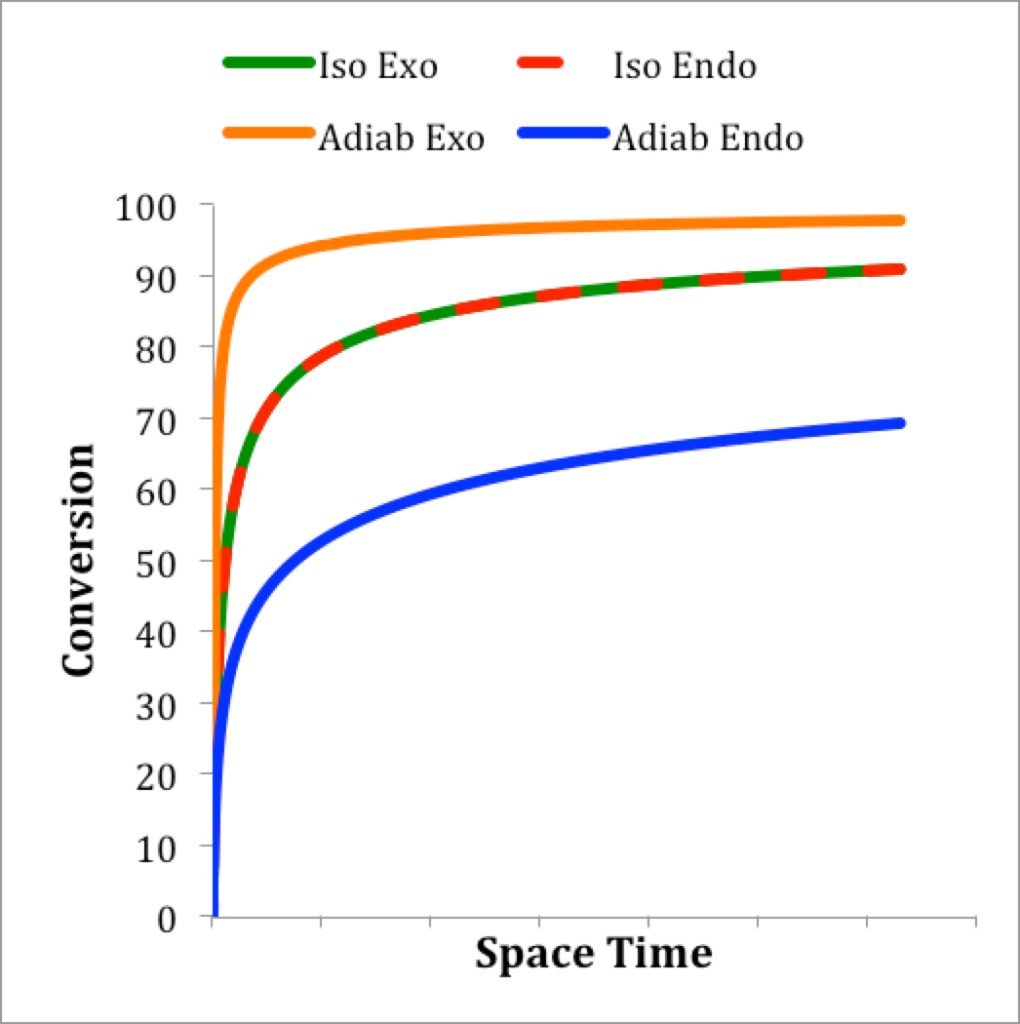
Analysis
Isothermal systems will be identical because kinetics are the same
  Start at zero conversion
    No reaction before entering reactor
  Positive slope
    High reactant concentration, high rate, reactant consumed, conversion increases
  Concave down
    Farther into the reactor, reactant concentration smaller, rate smaller, not as much conversion
  Asymptotically approaches 100% conversion
    At which point slope equals zero
Adiabatic systems will differ due to temperature effects
  Endothermic reaction, as conversion increases, temperature decreases, rate decreases beyond decrease seen in isothermal
  Same shape as isothermal, but always below isothermal curve

Slide 10
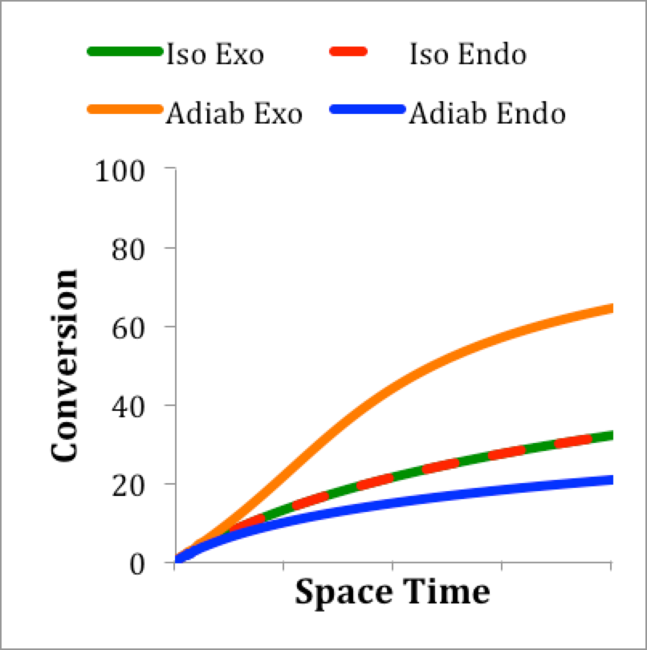
Adiabatic Exothermic Analysis
Competing effects
  As conversion increases with space time
    reactant concentration decreases tending to decrease rate
    temperature increases tending to increase rate
  Initially expect temperature effect to predominate leading to concave upward shape
  Eventually concentration must predominate
    Inflection at point where two effects become equal
    Concave down beyond that point
Adiabatic exothermic system always above other curves

Slide 11
Activity 25.2
The objectives of this activity are
  Identify two different types of transient responses to a step change in a PFR operating parameter
  Understand what feature of the step change leads to each type of transient response
  Examine the duration of the response of a PFR to a step change in one of its operating parameters
We will use the PFR shown above in a series of thought experiments to qualitatively probe the transient response of a PFR to a set of step changes in operating parameters
  At the instant shown, the step change has just occurred
  The green and blue fluid elements are both inside the reactor
    The green fluid element is the last one to have entered before the step change
    The blue fluid element entered just before the green one
  The red and yellow fluid element are both outside the reactor
    The yellow fluid element will be the first one to enter after the step change
    The red fluid element will enter right after the yellow one

Slide 12
Duration of the Transient
There was some unspecified step change right after the green fluid element entered the reactor
Will the changes that occur in the red fluid element as it moves through the reactor be exactly the same as the changes that occur in the yellow fluid element as it moves through the reactor?
  Why or why not?
Once the yellow fluid element has reached the outlet from the reactor, will the changes that occur in the next fluid element to enter the reactor as it moves through the reactor be exactly the same as the changes that occur in the yellow fluid element as it moved through the reactor?
  Is there a name for this condition
On the basis of your answers, can you state how long the transient lasted?

Slide 13
Duration of the Transient
There was some unspecified step change right after the green fluid element entered the reactor
Will the changes that occur in the red fluid element as it moves through the reactor be exactly the same as the changes that occur in the yellow fluid element as it moves through the reactor? Yes, they will be equal
  They start at equal compositions, flow at equal rates and experience the same heat transfer with the walls, so there is no difference between them
Once the yellow fluid element has reached the outlet from the reactor, will the changes that occur in the next fluid element to enter the reactor as it moves through the reactor be exactly the same as the changes that occur in the yellow fluid element as it moved through the reactor? Yes, they will be equal
  The reasons are the same; note every fluid element now has the same experience; the reactor is at steady state
On the basis of your answers, can you state how long the transient lasted?
  The duration of the transient is the amount of time it takes for the yellow fluid element to reach the reactor outlet, and that is equal to the residence time

Slide 14
First Step Change
There was a step change in the inlet composition
As the green fluid element moves through the reactor, will it experience the exact same changes that the blue element experiences?
  Why or why not?
As the yellow fluid element moves through the reactor, will it experience the exact same changes that the green fluid element experiences?
  Why or why not?
As the red fluid element moves through the reactor, will it experience the exact same changes that the yellow fluid element experiences?
  Why or why not?
What would change if there was a step change in the inlet temperature

Slide 15
First Step Change
There was a step change in the inlet composition
As the green fluid element moves through the reactor, will it experience the exact same changes that the blue element experiences? Yes, they will be equal
  They started at equal compositions, flow at equal rates and experience the same heat transfer with the walls, so there is no difference between them
As the yellow fluid element moves through the reactor, will it experience the exact same changes that the green fluid element experiences? No, they will be different
  The yellow fluid element will be reacting at a different rate than the green due to the composition difference
As the red fluid element moves through the reactor, will it experience the exact same changes that the yellow fluid element experiences? Yes, they will be equal
  For the same reason that the blue and green elements are equal
What would change if there was a step change in the inlet temperature
  Again, the blue and the green would be equal; the yellow and red would be equal, but the yellow and green would be different.

Slide 16
First Step Change
Based on the answers you gave on the previous slide, describe what changes you would observe as a function of time if you observed at the point indicated

Slide 17
First Step Change
Based on the answers you gave on the previous slide, describe what changes you would observe as a function of time if you observed at the point indicated
  There would be no changes over time until the yellow fluid element reached the observation point
  When the yellow fluid element reached the observation point, a step change would be observed
  After the yellow fluid element had reached the observation point, there would be no more changes over time

Slide 18
A Different Kind of Step Change
There was a step change increase in the flow rate
As the green fluid element moves through the reactor, will it experience the exact same changes that the blue element experiences?
  Why or why not?
As the yellow fluid element moves through the reactor, will it experience the exact same changes that the green fluid element experiences?
  Why or why not?
As the red fluid element moves through the reactor, will it experience the exact same changes that the yellow fluid element experiences?
  Why or why not?
Suppose instead of the flow rate, the temperature of the reactor wall changed (causing a step change in the heat transfer term)?

Slide 19
A Different Kind of Step Change
There was a step change increase in the flow rate
As the green fluid element moves through the reactor, will it experience the exact same changes that the blue element experiences? No, they will be different
  When the green element reaches the place where the blue element is, it will not have been in the reactor for as long (due to faster flow), so it will not have reacted as much
As the yellow fluid element moves through the reactor, will it experience the exact same changes that the green fluid element experiences? No, they will be different
  The reason is the same
As the red fluid element moves through the reactor, will it experience the exact same changes that the yellow fluid element experiences? Yes, they will be equal
  They enter at equal compositions, flow at equal rates and experience the same heat transfer with the walls, so there is no difference between them
Suppose instead of the flow rate, the temperature of the reactor wall changed (causing a step change in the heat transfer term)? Same answers

Slide 20
Second Step Change
Based on the answers you gave on the previous slide, describe what changes you would observe as a function of time if you observed at the point indicated
Compare and contrast the nature of the transient for the preceding case to this case

Slide 21
Second Step Change
Based on the answers you gave on the previous slide, describe what changes you would observe as a function of time if you observed at the point indicated
  As soon as the step change was applied, changes would be observed continually until the yellow fluid element reached the observation point
  After the yellow fluid element had reached the observation point, there would be no more changes over time
Compare and contrast the nature of the transient for the preceding case to this case
  In the first case, there will be a step change that moves along the reactor; it will be located at the interface between the green and yellow fluid elements
    This is sometimes referred to as a “front” moving through the reactor
  In the second case, there will initially be changes along the whole length of the reactor; as the yellow fluid element moves through, there will be continual changes in front of it, but there will be no changes (at a fixed position) behind it

Slide 22
Where We’re Going
Part I - Chemical Reactions
Part II - Chemical Reaction Kinetics
Part III - Chemical Reaction Engineering
  A. Ideal Reactors
  B. Perfectly Mixed Batch Reactors
  C. Continuous Flow Stirred Tank Reactors
  D. Plug Flow Reactors
    25. Reaction Engineering of PFRs
    26. Analysis of Steady State PFRs
    27. Analysis of Transient PFRs
  E. Matching Reactors to Reactions
Part IV - Non-Ideal Reactions and Reactors

