Slide 1
A First Course on Kinetics and Reaction Engineering
Class 24

Slide 2
Where We’re Going
Part I - Chemical Reactions
Part II - Chemical Reaction Kinetics
Part III - Chemical Reaction Engineering
  A. Ideal Reactors
  B. Perfectly Mixed Batch Reactors
  C. Continuous Flow Stirred Tank Reactors
    21. Reaction Engineering of CSTRs
    22. Analysis of Steady State CSTRs
    23. Analysis of Transient CSTRs
    24. Multiple Steady States in CSTRs
  D. Plug Flow Reactors
  E. Matching Reactors to Reactions
Part IV - Non-Ideal Reactions and Reactors

Slide 3
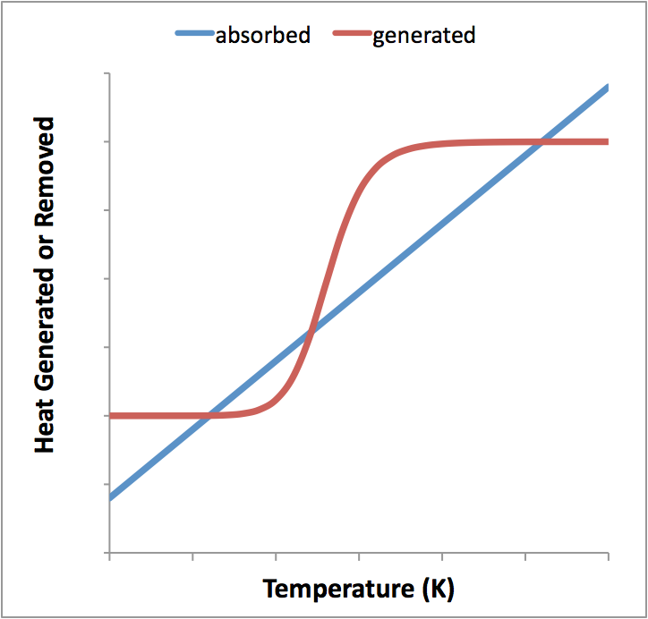
Satisfying the Steady State CSTR
Energy Balance
Choose an outlet temperature, solve the mole balance design equations, use results to compute two parts of the energy balance, plot the results
Energy balance is only satisfied at temperatures where the two curves intersect
In this case there are three solutions to the steady state CSTR design equations
  In all three cases the outlet temperature and outlet molar flow rates make sense physically
  Known as multiplicity of steady states

Slide 4
CSTR Steady States
Suppose the system was perturbed slightly away from a given steady state, would it tend naturally to return to that steady state
  if so, it’s a stable steady state (Points A & C)
  if not, it’s an unstable steady state. (Point B)
Real systems won’t operate naturally at an unstable steady state
The start-up or most recent transient will determine which steady state is reached
  Reactor design must include a safe and efficient start-up procedure that will bring the system to the desired steady state
System is typically designed to operate at one of the steady states, not the other
C
B
A

Slide 5
Questions?

Slide 6
Activity 24.1
Consider an adiabatic, steady state CSTR with a fluid volume of 0.4 L. Suppose the liquid phase reaction A → Z takes place in the reactor. The feed to the reactor is at 330 K; it flows at 1 L min⁻¹ and it contains 5 mol A L⁻¹. The heat capacity of the solution is 1000 cal L⁻¹ K⁻¹, and it independent of both temperature and composition. The reaction is exothermic with a heat of -30,000 cal mol⁻¹. The rate is first order in the concentration of A. The pre-exponential factor equals 4.8 x 10¹³ min⁻¹ and the activation energy is 24,000 cal mol⁻¹.
Write the steady-state mole balance on A and the energy balance for this reactor. Set up an Excel spreadsheet where each of the values given above are listed at the top. Then add columns for the outlet temperature, the outlet molar flow rate of A, the heat absorbed term and the heat generated term (see Unit 24). Fill in the temperature column with values from 250 to 550 K in steps of 10 K, and then enter formulae to fill in the other columns. Finally, on the same graph plot the heat absorbed versus T and the heat generated versus T. Call this your base case. Vary each parameter in the problem statement and determine how it affects the plot.

Slide 7
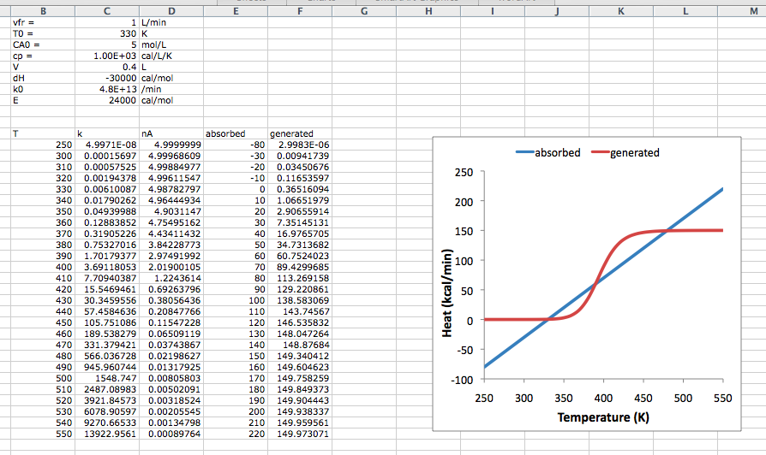

Slide 8
Results
Increasing the volumetric flow rate shifts the heat absorbed curve upward
Increasing the inlet temperature shifts the heat absorbed curve downward
Increasing the inlet concentration increases the size of the step in the heat generated curve
Increasing the heat capacity decreases the size of the step in the heat generated curve
Increasing the reaction volume shifts the step of the heat generated curve to lower temperature
Increasing the heat of reaction (making it less negative) decreases the size of the step in the heat generated curve
Increasing the pre-exponential factor shifts the step of the heat generated curve to lower temperature
Increasing the activation energy shifts the step of the heat generated curve to higher temperature

Slide 9
Activity 24.2
Choose a set of conditions from Activity 24.1 where the reactor displays three steady states
Write the steady state mole balance and energy balance design equations for that CSTR
Set up a MATLAB or other computer code to solve the design equations and use it to find all three steady states

Slide 10
Where We’re Going
Part I - Chemical Reactions
Part II - Chemical Reaction Kinetics
Part III - Chemical Reaction Engineering
  A. Ideal Reactors
  B. Perfectly Mixed Batch Reactors
  C. Continuous Flow Stirred Tank Reactors
    21. Reaction Engineering of CSTRs
    22. Analysis of Steady State CSTRs
    23. Analysis of Transient CSTRs
    24. Multiple Steady States in CSTRs
  D. Plug Flow Reactors
    25. Reaction Engineering of PFRs
    26. Analysis of Steady State PFRs
    27. Analysis of Transient PFRs
  E. Matching Reactors to Reactions
Part IV - Non-Ideal Reactions and Reactors

