Slide 1
A First Course on Kinetics and Reaction Engineering
Class 23

Slide 2
Where We’re Going
Part I - Chemical Reactions
Part II - Chemical Reaction Kinetics
Part III - Chemical Reaction Engineering
  A. Ideal Reactors
  B. Perfectly Mixed Batch Reactors
  C. Continuous Flow Stirred Tank Reactors
    21. Reaction Engineering of CSTRs
    22. Analysis of Steady State CSTRs
    23. Analysis of Transient CSTRs
    24. Multiple Steady States in CSTRs
  D. Plug Flow Reactors
  E. Matching Reactors to Reactions
Part IV - Non-Ideal Reactions and Reactors

Slide 3
Transient Behavior
While processes may be designed to operate at steady state, occasionally they still need to be started up or shut down.
  Maintenance of equipment
  Interruption of feed, heating or cooling
Definitions
  System response: values of the dependent variables (outlet molar flow rates and outlet temperature) as a function of time
  Operating parameters: everything else in the design equations
    particularly quantities that can change easily (either intentionally or unexpectedly)
As soon as an operating parameter of a CSTR is changed, the reactor enters a period of transient behavior
  During transient behavior, the outlet molar flow rates and the outlet temperature change over time
The transient behavior will end
  When (if) the system reaches a new steady state
    The outlet molar flow rates and temperature approach steady state values over time
    The steady state corresponds to the new operating parameters (those in effect after the most recent change)
  When another operating parameter is changed (causing a new period of transient behavior to begin)
  Never; the system could go into a state where the response variables undergo sustained periodic oscillations

Slide 4
Transient Analysis of CSTRs
Write a mole balance for every reactant and product of the reactions taking place
Write an energy balance on the reaction volume
If necessary, write an energy balance on the heat transfer fluid, e. g.
If necessary, add ODEs or eliminate dependent variables so the number of dependent variables and equations are equal
Assuming a numerical solution
  Identify the independent variable and its initial value
  Identify the dependent variables and their initial values
  Write code to evaluate each design equation (ODE) given the values of the independent and dependent variables
  Solve numerically and use the results to complete the requested design or engineering task

Slide 5
Questions?

Slide 6
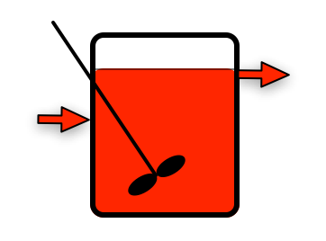
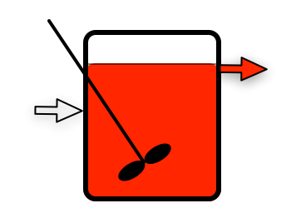
Activity 23.1
Prior Steady State
Feed Change
Cred = 1
T = 50 ºC
C
Cred = 1
T = 50 ºC
Cred = 0
T = 25 ºC
A
B
Suppose a stirred tank is operating at steady state as shown on the left (there’s no reaction), when the inlet composition is suddenly changed
  The inlet concentration of red coloring changes from 1 to 0 mol L⁻¹
  The temperature of the inlet flow stream changes from 50 ºC to 25 ºC
Assuming the transient will continue until a new steady state is reached, describe how the concentration of red coloring and the temperature will vary at the points labeled A, B and C if the fluid is a constant density liquid
Write a transient mole balance on the red coloring
  What initial condition is needed to solve this equation?

Slide 7
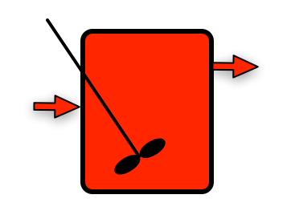
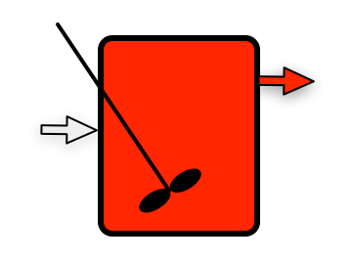
Activity 23.1
Prior Steady State
Feed Change
Cred = 1
T = 50 ºC
C
Cred = 1
T = 50 ºC
Cred = 0
T = 25 ºC
A
B
Suppose a stirred tank is operating at steady state as shown on the left, when the inlet composition is suddenly changed
  The inlet concentration of red coloring changes from 1 to 0 mol L⁻¹
  The temperature of the inlet flow stream changes from 50 ºC to 25 ºC
Assuming the transient will continue until a new steady state is reached, describe how the concentration of red coloring and the temperature will vary at the points labeled A, B and C if the fluid is an ideal gas
Write a transient mole balance on the red coloring
  What initial condition is needed to solve this equation?

Slide 8
Activity 23.2
Example 23.1 described a steady state CSTR where the rate of liquid-phase reaction (1) is adequately described by the rate expression given in equation (2). Reactant A is fed to a steady state CSTR at a rate of 0.01 lbmol min⁻¹, and reactant B is fed at a rate of 0.25 lbmol min⁻¹. This corresponds to an inlet volumetric flow rate of 0.08 ft³ min⁻¹. The CSTR has a fluid volume of 18 ft³, and it operates adiabatically. The heat of reaction may be taken to be constant and equal to -1.7 x 10⁴ BTU lbmol⁻¹. The heat capacities of A, B and Z are equal to 1000, 180 and 1200 BTU lbmol⁻¹ °R⁻¹, respectively, and they may be considered to be independent of temperature. If this reactor was operating at 650 °R and the volumetric flow rate was suddenly doubled, how would the conversion change?.
A + B ⇄ Z (1)
(2)

Slide 9
Where We’re Going
Part I - Chemical Reactions
Part II - Chemical Reaction Kinetics
Part III - Chemical Reaction Engineering
  A. Ideal Reactors
  B. Perfectly Mixed Batch Reactors
  C. Continuous Flow Stirred Tank Reactors
    21. Reaction Engineering of CSTRs
    22. Analysis of Steady State CSTRs
    23. Analysis of Transient CSTRs
    24. Multiple Steady States in CSTRs
  D. Plug Flow Reactors
  E. Matching Reactors to Reactions
Part IV - Non-Ideal Reactions and Reactors

