Slide 1
A First Course on Kinetics and Reaction Engineering
Class 23

Slide 2
Where We’re Going
Part I - Chemical Reactions
Part II - Chemical Reaction Kinetics
Part III - Chemical Reaction Engineering
A. Ideal Reactors
B. Perfectly Mixed Batch Reactors
C. Continuous Flow Stirred Tank Reactors
21. Reaction Engineering of CSTRs
22. Analysis of Steady State CSTRs
23. Analysis of Transient CSTRs
24. Multiple Steady States in CSTRs
D. Plug Flow Reactors
E. Matching Reactors to Reactions
Part IV - Non-Ideal Reactions and Reactors

Slide 3
Transient Behavior
While processes may be designed to operate at steady state, occasionally they still need to be started up or shut down.
Maintenance of equipment
Interruption of feed, heating or cooling
Definitions
System response: values of the dependent variables (outlet molar flow rates and outlet temperature) as a function of time
Operating parameters: everything else in the design equations
particularly quantities that can change easily (either intentionally or unexpectedly)
As soon as an operating parameter of a CSTR is changed, the reactor enters a period of transient behavior
During transient behavior, the outlet molar flow rates and the outlet temperature change over time
The transient behavior will end
When (if) the system reaches a new steady state
The outlet molar flow rates and temperature approach steady state values over time
The steady state corresponds to the new operating parameters (those in effect after the most recent change)
When another operating parameter is changed (causing a new period of transient behavior to begin)
Never; the system could go into a state where the response variables undergo sustained periodic oscillations

Slide 4
Transient Analysis of CSTRs
Write a mole balance for every reactant and product of the reactions taking place
Write an energy balance on the reaction volume
If necessary, write an energy balance on the heat transfer fluid, e. g.
If necessary, add ODEs or eliminate dependent variables so the number of dependent variables and equations are equal
Assuming a numerical solution
Identify the independent variable and its initial value
Identify the dependent variables and their initial values
Write code to evaluate each design equation (ODE) given the values of the independent and dependent variables
Solve numerically and use the results to complete the requested design or engineering task

Slide 5
Questions?

Slide 6
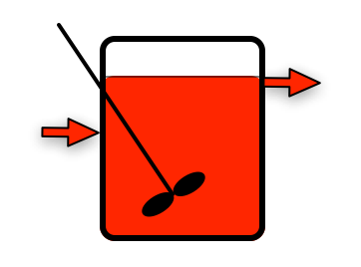
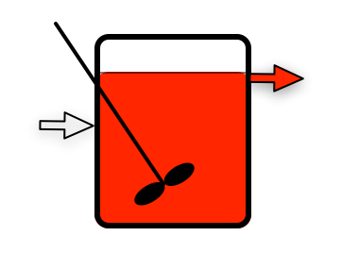
Activity 23.1
Prior Steady State
Feed Change
Cred = 1
T = 50 ºC
C
Cred = 1
T = 50 ºC
Cred = 0
T = 25 ºC
A
B
Suppose a stirred tank is operating at steady state as shown on the left (there’s no reaction), when the inlet composition is suddenly changed
The inlet concentration of red coloring changes from 1 to 0 mol L⁻¹
The temperature of the inlet flow stream changes from 50 ºC to 25 ºC
Assuming the transient will continue until a new steady state is reached, describe how the concentration of red coloring and the temperature will vary at the points labeled A, B and C if the fluid is a constant density liquid
Write a transient mole balance on the red coloring
What initial condition is needed to solve this equation?

Slide 7
Qualitative Analysis
Prior Steady State
Feed Change
Cred = 1
T = 50 ºC
C
Cred = 1
T = 50 ºC
Cred = 0
T = 25 ºC
A
B
At point A
Cred will be constant and equal to 0 mol L⁻¹
T will be constant and equal to 25 ºC
At point B
Cred will initially equal 1 mol L⁻¹, and it will continually decrease until it becomes equal to 0 mol L⁻¹
T will will initially equal 50 ºC, and it will continually decrease until it becomes equal to 25 ºC
At point C
Cred and T will be the same as they are at point B

Slide 8
Mole Balance
Prior Steady State
Feed Change
Cred = 1
T = 50 ºC
C
Cred = 1
T = 50 ºC
Cred = 0
T = 25 ºC
A
B
General mole balance:

Slide 9
Mole Balance
Prior Steady State
Feed Change
Cred = 1
T = 50 ºC
C
Cred = 1
T = 50 ºC
Cred = 0
T = 25 ºC
A
B
General mole balance:
No reaction, so last term equals zero
Constant density fluid and reactor initially full, so V and are constant
Their derivatives are then equal to zero
Mole balance after simplification:
Initial condition is the value of ṅred at t = 0

Slide 10
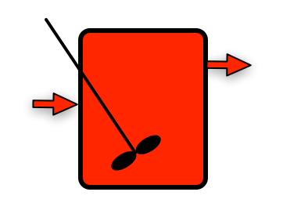
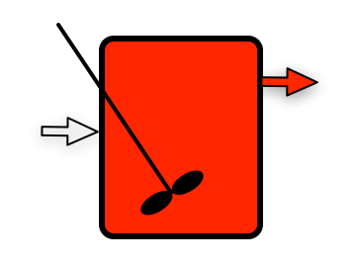
Activity 23.1
Prior Steady State
Feed Change
Cred = 1
T = 50 ºC
C
Cred = 1
T = 50 ºC
Cred = 0
T = 25 ºC
A
B
Suppose a stirred tank is operating at steady state as shown on the left, when the inlet composition is suddenly changed
The inlet concentration of red coloring changes from 1 to 0 mol L⁻¹
The temperature of the inlet flow stream changes from 50 ºC to 25 ºC
Assuming the transient will continue until a new steady state is reached, describe how the concentration of red coloring and the temperature will vary at the points labeled A, B and C if the fluid is an ideal gas
Write a transient mole balance on the red coloring
What initial condition is needed to solve this equation?

Slide 11
Qualitative Analysis
Prior Steady State
Feed Change
Cred = 1
T = 50 ºC
C
Cred = 1
T = 50 ºC
Cred = 0
T = 25 ºC
A
B
At point A
Cred will be constant and equal to 0
T will be constant and equal to 25 ºC
At point B
Cred will initially equal 1 mol L⁻¹, and it will continually decrease until it becomes equal to 0 mol L⁻¹
T will will initially equal 50 ºC, and it will continually decrease until it becomes equal to 25 ºC
At point C
Cred and T will be the same as they are at point B

Slide 12
Transient Mole Balance
Prior Steady State
Feed Change
Cred = 1
T = 50 ºC
C
Cred = 1
T = 50 ºC
Cred = 0
T = 25 ºC
A
B
General mole balance:
As before
no reaction so last term is zero
reaction volume is constant so its derivative is zero
The temperature is changing; pressure and total molar flow rates are constant
the volumetric flow rate must also change over time

Slide 13
Two Approaches to Solving
Express the volumetric flow rate in terms of the other dependent variables and eliminate its derivative
where f is a known analytic function of the dependent variables (from the energy balance)
Substituting the known function eliminates the derivative of from the ODE at the top of the page
Add another differential equation
Some ODE solvers (including fsolve in MATLAB) allow the ODEs to be written in matrix form
Otherwise substitute as above in the original ODE (top of page) and substitute f from above in the ODE here to get the equations in the desired form for numerical solution

Slide 14
Activity 23.2
Example 23.1 described a steady state CSTR where the rate of liquid-phase reaction (1) is adequately described by the rate expression given in equation (2). Reactant A is fed to a steady state CSTR at a rate of 0.01 lbmol min⁻¹, and reactant B is fed at a rate of 0.25 lbmol min⁻¹. This corresponds to an inlet volumetric flow rate of 0.08 ft³ min⁻¹. The CSTR has a fluid volume of 18 ft³, and it operates adiabatically. The heat of reaction may be taken to be constant and equal to -1.7 x 10⁴ BTU lbmol⁻¹. The heat capacities of A, B and Z are equal to 1000, 180 and 1200 BTU lbmol⁻¹ °R⁻¹, respectively, and they may be considered to be independent of temperature. If this reactor was operating at 650 °R and the volumetric flow rate was suddenly doubled, how would the conversion change?.
A + B ⇄ Z (1)
(2)

Slide 15
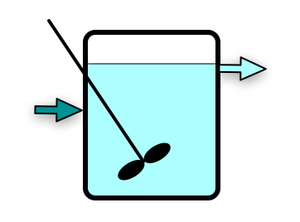
Schematic Diagram
1: A + B ⇄ Z;
Initial Steady State
= (constant ρ liquid)
T = 653 ºR
ṅA = 0.0005 lbmol min⁻¹
ṅB = 0.2405 lbmol min⁻¹
ṅZ = 0.0095 lbmol min⁻¹
= 0.08 ft³ min ⁻¹
T⁰ = 650 ºR
ṅA⁰ = 0.01 lbmol min⁻¹
ṅB⁰ = 0.25 lbmol min⁻¹
ṅZ⁰ = 0 lbmol min⁻¹
V = 18 ft³
= 0
Ẇ ≈ 0
Change of Operating Parameters
= (constant ρ liquid)
T =
ṅA =
ṅB =
ṅZ =
= 0.16 ft³ min ⁻¹
T⁰ = 650 ºR
ṅA⁰ = 0.02 lbmol min⁻¹
ṅB⁰ = 0.5 lbmol min⁻¹
ṅZ⁰ = 0 lbmol min⁻¹

Slide 16
Design Equations

Slide 17
Numerical Solution
Initial values given above
Code to evaluate derivatives
Only variable quantity in ODEs is r1
Solve for many values of t and plot

Slide 18
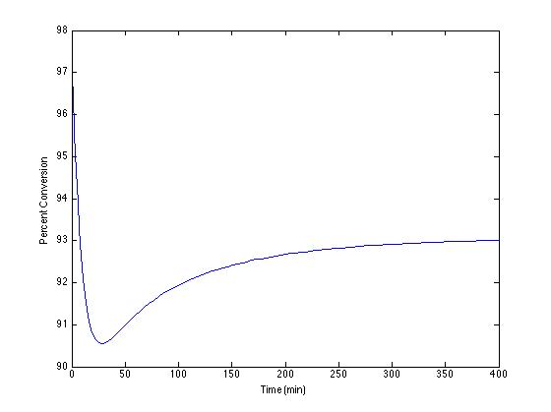
Results

Slide 19
Where We’re Going
Part I - Chemical Reactions
Part II - Chemical Reaction Kinetics
Part III - Chemical Reaction Engineering
A. Ideal Reactors
B. Perfectly Mixed Batch Reactors
C. Continuous Flow Stirred Tank Reactors
21. Reaction Engineering of CSTRs
22. Analysis of Steady State CSTRs
23. Analysis of Transient CSTRs
24. Multiple Steady States in CSTRs
D. Plug Flow Reactors
E. Matching Reactors to Reactions
Part IV - Non-Ideal Reactions and Reactors

