Slide 1
A First Course on Kinetics and Reaction Engineering
Class 22

Slide 2
Where We’re Going
Part I - Chemical Reactions
Part II - Chemical Reaction Kinetics
Part III - Chemical Reaction Engineering
A. Ideal Reactors
B. Perfectly Mixed Batch Reactors
C. Continuous Flow Stirred Tank Reactors
21. Reaction Engineering of CSTRs
22. Analysis of Steady State CSTRs
23. Analysis of Transient CSTRs
24. Multiple Steady States in CSTRs
D. Plug Flow Reactors
E. Matching Reactors to Reactions
Part IV - Non-Ideal Reactions and Reactors

Slide 3
A Generic Approach to the Analysis of a CSTR
Make a schematic diagram
Incorporate all known specifications, putting them in a consistent set of units
Introduce any shorthand notation, e. g. A + B → Y + Z
Gather necessary physico-chemical data
Perform an equilibrium analysis
Verify that rate expressions are accurate at equilibrium
Write the design equations
One mole balance for each reactant and product of any of the reactions taking place
An energy balance on the reaction volume
If needed, an energy balance on the heat transfer fluid
Convert the equations to a single type of composition variable
Molar flow rates, ṅi
Make sure the equations are properly formulated
N equations in N unknowns
Use additional system specifications to eliminate unknowns
Assume a basis, if appropriate
Solve the design equations (probably numerically) and complete the assigned task or analysis

Slide 4
Design Equations and Other Useful Relationships
Mole Balance
Energy Balance on the Reacting Fluid
Energy Balance on a Perfectly Mixed Heat Transfer Fluid
Other Relationships
Sensible Heat Term

Slide 5
Questions?

Slide 6
Activity 22.1
In Example 20.2, the operation of a batch reactor was analyzed. Specifically, a coolant flow rate of 0.2 kg min⁻¹ was selected to maximize the net rate of production of B (0.0153 mol min⁻¹ including turnaround time) via reaction (1). Suppose that reactor is converted to a CSTR that operates with a space time equal to the total processing time of the two steps in the batch reactor operational protocol (63.8 min). That is, the feed to the CSTR has the same composition and temperature as the initial charge to the batch reactor (a 2 M solution of A at 23 ºC), and the 20 ºC cooling water flows into the jacket at a rate of 0.2 kg min⁻¹. What will the final steady state temperature and outlet molar flow rate of B equal?
The rate expression for reaction (1) is given in equation (2). The heat of reaction (1) may be taken to be constant and equal to -22,200 cal mol⁻¹. The heat capacity of the reacting solution is approximately constant and equal to 440 cal L⁻¹ K⁻¹, and its density is constant. The reaction volume is 4 L, and the jacket volume is 0.5 L with a heat transfer area of 0.6 ft² and a heat transfer coefficient of 1.13 x 10⁴ cal ft⁻² h⁻¹ K⁻¹. The cooling water may be taken to have a constant density of 1 g cm⁻³ and a constant heat capacity of 1 cal g⁻¹ K⁻¹.
A → B (1)
(2)

Slide 7
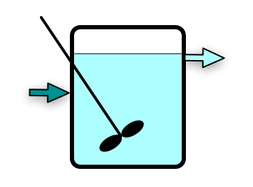
Solution
Mole balances
Energy balance on reaction volume
Energy balance on cooling water
Four equations in 4 unknowns
To solve numerically, must evaluate functions, fi, given ṅA, ṅB, T, Te
Constants:
Other variable quantities:
A → B; r1 = k0⋅exp(-E/RT)⋅CA
=
T =
ṅA =
ṅB =
= V/τ
T⁰ = 23 ºC
ṅA⁰ = CA⁰⋅
ṅB⁰ = 0
V = 4 L
Vjacket = 0.5 L
A = 0.6 ft²
U = 1.13 x 10⁴ cal ft⁻² h⁻¹ K⁻¹
ṁwater = 0.2 kg min⁻¹
Te⁰ = 20 ºC; Te =

Slide 8
Activity 22.2
Continuing Activity 22.1, find the space time that maximizes the steady state outlet molar flow rate of B from the CSTR.
Using the space time found above, along with all other reactor parameters, as a base case, predict how a small increase in each operating parameter (inlet concentration of A, inlet concentration of B, inlet temperature, volumetric flow rate, coolant flow rate and inlet coolant temperature) will affect the conversion and the outlet flow rate of B. Then perform simulations to confirm or refute your predictions. If your prediction was wrong, make sure you can qualitatively explain the correct outcome.

Slide 9
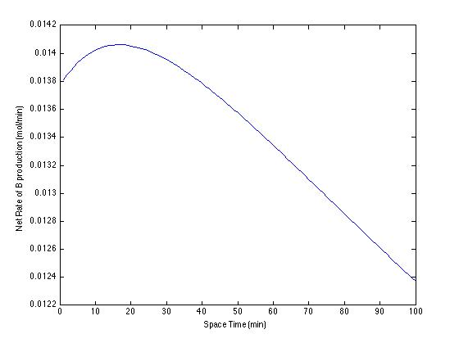
Optimization of the Space Time
Optimum space time = 17 min
Conversion: 3%
Outlet B flow rate: 0.0141 mol/min
Outlet T: 23.5 ºC
Jacket T: 21.3 ºC
Predicted effect on conversion
T⁰
ṅA⁰
ṅB⁰
ṁwater
Te⁰
Predicted effect on outlet B flow
T⁰
ṅA⁰
ṅB⁰
ṁwater
Te⁰

Slide 10
Where We’re Going
Part I - Chemical Reactions
Part II - Chemical Reaction Kinetics
Part III - Chemical Reaction Engineering
A. Ideal Reactors
B. Perfectly Mixed Batch Reactors
C. Continuous Flow Stirred Tank Reactors
21. Reaction Engineering of CSTRs
22. Analysis of Steady State CSTRs
23. Analysis of Transient CSTRs
24. Multiple Steady States in CSTRs
D. Plug Flow Reactors
E. Matching Reactors to Reactions
Part IV - Non-Ideal Reactions and Reactors

