Slide 1
A First Course on Kinetics and Reaction Engineering
Class 21

Slide 2
Where We’re Going
Part I - Chemical Reactions
Part II - Chemical Reaction Kinetics
Part III - Chemical Reaction Engineering
A. Ideal Reactors
B. Perfectly Mixed Batch Reactors
C. Continuous Flow Stirred Tank Reactors
21. Reaction Engineering of CSTRs
22. Analysis of Steady State CSTRs
23. Analysis of Transient CSTRs
24. Multiple Steady States in CSTRs
D. Plug Flow Reactors
E. Matching Reactors to Reactions
Part IV - Non-Ideal Reactions and Reactors

Slide 3
Reaction Engineering with CSTRs
Typically CSTRs are designed to operate most of the time at steady state
Transient operation occurs whenever a reactor variable is changed
Start up and shut down are examples of transient operation
Factors that favor CSTRs
Liquid phase reaction
Large quantities of reactant to be processed
Exothermic reactions
Reactions with “unusual” kinetics
Reactant inhibited reactions
Auto-catalytic reactions
Cold feed and exothermic reaction (auto-thermal operation)
Feed is heated due to being mixed directly into the hot reactor contents; no need for a separate heat exchanger
Disadvantages
For reactions with “typical” kinetics, the rate of reaction is low throughout the process
Due to mixing, reactant concentration is low and product concentration is high
Need larger reactor volume (compared to batch or plug flow reactor)
Not well-suited to gas phase reactions because gases are hard to “stir.”

Slide 4
Qualitative Analysis of CSTRs
Steady state CSTRs are fundamentally different from batch reactors
The composition and temperature change during the time that reaction occurs in a batch reactor
The amount of time reaction occurs is controlled directly
The composition and temperature are constant during the time that reaction occurs in a steady state CSTR
The amount of time reaction occurs is controlled by changing the flow rate
On average, the reaction occurs for a time equal to the space time, τ
Qualitative analysis of CSTR
Conversion, concentration, temperature and other profiles as a function of space time behave similar to profiles for batch reactors as a function of processing time
When comparing to batch reactors at processing times equal to the CSTR space time
Concentrations and temperature change during the time the fluid is reacting in a batch reactor
Concentrations and temperature are constant during the time the fluid is reacting in a CSTR
Their values are the final values; i. e. the reactant concentration is low and the product concentration is high
In an adiabatic reactor, the temperature is the final value; higher for exothermic reactions and lower for endothermic reactions

Slide 5
Questions?

Slide 6
Activity 21.1
The handout for Activity 21.1 lists 10 problems, each involving a CSTR
Read through each problem and
Determine whether it calls for the analysis of a steady state CSTR or a transient CSTR
If you decide a problem involves a transient analysis, justify your response by identifying at least one reactor variable that will change over time

Slide 7
Activity 21.1
Question 1: steady state
Question 2: transient
The outlet cell mass, among other things, will vary over time
Question 3: transient
The outlet concentrations of all reagents will vary over time
Question 4: steady state
Question 5: steady state
Question 6: transient
The reactant concentrations leaving the reactor will vary over time
Question 7: steady state
The outlet concentration of Z will not vary with time
Question 8: steady state
Question 9: transient
The outlet concentrations of reactants and products will vary over time
Question 10: transient
The outlet temperature will vary over time

Slide 8
Qualitative Analysis of a CSTR
Perform a qualitative analysis of a CSTR within which an auto-catalytic reaction is taking place isothermally. Sketch the conversion versus the space time. Then qualitatively compare to the behavior for the same reaction taking place in a perfectly mixed batch reactor.

Slide 9
Qualitative Analysis
Key Facts
Reactor is isothermal, therefore no thermal effects
Reaction is autocatalytic, therefore the rate increases as the concentration of product increases
Qualitative Analysis of CSTR
Conversion equals zero at space time of zero
Conversion increases as the space time increases, so initial slope is positive
Further increase in the space time increases the conversion
Therefore the product concentration increases
Therefore the rate increases
Therefore, the change in the conversion becomes greater
The plot of conversion versus space time will initially be concave up (increasing slope)
That trend can’t continue for all space times; the conversion would go to infinity
Eventually the depletion of reactant causes the rate to decrease with increasing space time
Therefore, the rate passes through a maximum
Therefore the conversion passes through an inflection point
From that point onward, the conversion versus space time slope decreases (concave down)
As the space time approaches infinity, the slope approaches zero and the conversion approaches its equilibrium value

Slide 10
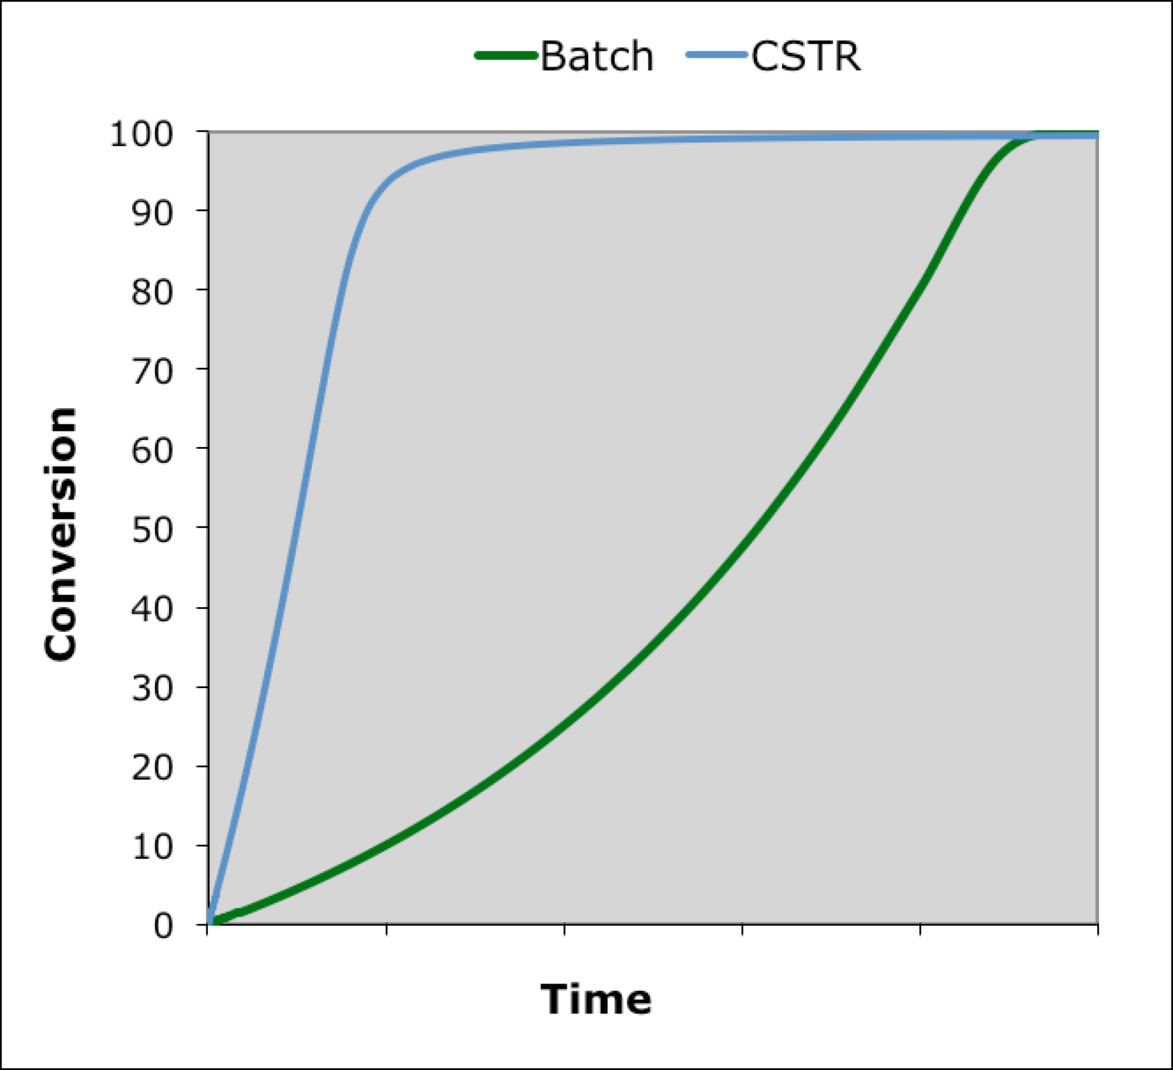
Comparison to a Batch Reactor
At low processing times, the rate in the batch reactor will be small because it starts with no product present
At an equal space time, the rate in the CSTR will be larger because for the whole time the fluid reacts, the product is present
Therefore, the CSTR curve will lie above the batch reactor curve
The batch reactor curve will display an inflection point, just as the CSTR does and for the same reason
At smaller processing times, the effect of the increasing product concentration predominates and the rate increases
At larger processing times, the effect of reactant depletion predominates and the rate decreases

Slide 11
Where We’re Going
Part I - Chemical Reactions
Part II - Chemical Reaction Kinetics
Part III - Chemical Reaction Engineering
A. Ideal Reactors
B. Perfectly Mixed Batch Reactors
C. Continuous Flow Stirred Tank Reactors
21. Reaction Engineering of CSTRs
22. Analysis of Steady State CSTRs
23. Analysis of Transient CSTRs
24. Multiple Steady States in CSTRs
D. Plug Flow Reactors
E. Matching Reactors to Reactions
Part IV - Non-Ideal Reactions and Reactors

