Slide 1
A First Course on Kinetics and Reaction Engineering
Class 16

Slide 2
Where We’re Going
Part I - Chemical Reactions
Part II - Chemical Reaction Kinetics
  A. Rate Expressions
  B. Kinetics Experiments
  C. Analysis of Kinetics Data
    13. CSTR Data Analysis
    14. Differential Data Analysis
    15. Integral Data Analysis
    16. Numerical Data Analysis
Part III - Chemical Reaction Engineering
Part IV - Non-Ideal Reactions and Reactors

Slide 3
Numerical Least Squares
When a single-response model equation cannot be linearized, numerical least squares may offer a solution
  You’ll need to provide the experimental set and response variable data, a guess for each model parameter and code that calculates the model predicted response for a data point, given the model parameters and the set variable values for that data point
When a single-response model equation cannot be analytically integrated or explicitly solved for the response variable, numerical least squares may offer a solution
  Also if the model is a set of algebraic equations or a set of initial value, ordinary differential equations
  The model equation(s) will need to be solved numerically
    In the code above, you will need to call an appropriate equation solver
    You will need to provide additional input items
      guesses for the solution (algebraic equations) or initial/final values (ODEs)
      code to evaluate the equations being solved
  The code you provide above must use these results to calculate the model predicted response
Trade-offs
  Linear least squares requires analytical integration (for ODE models), linearization and calculation of re-defined set and response variables, but the parameters are calculated directly
  Numerical least squares eliminates the need to integrate ODEs, linearize equations and calculate re-defined variables, but finding the parameters requires a guess
    If the guess is not close enough, the method may fail to find values for the parameters

Slide 4
Analyzing Multiple Response Data
When multiple response data are involved
  You can’t use numerical least squares fitting routines provided by common mathematics software packages
    they are written to minimize the sum of the squares of the errors in a single response variable
  Instead, you will need to
    decide what objective function is an appropriate replacement for the sum of the squares of the errors and provide code to calculate it, given the experimental and model-predicted responses
    use a numerical minimization routine instead of a numerical least squares routine
      most mathematics software packages provide several
    calculate statistical quantities such as correlation coefficients and 95% confidence intervals yourself
The solution of the model equations and calculation of the model-predicted response can be done numerically as described on the last slide.
A simple sum of the squares of the errors of all responses is almost never the appropriate objective function to minimize when finding the best values for the parameters
  i. e. do not use
If every response has been measured in every experiment (dense response matrix) and the errors can be assumed to be Normally distributed, minimize this determinant

Slide 5
Questions?

Slide 6
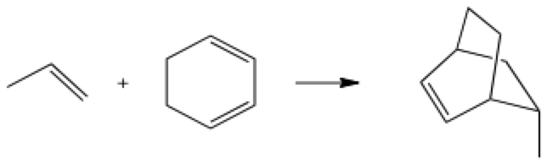
Recall Example 15.2
Reaction (1) was studied at 600 K in a constant volume batch reactor. The initial charge to the reactor consisted of 150 Torr of A and 450 Torr of B. A spectrophotometer was used to record a signal from which the fractional conversion of A could be recorded versus time. Use the data given in the table at the right to test the validity of the rate expression, r = k⋅[A]⋅[B], and find the “best” value for k. Use the integral method of data analysis.
A + B → Z (1)
time (h) | fractional conversion of A
23.1 | 0.17
33.3 | 0.22
58.2 | 0.34
69.7 | 0.41
90.7 | 0.49
127.7 | 0.58
192.1 | 0.7
240.6 | 0.77
281.1 | 0.83

Slide 7
Solution Using Linear Least Squares
Design equation:
Substitute for CA and CB:
Separate the variables:
Integrate:
Linearize; Calculate x and y:
Fit using linear least squares
Additional relationships used along the way (given fA & t):

Slide 8
Activity 16.1
Solve Example 15.2 Numerically
Write mole balances for A, B and Z (to be solved numerically)
  What must be provided to the software used to solve the set of ODEs?
    For the code, what quantities will be known and what equations will used?
Fit the model to the data using numerical least squares
  What must be provided to the software used to perform the numerical least squares?
    For the code, what quantities will be known and what equations will used?
What is the result?

Slide 9
Activity 16.1
Solve Example 15.2 Numerically
Write mole balances for A, B and Z (to be solved numerically)
  What must be provided to the software used to solve the set of ODEs?
    For the code, what quantities will be known and what equations will used?

Slide 10
Activity 16.1
Solve Example 15.2 Numerically
Write mole balances for A, B and Z (to be solved numerically)
  What must be provided to the software used to solve the set of ODEs?
    Initial values of t, nA, nB and nZ for each data point
      t = 0, , , nZ = 0
    Final value of t: given as set variable
    Code to evaluate the right-hand side of the three differential equations above
    For the code, what quantities will be known and what equations will used?
      Known quantities
        experimental constants: T, V (basis), PA⁰, PB⁰
        independent variable: t
        dependent variables: nA, nB and nZ
        set variables: tfinal, fA
        parameters: k
      Equations

Slide 11
Activity 16.1
Solve Example 15.2 Numerically
Fit the model to the data using numerical least squares
  What must be provided to the software used to perform the numerical least squares?

Slide 12
Activity 16.1
Solve Example 15.2 Numerically
Fit the model to the data using numerical least squares
  What must be provided to the software used to perform the numerical least squares?
    A guess for the model parameter, k
    The experimental values of the set variables, tfinal, and the corresponding response variables, fA
      Given in the problem statement
    Code to calculate the model-predicted response
    For the code, what quantities will be known and what equations will used?
      Known quantities (for each data point)
        experimental constants: T, V (basis), PA⁰, PB⁰
        final values of dependent variables: nA, nB and nZ
        set variables: tfinal, fA
        parameters: k
      Equation

Slide 13
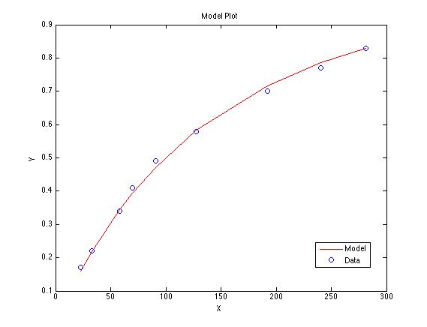
Activity 16.1
Solve Example 15.2 Numerically
Results
  k = 0.643 ± 0.023 L mol⁻¹ h⁻¹
  Model plot at right
  r² = 0.997
Assessment
  r² close to 1
  deviations of data from model
    small in magnitude
    random (no trends)
The rate expression is
acceptable

Slide 14
Activity 16.2
A new enzyme has been found for the dehydration reaction given in equation (1). A series of experiments were performed using a CSTR operating at steady-state and isothermally. The inlet flow rate was fixed at 5 mL per min and the reactor fluid volume was constant at 50 mL in all experiments. The inlet concentration of substrate, S, was changed for each experiment and the data given in the table to the right for the product, P, concentration were recorded. Determine whether Michaelis-Menten kinetics adequately describe the rate of reaction by determining the best values for the two kinetic parameters in the Michaelis-Menten rate equation.
S → P + H2O (1)
Inlet S Concentration (mmol/L) | Outlet P Concentration (mmol/L)
12.6 | 1.01
11.2 | 0.98
9.0 | 0.92
8.1 | 0.90
6.3 | 0.83
5.6 | 0.79
4.3 | 0.71
3.6 | 0.65
2.3 | 0.52
1.0 | 0.29

Slide 15
Activity 16.2
This problem is the same as Example 13.2
  In Unit 13 it was solved using linear least squares
  Write a mole balance for one reactant or product
  Substitute the rate expression
  Linearize the resulting model equation
  Calculate x and y for each experiment
  Fit using linear least squares
  Calculate the parameters from the slope and intercept
  Calculate the uncertainties in the parameters from the uncertainties in the slope and intercept
Now solve it numerically
  Write mole balance design equations for every reactant and product
  Identify the unknown quantities in the set of mole balance design equations
  List the things you need to provide in order to solve these equations numerically
    For code you must provide, identify known or given quantities and show equations needed to calculate everything else
  List the things you need to provide in order to fit the model to the experimental data numerically
    For code you must provide, identify known or given quantities and show equations needed to calculate everything else
  Solve the problem and compare and contrast the use of linear vs. numerical least squares

Slide 16
Activity 16.2
Solve Example 13.2 Numerically
Write mole balance design equations for every reactant and product
Identify the unknown quantities in the set of mole balance design equations

Slide 17
Activity 16.2
Solve Example 13.2 Numerically
Mole balances (W = H2O):
Unknowns in mole balances are ṅS, ṅP and ṅW
To solve numerically, you must provide

Slide 18
Activity 16.2
Solve Example 13.2 Numerically
Mole balances (W = H2O):
Unknowns in mole balances are ṅS, ṅP and ṅW
To solve numerically, you must provide
  Guesses for each of the unknowns
    Note that you know the experimental response for each data point and it can be used to calculate these guesses
    That is, in this problem you know the measured outlet concentration of P and you know the volumetric flow rate (which is constant since this is a liquid phase system)
      a good guess for ṅP is
      from stoichiometry, this is also a good guess for ṅW
      from stoichiometry, a good guess for ṅS is then ṅS⁰ - ṅP
  Code that evaluates the right-hand side of each of the equations being solved when they are written as above, given values for the unknowns (ṅS, ṅP and ṅW), set variables ([S]⁰) and parameters (Vmax and Km)
    Known constants: V (50 mL), ṅP⁰ (0), ṅW⁰ (0), (5 mL/min)
    Equation to use:

Slide 19
Activity 16.2
Solve Example 13.2 Numerically
To fit the model to the data using numerical least squares you must provide

Slide 20
Activity 16.2
Solve Example 13.2 Numerically
To fit the model to the data using numerical least squares you must provide
  A guess for each parameter (Vmax and Km)
  The experimental values of the set variable ([S]⁰) and the response variable ([P])
  Code that calculates the model-predicted value of the response variable given the set variable ([S]⁰), parameters (Vmax and Km) and solution to the equations found numerically as described on the last slide (ṅS, ṅP and ṅW)
    Known constants: V (50 mL), ṅP⁰ (0), ṅW⁰ (0), (5 mL/min)
    Equation to use:

Slide 21
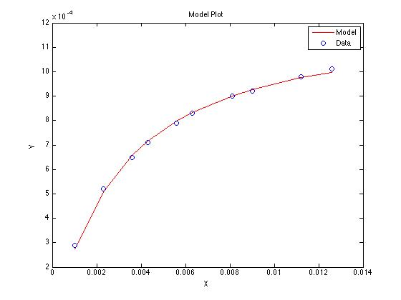
Activity 16.2
Solve Example 13.2 Numerically
To fit the model to the data using numerical least squares you must provide
  A guess for each parameter (Vmax and Km)
  The experimental values of the set variable ([S]⁰) and the response variable ([P])
  Code that calculates the model-predicted value of the response variable given the set variable ([S]⁰), parameters (Vmax and Km) and solution to the equations found numerically as described on the last slide (ṅS, ṅP and ṅW)
    Known constants: V (50 mL), ṅP⁰ (0), ṅW⁰ (0), (5 mL/min)
    Equation to use:
Results
  Vmax = 1.21 ± 0.03 x 10⁻⁴ mmol mL⁻¹ min⁻¹
  Km = 0.0025 ± 0.0002 mmol mL⁻¹
  Model plot at right
  r² = 0.998
Assessment
  r² close to 1
  small, random deviations of data from model
The rate expression is acceptable

Slide 22
Where We’re Going
Part I - Chemical Reactions
Part II - Chemical Reaction Kinetics
  A. Rate Expressions
  B. Kinetics Experiments
  C. Analysis of Kinetics Data
    13. CSTR Data Analysis
    14. Differential Data Analysis
    15. Integral Data Analysis
    16. Numerical Data Analysis
Part III - Chemical Reaction Engineering
  A. Ideal Reactors
    17. Reactor Models and Reaction Types
  B. Perfectly Mixed Batch Reactors
  C. Continuous Flow Stirred Tank Reactors
  D. Plug Flow Reactors
  E. Matching Reactors to Reactions
Part IV - Non-Ideal Reactions and Reactors

