Slide 1
A First Course on Kinetics and Reaction Engineering
Class 15

Slide 2
Where We’re Going
Part I - Chemical Reactions
Part II - Chemical Reaction Kinetics
A. Rate Expressions
B. Kinetics Experiments
C. Analysis of Kinetics Data
13. CSTR Data Analysis
14. Differential Data Analysis
15. Integral Data Analysis
16. Numerical Data Analysis
Part III - Chemical Reaction Engineering
Part IV - Non-Ideal Reactions and Reactors

Slide 3
Integral Data Analysis
Distinguishing features of integral data analysis
The model equation is a differential equation
The differential equation is integrated to obtain an algebraic equation which is then fit to the experimental data
Before it can be integrated, the differential model equation must be re-written so the only variable quantities it contains are the dependent and independent variables
For a batch reactor, ni and t
For a PFR, ṅi and z
Be careful with gas phase reactions where the number of moles changes
P and ntot (in a batch reactor) or and ṅtot (in a PFR) will be variable quantities
Often the integrated form of the PFR design equation cannot be linearized
Use non-linear least squared (Unit 16)
If there is only one kinetic parameter
Calculate its value for every data point
Average the results and find the standard deviation
If the standard deviation is a small fraction of the average and if the deviations of the individual values from the average are random
The model is accurate
The average is the best value for the parameter and the standard deviation is a measure of the uncertainty

Slide 4
Half-life Method
Useful for testing rate expressions that depend, in a power-law fashion, upon the concentration of a single reactant
The half-life, t1/2, is the amount of time that it takes for the concentration of the reactant to decrease to one-half of its initial value.
The dependence of the half-life upon the initial concentration can be used to determine the reaction order, α
if the half-life does not change as the initial concentration of A is varied, the reaction is first order (α = 1)
otherwise, the half-life and the initial concentration are related
the reaction order can be found from the slope of a plot of the log of the half-life versus the log of the initial concentration

Slide 5
Questions?

Slide 6
Activity 15.1
t (min) | CA(M)
1 | 0.874
2 | 0.837
3 | 0.800
4 | 0.750
5 | 0.572
6 | 0.626
7 | 0.404
8 | 0.458
9 | 0.339
10 | 0.431
12 | 0.249
15 | 0.172
20 | 0.185
A rate expression is needed for the reaction A → Y + Z, which takes place in the liquid phase. It doesn’t need to be highly accurate, but it is needed quickly. Only one experimental run has been made, that using an isothermal batch reactor. The reactor volume was 750 mL and the reaction was run at 70 °C. The initial concentration of A was 1M, and the concentration was measured at several times after the reaction began; the data are listed in the table on the right.
Find the best value for a first order rate coefficient using the integral method of analysis.

Slide 7
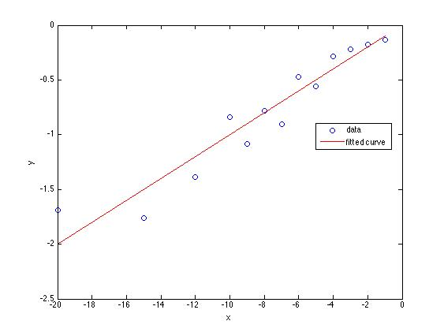
Solution
Mole balance on A:
Rate expression:
Mole balance after substitution:
Prepare for integration
After integration:
Model is linear, y = m⋅x
Calculation of x and y
Fit
r² = 0.91
m = 0.10 ± 0.01 min⁻¹

Slide 8
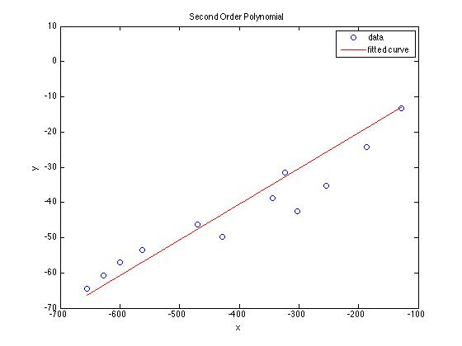
Comparison of Differential and Integral Analysis
Differential Analysis (Activity 14.1c)
Second order polynomial used to approximate dnA/dt
Top right model plot
r² = 0.85
m = 0.10 ± 0.01 min⁻¹
Best finite differences (central differences)
r² = 0.16
m = 0.08 ± 0.03 min⁻¹
Integral Analysis (Activity 15.1)
Bottom right model plot
r² = 0.91
m = 0.10 ± 0.01 min⁻¹
When data are noisy
Integral analysis is preferred
fit once
Polynomial approximation is second best
fit twice
Finite differences approximation should be avoided

Slide 9
Activity 15.2
The gas phase, isothermal decomposition shown in reaction (1), was studied at 1150 K and 1 atm pressure using a PFR.
2 A → 2 Y + Z (1)
The feed was pure A, and the tubular reactor had a volume of 150 cm³. The inlet flow rate was varied and the outlet partial pressure of Z was measured. The data are tabulated in the table to the right.
Group 1: Test the adequacy of rA = −k⋅CA as a rate expression.
Group 2: Test the adequacy of rA = −k⋅CA² as a rate expression.
Inlet Feed Rate (cm³ min⁻¹) | Outlet Mole Fraction of Z
2.26 | 0.088
1.23 | 0.131
0.73 | 0.166
0.51 | 0.195
0.29 | 0.228
0.17 | 0.260
0.09 | 0.287
Notes:
three groups at board solving; three groups in seats solving, seats check answer of board, go over solutions.

Slide 10
Mole Balance Design Equation
Mole balance on A:
Substitute the rate expressions
Prepare for integration
Definition of concentration and ideal gas law:
Mole table or definition of extent of reaction
Substituting
Separate the variables and integrate

Slide 11
Neither equation can be properly linearized for fitting by linear least squares
Each equation has only one parameter, k
Rearrange to get expression for k
Calculate value of k for each data point
Find average k and its standard deviation
Check that standard deviation is small compared to average and there are no trends in the differences between individual k values and the average
To calculate k
P and T are given, R is a known universal constant
Note that π⋅D²⋅L = 4⋅V, and V is given
Feed is pure A, so
From mole table or definition of extent of reaction
(previous slide)

Slide 12
Results
Inlet Feed Rate (cm³ min⁻¹) | Outlet Mole Fraction of Z | First Order k (min⁻¹) | Second Order k (cm³ mol ⁻¹ min⁻¹)
2.26 | 0.088 | 0.0034 | 753
1.23 | 0.131 | 0.0032 | 787
0.73 | 0.166 | 0.0027 | 759
0.51 | 0.195 | 0.0026 | 797
0.29 | 0.228 | 0.0020 | 750
0.17 | 0.260 | 0.0017 | 786
0.09 | 0.287 | 0.0012 | 797
Average: |  | 0.0024 | 775
Standard Deviation: |  | 0.0008 | 21
First order standard deviation is 33% of average and values show a trend
Second order standard deviation is 3% of average and there does not appear to be a trend
The second order rate expression is acceptable

Slide 13
Where We’re Going
Part I - Chemical Reactions
Part II - Chemical Reaction Kinetics
A. Rate Expressions
B. Kinetics Experiments
C. Analysis of Kinetics Data
13. CSTR Data Analysis
14. Differential Data Analysis
15. Integral Data Analysis
16. Numerical Data Analysis
Part III - Chemical Reaction Engineering
Part IV - Non-Ideal Reactions and Reactors

