Slide 1
A First Course on Kinetics and Reaction Engineering
Class 14

Slide 2
Where We’re Going
Part I - Chemical Reactions
Part II - Chemical Reaction Kinetics
A. Rate Expressions
B. Kinetics Experiments
C. Analysis of Kinetics Data
13. CSTR Data Analysis
14. Differential Data Analysis
15. Integral Data Analysis
16. Numerical Data Analysis
Part III - Chemical Reaction Engineering
Part IV - Non-Ideal Reactions and Reactors

Slide 3
Fitting Models with Derivatives to Experimental Data
In the differential method, derivatives that appear in the model equation are treated like experimentally measured variables
Usually not highly accurate, there best for initial or quick analysis
Requires estimation of the value of the derivative
Batch reactors
The experimental data allow calculation of the dependent variable (usually ni) at several different values of the independent variable, t
Tangent method (historical): plot the data, draw a smooth curve, at each t, draw a tangent, estimate the derivative as the slope of the tangent
Polynomial method: fit a polynomial that yields a smooth curve to the experimental data, at each t, evaluate the derivative of the polynomial and use the result to estimate the derivative
Finite difference method: connect the data points by straight line segments, at each t, estimate the derivative as the slope of the line segment preceding (backward differences) or following (forward differences) the point or as the average of the slopes of the line segments preceding and following (central differences) the point.

Slide 4
Differential Data Analysis
Initial rates
Prepare reagents in well-known proportions, start the reaction and only estimate the derivative at the start of the reaction using any of the preceding methods
Allows variation of a single concentration while holding all others constant
PFRs
The experimental data typically do not allow the calculation of the dependent variable (usually ṅi) at several different values of the independent variable, z
Differential data analysis can only be used if the reactor was operated differentially
only valid if the change in ṅi was small, e. g. 5%
When the rate expression is substituted into the design equation, it should be evaluated at the average of the inlet and outlet composition
best if the inlet and outlet concentration of each species only differ by a small amount, e. g. 5%
Results from differential data analysis are more strongly influenced by experimental “noise” than results from integral data analysis (Unit 15)

Slide 5
Questions?

Slide 6
Activity 14.1(a)
A rate expression is needed for the reaction A → Y + Z, which takes place in the liquid phase. It doesn’t need to be highly accurate, but it is needed quickly. Only one experimental run has been made, that using an isothermal batch reactor. The reactor volume was 750 mL and the reaction was run at 70 °C. The initial concentration of A was 1M, and the concentration was measured at several times after the reaction began; the data are listed below.
Plot the data, fit a 2nd, 3rd, 4th and 5th order polynomial to the data and plot the polynomials. Choose the best polynomial and use it to estimate dnA/dt for each experimental data point.
t (min) | CA(M)
1 | 0.874
2 | 0.837
3 | 0.800
4 | 0.750
5 | 0.572
6 | 0.626
7 | 0.404
8 | 0.458
9 | 0.339
10 | 0.431
12 | 0.249
15 | 0.172
20 | 0.185

Slide 7
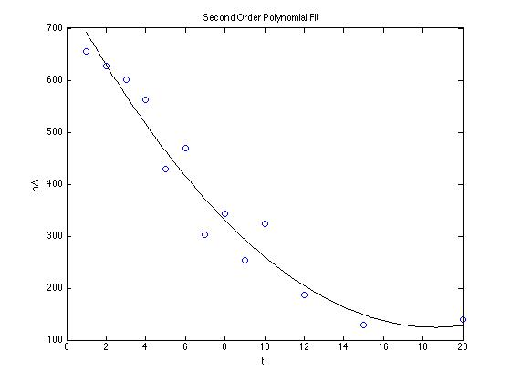
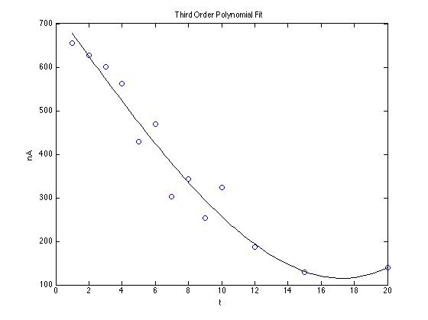

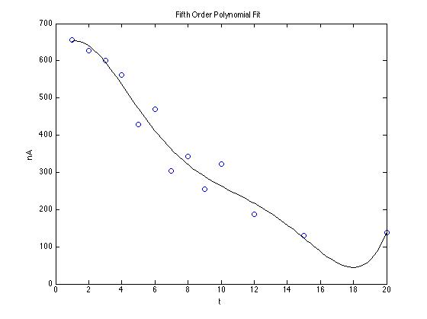
Note nA = CA⋅V
2nd Order
3rd Order
4th Order
5th Order

Slide 8
Activity 14.1(b)
t (min) | CA(M)
1 | 0.874
2 | 0.837
3 | 0.800
4 | 0.750
5 | 0.572
6 | 0.626
7 | 0.404
8 | 0.458
9 | 0.339
10 | 0.431
12 | 0.249
15 | 0.172
20 | 0.185
A rate expression is needed for the reaction A → Y + Z, which takes place in the liquid phase. It doesn’t need to be highly accurate, but it is needed quickly. Only one experimental run has been made, that using an isothermal batch reactor. The reactor volume was 750 mL and the reaction was run at 70 °C. The initial concentration of A was 1M, and the concentration was measured at several times after the reaction began; the data are listed below.
Use forward, backward and central differences to estimate dnA/dt for each experimental data point. When using central differences, use a forward difference for the first data point and a backward difference for the last data point.

Slide 9
Finite Differences
Forward
Backward
Central
t (min) | dnA/dt (mol/min)
1 | -27.7500
2 | -27.7500
3 | -37.5000
4 | -133.5000
5 | 40.5000
6 | -166.5000
7 | 40.5000
8 | -89.2500
9 | 69.0000
10 | -68.2500
12 | -19.2500
15 | 1.9500
20
t (min) | dnA/dt (mol/min)
1
2 | -27.7500
3 | -27.7500
4 | -37.5000
5 | -133.5000
6 | 40.5000
7 | -166.5000
8 | 40.5000
9 | -89.2500
10 | 69.0000
12 | -68.2500
15 | -19.2500
20 | 1.9500
t (min) | dnA/dt (mol/min)
1 | -27.7500
2 | -27.7500
3 | -32.6250
4 | -85.5000
5 | -46.5000
6 | -63.0000
7 | -63.0000
8 | -24.3750
9 | -10.1250
10 | 0.3750
12 | -43.7500
15 | -8.6500
20 | 1.9500

Slide 10
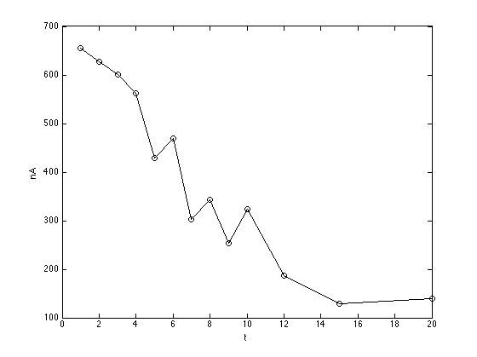
nA vs. t Effect of Noise in the Data on Finite Differences

Slide 11
Activity 14.1(c)
t (min) | CA(M)
1 | 0.874
2 | 0.837
3 | 0.800
4 | 0.750
5 | 0.572
6 | 0.626
7 | 0.404
8 | 0.458
9 | 0.339
10 | 0.431
12 | 0.249
15 | 0.172
20 | 0.185
A rate expression is needed for the reaction A → Y + Z, which takes place in the liquid phase. It doesn’t need to be highly accurate, but it is needed quickly. Only one experimental run has been made, that using an isothermal batch reactor. The reactor volume was 750 mL and the reaction was run at 70 °C. The initial concentration of A was 1M, and the concentration was measured at several times after the reaction began; the data are listed below.
Find the best value for a first order rate coefficient using the differential method of analysis and each of the estimates of dnA/dt from parts (a) and (b). Comment upon the results.

Slide 12
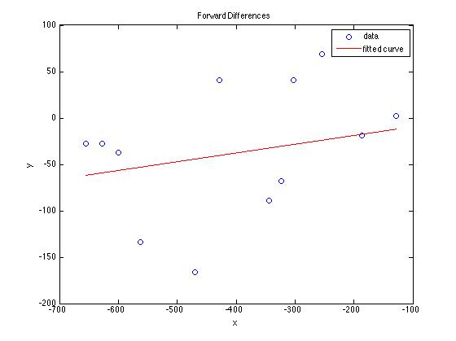
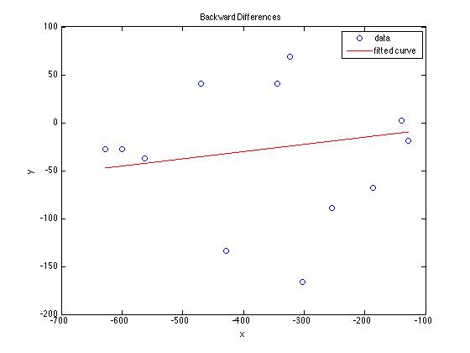
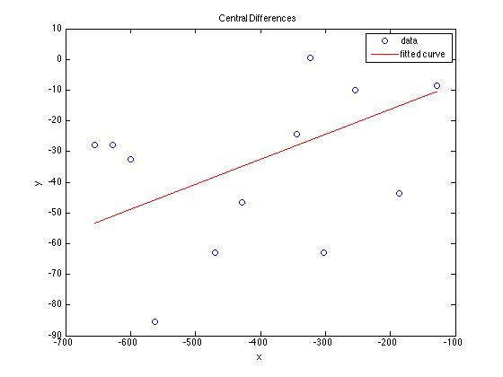
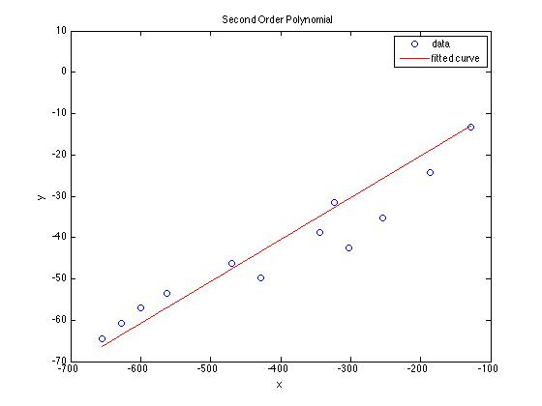
First Order Rate Expression

Slide 13
Where We’re Going
Part I - Chemical Reactions
Part II - Chemical Reaction Kinetics
A. Rate Expressions
B. Kinetics Experiments
C. Analysis of Kinetics Data
13. CSTR Data Analysis
14. Differential Data Analysis
15. Integral Data Analysis
16. Numerical Data Analysis
Part III - Chemical Reaction Engineering
Part IV - Non-Ideal Reactions and Reactors

