Slide 1
A First Course on Kinetics and Reaction Engineering
Class 13

Slide 2
Where We’re Going
Part I - Chemical Reactions
Part II - Chemical Reaction Kinetics
  A. Rate Expressions
  B. Kinetics Experiments
  C. Analysis of Kinetics Data
    13. CSTR Data Analysis
    14. Differential Data Analysis
    15. Integral Data Analysis
    16. Numerical Data Analysis
Part III - Chemical Reaction Engineering
Part IV - Non-Ideal Reactions and Reactors

Slide 3
Testing a Rate Expression Using CSTR Data
Assuming one reaction is taking place and a steady state reactor, a single mole balance design equation is needed to model the reactor
  i is any one reactant or product; j is the one reaction that is taking place
Analysis procedure
  Substitute math function to be tested as rate expression into the design equation above
  Linearize the resulting equation
    y = m1 x1 + m2 x2 + ... + mn xn + b
      each slope, mi, must be constant with the same value in every experiment and it must contain at least one unknown parameter from the rate expression
      there must be at least one slope (i. e. n ≥ 1)
      there does not have to be an intercept, b
  Calculate values of y and xi for every experimental data point
  Use linear least squares to fit the linearized model equation to the experimental data
  Decide whether the fit is sufficiently accurate
    correlation coefficient
    model plot or parity plot and residuals plots
  If the fit is accurate, calculate the best values of the rate expression parameters and their uncertainties
  If the fit is not accurate, choose a different mathematical function to test as a rate expression

Slide 4
Useful Points and Relationships
The concentrations or partial pressures in the rate expression are evaluated at the outlet conditions, which are the same as the perfectly mixed contents of the reactor where the reaction is taking place
For liquid phase systems, it can usually be assumed that the volumetric flow rate is constant so the inlet and outlet volumetric flow rates are equal
For ideal gases
For liquid or gas phase systems

Slide 5
Questions?

Slide 6
Activity 13.1
Suppose the liquid phase reaction A + B → Y + Z was studied in a 100 L CSTR
Three kinds of experiments were performed to generate kinetics data
  The results are given in the handout, 13_Activity_1_Handout.xlsx, that accompanies this Unit
  Experiments to gauge whether the reaction is reversible or not are highlighted in light blue and are summarized below
  Experiments to help guess the concentration dependence of the rate are highlighted in light green and are summarized on the next slide
  Experiments to generate a large kinetics data set, spanning the conditions of interest are highlighted in light orange and are also summarized on the next slide
Experiments to gauge reversibility of the reaction (light blue highlight)
  2 experiments
    One at low temperature (298 K) and one at high temperature (360 K)
    High concentrations of products (CY = CZ = 1.0 M) and low concentrations of reactants (CA = CB = 0.1 M)
    Low flow rate (high space time) to get highest conversion possible
  Results
    To within the experimental noise, no product was converted to reactant
    The reaction appears to be irreversible

Slide 7
Experimental Results
Experiments to scope composition dependence (highlighted in light green)
  Problem: we set the inlet concentrations, not the outlet concentration
    If the space time is high, all of the concentrations will be considerably different at the outlet than they were at the inlet
    Therefore, use a small space time so that the concentrations change only slightly
  5 experiments, all at the same temperature (325 K) and largest allowed flow (1000 L/min)
    Base case inlet composition: CA = CB = CY = CZ = 1 M
      Outlet CY is 1.06 M, so concentration changes are small
  Results
    Double inlet CA or CB, ΔCY is approximately double the base case
    Double inlet CY or CZ, ΔCY is approximately the same as the base case
    r = k CA CB may be a good first guess for the rate expression
Experiments to generate a large data set spanning conditions of interest (highlighted in light orange)
  Five “blocks” of experiments at 305, 320, 330, 345 and 355 K
  Within each block want to span a range of concentrations of each reagent by
    Using different feed compositions
    Varying space time
  A statistical design is preferred
    I just randomly selected different inlet settings trying to span the range of concentrations
      For each block I arbitrarily picked inlet concentrations then did a few experiments with different flow rates (to span a range of conversions)
      Repeated with a second set of inlet concentrations

Slide 8
Activity 13.1a
The kinetics data for this example consist of five “blocks” of constant temperature experiments
Data of this kind can be processed in two steps
  In the first step, each of the blocks is processed separately
    Since all of the experiments in the block use the same temperature, the rate coefficient(s) can be treated as a single unknown parameter within any one block
    The data in a block can be analyzed, and the best value for the rate coefficient(s) at that block temperature can be determined
  In the second step, the temperature dependence of the rate coefficient(s) can be determined by fitting the Arrhenius expression to the resulting k vs. block temperature data
To begin, you have been assigned one of the constant temperature blocks of data to analyze
  Test the rate expression suggested by the preliminary experiments (r = k CA CB) using the data in the block you have been assigned
  Determine whether the rate expression is satisfactory
    If it is, determine the best value for k at the temperature of your block
  Determine the best values for the pre-exponential factor and the activation energy

Slide 9
Analysis of a Data Block
Mole balance on Y
Rate expression to test
Substituting
The model is linear
  Define
  The model becomes
Can fit using linear least squares
  Need to calculate y and x for each data point in the block
Calculation of y
  Given:
  y can be calculated
Calculation of x
  from a mole table
  Given: V and (from above)
  x can be calculated
Fit block using linear least squares

Slide 10
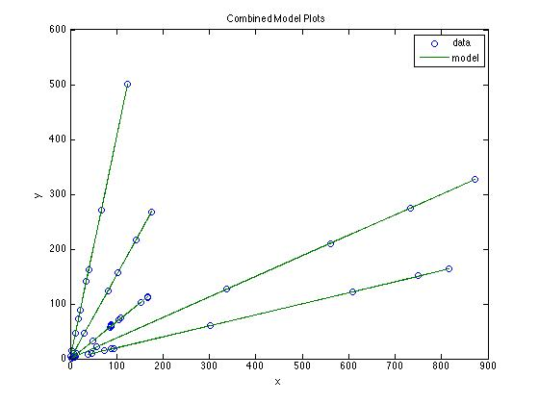
Step 1 Fitting Results
Excluded reversibility experiments
  Apparent conversions were of the same order as experimental noise
Correlation coefficient ~ 1 for each block
Small, random deviations of data in model plots
The rate expression is acceptable
  Slope of fitted line is equal to rate coefficient
  Uncertainty in slope equals uncertainty in rate coefficient
Note, now have values of rate coefficient at each of 5 temperatures
  In step 2, can make an Arrhenius plot
Accompanying files
  Activity_13_1_Results.xlsx shows data grouping/numbering
  Activity_13_1.m performs calculations
T (K) | r² | k (L/mol/min) | 95% C.L.
305 | 1 | 0.2009 | 0.0004
315 | 1 | 0.3753 | 0.0003
325 | 0.999 | 0.6755 | 0.0067
340 | 1 | 1.5297 | 0.0038
360 | 0.9999 | 4.0759 | 0.0194

Slide 11
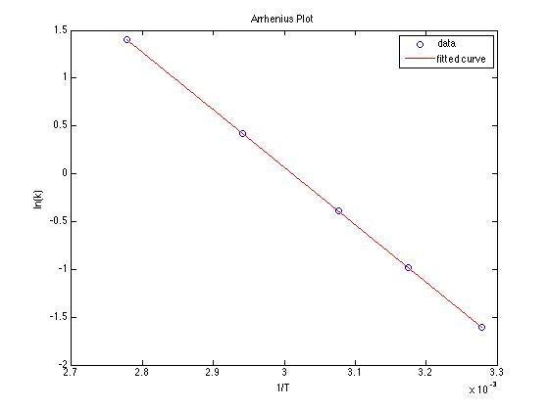
Step 2, Find the Arrhenius Parameters
Simply fit the Arrhenius expression to the results from the first part of the analysis shown at the right
  If power-law exponents had been determined in the first part of the analysis and they were not the same for each block temperature, one could separately attempt to fit some functional form for the temperature dependence of each exponent
    Unlike the rate coefficients where the functional form is known (Arrhenius expression) there isn’t any theory to guide selection of a functional form for the exponents
The fit is very good
  k0 = 7.27 ± 0.18 x 10⁷ L/mol/min
  E = 49.97 ± 0.07 kJ/mol
T (K) | r² | k (L/mol/min) | 95% C.L.
305 | 1 | 0.2009 | 0.0004
315 | 1 | 0.3753 | 0.0003
325 | 0.999 | 0.6755 | 0.0067
340 | 1 | 1.5297 | 0.0038
360 | 0.9999 | 4.0759 | 0.0194

Slide 12
Activity 13.1b
An alternative approach is to analyze the full set of kinetics data all at once
  To do this, the rate expression must be written as r = k0 exp(-E/RT) CA CB and substituted in the design equation
  The rest of the fitting process is analogous, but it uses the entire data set at once instead of processing in constant temperature blocks.
Test the rate expression using this approach and compare the results to the previous findings

Slide 13
Activity 13.1b
An alternative approach is to analyze the full set of kinetics data all at once
  To do this, the rate expression must be written as r = k0 exp(-E/RT) CA CB
  Substitution in the design equation
  Linearization
    This has the form y = mx + b if
  Calculate y and x for every data point in the full set and fit y = mx + b to the resulting data
In general, this approach is not recommended, especially if there are kinetics parameters other than rate coefficients (e. g. power-law exponents)
  The strong exponential temperature dependence can mask weaker concentration dependence of the reaction rate

Slide 14
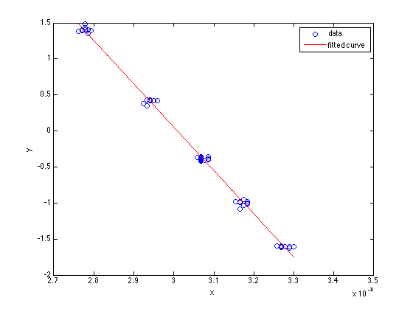
Activity 13.1b
Results from fitting all at once
  r² = 0.9953
  k0 = 7.21 ± 2.62 x 10⁷ L/mol/min
  E = 49.99 ± 0.99 kJ/mol
Results from two step fitting
  k0 = 7.27 ± 0.18 x 10⁷ L/mol/min
  E = 49.97 ± 0.07 kJ/mol

Slide 15
Where We’re Going
Part I - Chemical Reactions
Part II - Chemical Reaction Kinetics
  A. Rate Expressions
  B. Kinetics Experiments
  C. Analysis of Kinetics Data
    13. CSTR Data Analysis
    14. Differential Data Analysis
    15. Integral Data Analysis
    16. Numerical Data Analysis
Part III - Chemical Reaction Engineering
Part IV - Non-Ideal Reactions and Reactors

