Slide 1
A First Course on Kinetics and Reaction Engineering
Class 12

Slide 2
Where We’re Going
Part I - Chemical Reactions
Part II - Chemical Reaction Kinetics
A. Rate Expressions
B. Kinetics Experiments
11. Laboratory Reactors
12. Performing Kinetics Experiments
C. Analysis of Kinetics Data
Part III - Chemical Reaction Engineering
Part IV - Non-Ideal Reactions and Reactors

Slide 3
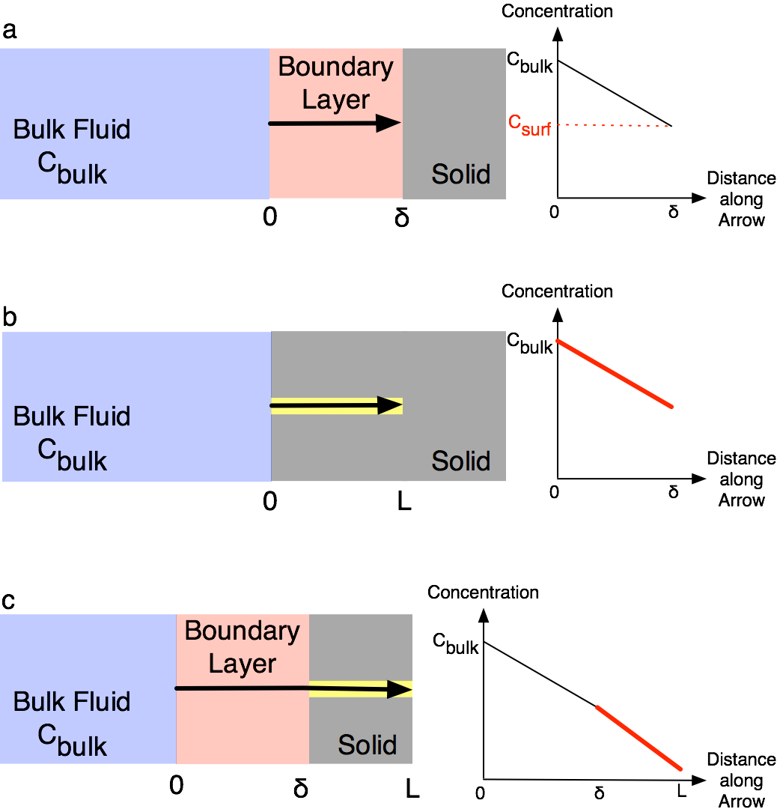
Testing Reactor Models
If mixing is perfect, the rate of reaction should not depend upon agitator speed
Interfacial Gradients
The ideal reactor models assume locally uniform composition
When two phases coexist, concentration and/or temperature gradients develop near the interface between the phases
Gradients between the bulk fluid and the surface can cause external transport limitations
Gradients within the pores of a solid can cause internal transport limitations
Experimental and computational tests can be performed to make sure the rate is negligibly affected by these gradients
External transport limitation tests
The conversion should not vary with linear flow velocity if the residence time is constant
At very low flow rates this test lacks sensitivity
Be suspicious of first order kinetics with very low activation energies

Slide 4
Testing for Transport Limitations and Performing Kinetics Experiments
Computational tests for external transport limitations
Experimental test for internal transport limitations
For fixed residence time, the conversion should not vary as a function of catalyst particle size
For fixed dispersion of supported catalysts, the conversion should not vary with catalyst loading
Be suspicious if the activation energy drops by 50% at higher temperatures
Computational tests for internal transport limitations
Typical kinetics experiments
Batch reactor: charge and bring to temperature, measure initial composition
measure composition vs. time
several data points per experiment
Flow reactors: set inlet conditions and temperature, wait until system is at steady state
measure outlet composition
one data point per experiment

Slide 5
Kinetics Experiments
Three possible objectives
Determine whether the reaction is reversible by attempting to attain 100% conversion of the limiting reagent
Conduct a few experiments where “base conditions” are selected and concentration of each reagent is changed holding all others constant
Results can help when guessing a rate expression to test
Gather data that span all possible temperatures and compositions of interest for the resulting rate expression
Experimental approach
Operate the reactor in the preferred mode to simplify data analysis
Conduct experiments in constant temperature blocks
Analyze data in two steps: first by block to get rate coefficient(s) at each block temperature
Then analyze rate coefficients vs. block temperatures to get Arrhenius parameters
Consider statistical design of experiments

Slide 6
Questions?

Slide 7
Activity 12.1 Four Slide Presentation
Units 11 and 12 presented a number of different procedures for “testing” laboratory reactors. Prepare a four slide presentation that summarizes the important information. You can simply sketch out your slides on paper; you do not need to actually prepare slides (you may, if you wish).
The recommended format for the presentation is to use the first slide to describe why the tests are necessary and what they actually test. The remaining three slides should be devoted to actual tests, organized in some logical order.
A few of you may be called upon to show your slides and describe the points you would seek to make with each slide.

Slide 8
Activity 12.2
Example 12.5 indicated that there are differences between the kinetics data generated using a batch reactor and those generated using a CSTR
There are also differences in the experiments used to generate the data
In this activity, the nature of these differences will be observed using kinetics simulators for a batch reactor and a CSTR
Apart from batch versus continuous, what experimental aspects are different?
How can these differences be rationalized without resorting to equations?
What implications might these differences have upon the data analysis?
As you work, you should copy your simulator results to the Excel handout 12_Activity_2.xlsx
As you work through the activity, you will enter simulator results in cells that are colored green
As you fill in those results, values will appear in cells colored yellow and blue
Generation of batch reactor kinetics data using a single experiment
Set T = 340 ºC, V = 5 L, CA = CB = 1.0 M and CX = CY = 0.0 M
Start the experiment and watch the concentration of Y
Record a data point when CY is approximately 0.2, 0.4, 0.6, 0.8 and 0.9 M
Note any trends you observe
Fill in the results in the cells of the batch reactor table (top, left) that are colored light green

Slide 9
Generate CSTR data using the same feed composition and reaction times
The upper CSTR data table on the spreadsheet should be pre-filled in except for the last two columns
Each row is a separate CSTR experiment
The feed composition for every experiment is the same as the initial composition in the batch experiment; the temperatures are the same, as well
The feed flow rates have been filled in for you so that the CSTR residence times are equal to the elapsed times for your five batch reactor experiments
Use the CSTR simulator to perform the 5 experiments using the settings in the table
Record the outlet temperature and concentration of Y for each experiment in the spreadsheet
Note any trends you observe
Note any differences you observe between the batch experiment or data and the CSTR
Generate alternative CSTR data where the CSTR feed composition equals the batch reactor composition at the start of a batch reactor interval and the residence time in the CSTR equals the length of the batch reactor interval
The lower CSTR data table on the spreadsheet should again be pre-filled in except for the last two columns
Note, in this series of experiments, the CSTR feed simulates the batch reactor composition at the start of each of the five sampling intervals
The CSTR feed rate has been calculated so that the CSTR residence time is equal to the elapsed time until the next batch reactor sample was taken
As above, use the CSTR simulator to perform the 5 experiments using the settings in the table
Note any trends and and differences between the batch experiment or data and the CSTR

Slide 10
Procedure Summary
Generation of batch reactor kinetics data using a single experiment
Set T = 340 ºC, V = 5 L, CA = CB = 1.0 M and CX = CY = 0.0 M
Start the experiment and watch the concentration of Y
Record a data point when CY is approximately 0.2, 0.4, 0.6, 0.8 and 0.9 M
Note any trends you observe
Fill in the results in the cells of the batch reactor table (top, left) that are colored light green
Generate CSTR data using the same feed composition and reaction times
Use the CSTR simulator to perform the 5 experiments using the settings in the upper CSTR table
Record the outlet temperature and concentration of Y for each experiment in the spreadsheet
Note any trends you observe
Note any differences you observe between the batch experiment or data and the CSTR
Generate alternative CSTR data
As above, use the CSTR simulator to perform the 5 experiments using the settings in the lower CSTR table
Record the outlet temperature and concentration of Y for each experiment in the spreadsheet
Note any trends you observe
Note any differences you observe between the batch experiment or data and the CSTR

Slide 11
Discuss and Rationalize
List trends you observed in the batch experiment and data
Offer a qualitative explanation for the trend; you may not use an equation to explain the trend
List trends you observed in the CSTR experiment and data
Offer a qualitative explanation for the trend; you may not use an equation to explain the trend
List the differences you observed between the batch experiment/results and the CSTR experiment/results
Offer a qualitative explanation for the differences
Discuss what implications the differences might have upon the use of the data for the testing of a rate expression
Can you think of a way to eliminate the differences between the two sets of data?

Slide 12
Where We’re Going
Part I - Chemical Reactions
Part II - Chemical Reaction Kinetics
A. Rate Expressions
B. Kinetics Experiments
11. Laboratory Reactors
12. Performing Kinetics Experiments
C. Analysis of Kinetics Data
13. CSTR Data Analysis
14. Differential Data Analysis
15. Integral Data Analysis
16. Numerical Data Analysis
Part III - Chemical Reaction Engineering
Part IV - Non-Ideal Reactions and Reactors

