Slide 1
A First Course on Kinetics and Reaction Engineering
Class 9

Slide 2
Where We’re Going
Part I - Chemical Reactions
Part II - Chemical Reaction Kinetics
  A. Rate Expressions
    4. Reaction Rates and Temperature Effects
    5. Empirical and Theoretical Rate Expressions
    6. Reaction Mechanisms
    7. The Steady State Approximation
    8. Rate Determining Step
    9. Homogeneous and Enzymatic Catalysis
    10. Heterogeneous Catalysis
  B. Kinetics Experiments
  C. Analysis of Kinetics Data
Part III - Chemical Reaction Engineering
Part IV - Non-Ideal Reactions and Reactors

Slide 3
Conservation of Catalyst and Charge
Homogeneous catalysts and enzymes are not produced or consumed in the overall, macroscopically observed reaction
  In the mechanism they typically appear in as complexes with one or more species
  The concentration of these complexes and of the non-complexed catalyst can be difficult to measure; they should be treated like reactive intermediates and their concentrations eliminated
The Bodenstein steady state equations and the quasi-equilibrium expressions very often cannot be solved to obtain expressions for reactive intermediates involving complexed catalysts or enzymes
  Add an equation expressing conservation of catalyst and/or conservation of charge to generate a set of equations that can be solved for the concentrations of reactive intermediates
Conservation of catalyst
    C⁰cat is the equivalent concentration of the catalyst (or enzyme) before it is added to the system
    νcat,i is the number of catalyst species in the form originally added to the system that are needed to create one complex of the catalyst with species i
Conservation of charge

Slide 4
Michaelis-Menten Rate Expressions
Michaelis-Menten kinetic expressions for enzymatic reactions are derived from mechanisms
  Often the product formation step is effectively irreversible
  The Bodenstein steady state approximation and the conservation of enzymes are used in generating the rate expression
The simplest Michaelis-Menten expression for the reaction S → P is derived from a two step mechanism
  E + S ⇄ E-S
  E-S → E + P
The simple Michaelis-Menten rate expression can be linearized by taking its reciprocal
  A plot of the reciprocal of the rate versus the reciprocal of the substrate concentration should be linear
    Called a Lineweaver-Burk plot
    Useful when finding the best values for Vmax and Km from experimental data

Slide 5
Questions?

Slide 6
Michaelis-Menten Kinetics with a Co-Factor
Consider the macroscopically observed reaction (1) which is catalyzed by the enzyme E. This enzyme will not complex with the substrate, S, unless it first complexes with the co-factor, C. The complete reaction mechanism is given by reactions (2) through (4), where step (4) is effectively irreversible. Derive a Michaelis-Menten type rate expression based upon this mechanism. You may assume that the concentration of the non-complexed cofactor is easy to measure, and therefore the concentration of non-complexed cofactor may appear in the rate expression.
S → P (1)
E + C ⇄ E-C (2)
E-C + S ⇄ S-E-C (3)
S-E-C → E-C + P (4)

Slide 7
Setting Up the Solution
Write an expression for the rate of generation of a reactant or product
Identify E, E-C and S-E-C as reactive intermediates and apply the Bodenstein steady state approximation to two of them
Write an expression for the conservation of enzyme
Solve the steady state and enzyme conservation equations to get expressions for the concentrations of the reactive intermediates

Slide 8
Simplifying the Rate Expression
Substitute the expression for [S-E-C] into the rate expression
Define
Michaelis-Menten form of the rate expression

Slide 9
Lineweaver Burk Analysis
Inhibited Enzymatic Reaction
Suppose the enzyme-catalyzed reaction (1) is believed to obey Michaelis-Menten kinetics with inhibition, equation (2). This is the rate expression derived in Example 9.3. To test this, the rate of production of P was measured as a function of the concentrations of S and I using a 500 cm³ chemostat and 10.0 mg of enzyme. The temperature, pressure and solution volume were all constant over the course of the experiments. On the basis of the resulting data, presented in the Table, does equation (2) offer an acceptable description of the reaction rate? If so, what are the best values of Vmax, KI and Km?
S → P (1)
(2)
CS (M) | CI (M) | rP (M/min)
0.100 | 0.100 | 0.000798
0.086 | 0.050 | 0.000838
0.080 | 0.005 | 0.000912
0.075 | 0.001 | 0.000915
0.070 | 0.100 | 0.000745
0.063 | 0.050 | 0.000819
0.056 | 0.005 | 0.000898
0.048 | 0.001 | 0.000901
0.047 | 0.100 | 0.000689
0.041 | 0.050 | 0.000771
0.036 | 0.005 | 0.000896
0.030 | 0.001 | 0.000890
0.025 | 0.100 | 0.000563
0.021 | 0.050 | 0.000664
0.015 | 0.005 | 0.000846
0.010 | 0.001 | 0.000855

Slide 10
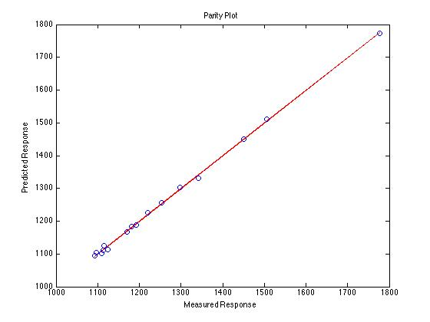
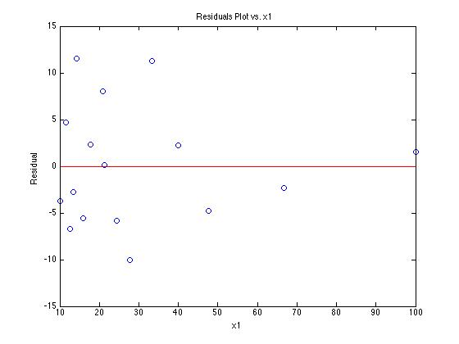
Linearize the Model and Fit to the Data
Take the reciprocal of the rate expression
Define new variables to give a linear model
Calculate x1, x2 and y for each data point and fit the linear model to the resulting data
  r², = 0.999
  m1 = 0.67 ± 0.16 min
  m2, = 166 ± 3 min M⁻¹
  b = 1084 ± 7 min M⁻¹

Slide 11
Calculate the Model Parameters
The fit is acceptably accurate
Calculate the model parameters and their uncertainties
Vmax = (9.22 ± 0.06) x 10⁻⁴ M min⁻¹
Km = (6.18 ± 1.47) x 10⁻⁴ M
KI = 0.153 ± 0.003

Slide 12
Where We’re Going
Part I - Chemical Reactions
Part II - Chemical Reaction Kinetics
  A. Rate Expressions
    4. Reaction Rates and Temperature Effects
    5. Empirical and Theoretical Rate Expressions
    6. Reaction Mechanisms
    7. The Steady State Approximation
    8. Rate Determining Step
    9. Homogeneous and Enzymatic Catalysis
    10. Heterogeneous Catalysis
  B. Kinetics Experiments
  C. Analysis of Kinetics Data
Part III - Chemical Reaction Engineering
Part IV - Non-Ideal Reactions and Reactors

