Slide 1
A First Course on Kinetics and Reaction Engineering
Class 5

Slide 2
Where We’ve Been
Part I - Chemical Reactions
Part II - Chemical Reaction Kinetics
A. Rate Expressions
4. Reaction Rates and Temperature Effects
5. Empirical and Theoretical Rate Expressions
6. Reaction Mechanisms
7. The Steady State Approximation
8. Rate Determining Step
9. Homogeneous and Enzymatic Catalysis
10. Heterogeneous Catalysis
B. Kinetics Experiments
C. Analysis of Kinetics Data
Part III - Chemical Reaction Engineering
Part IV - Non-Ideal Reactions and Reactors

Slide 3
Empirical and Theoretical Rate Expressions
Empirical rate expressions are chosen for their mathematical convenience
Power law rate expressions:
mi is the reaction order in i
Multiplicative term to force proper behavior at equilibrium:
Monod equation for cell growth
Elementary reaction is one where the reaction as written is an exact description of what happens in a single molecular event
Principle of microscopic reversibility: at the molecular level, every reaction must be reversible
Collision theory rate expression for a gas phase elementary bimolecular reaction between two different types of reactants
Transition state theory rate expression for an elementary reaction

Slide 4
Theoretical Rate Expressions
Collision theory and transition state theory give almost the same mathematical form for the net rate of an elementary reaction
They differ in the form and temperature dependence of the pre-exponential ter
Generally the differences in temperature dependence of the pre-exponential terms are almost impossible to detect due to the exponential term
We will usually take the pre-exponential terms to be constants
Both theories give the exact same mathematical form for the rate expression for an elementary reaction
This makes the forward and reverse rate coefficients obey the Arrhenius expression

Slide 5
Questions?

Slide 6
Power Law Rate Expressions and Reversible Reactions
The rate expression, , is valid for the reaction 2 A ⇄ Y + Z at conditions far from equilibrium
k = 1 h⁻¹
Kc = 16
Your assignment is to evaluate this rate expression at conditions close to equilibrium and then to “correct” it as follows
Prepare a three slide presentation about this rate expression
Slide 1: The problem
Slide 2: How to fix it
Slide 3: Discussion, issues and/or comments on the corrected rate expression
To help you in preparation of your presentation
Assume you have a fixed volume system that initially contains 1 mol L⁻¹ of A and nothing else
Fill in the columns of the spreadsheet for fA, CA, CY, CZ, and the rates predicted by the original rate expression and the corrected rate expression with a equal to 0.5, 1.0 and 2.0
Use the resulting data to plot each of the four rates predicted by the original rate expression and the three corrected versions

Slide 7
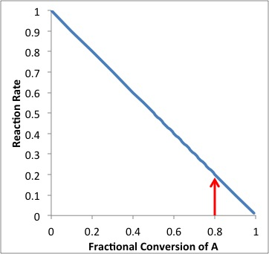
Power Law Rate Expressions Fail Near Equilibrium
The reaction, 2 A ⇄ Y + Z, is reversible
If the reaction started with 1 mol L⁻¹ of A and nothing else, it would reach thermodynamic equilibrium at a conversion of 80%
C0,A = 1; K = 16 ⇒ fA = 0.8
At equilibrium, the rate should equal zero
The rate expression predicts a rate of 0.2 at equilibrium
r = k*CA
C0,A = 1; fA = 0.8; CA = C0,A(1-fA); k = 1 ⇒ r = 0.2

Slide 8
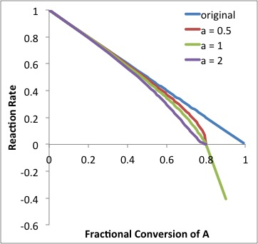
Correcting Near-Equilibrium Behavior
At thermodynamic equilibrium
Initially
Far from equilibrium, no change
Near equilibrium, goes to zero

Slide 9
Issues When Used Beyond Equilibrium
At conditions beyond equilibrium, the reaction should proceed in the reverse direction
The rate should become negative
The correction term will become negative at conditions beyond equilibrium
Exponentiating it can cause problems
if a is fractional; result is indeterminate (square root of a negative number)
if a is an even integer; result becomes positive instead of negative
if a is an odd integer; result remains negative as required
General rule: if the rate expression will be used for conditions beyond equilibrium, require a to be an odd integer
If the rate expression will never be applied at conditions beyond equilibrium (including intermediate results in the numerical solution of design equations), a can be treated as an adjustable parameter that must be greater than 0

Slide 10
Molecularity of Elementary Reactions
Sit on the floor forming a circle and facing into the circle
Two people each will be given a ping pong ball; one person should act as the “collision counter”
When I say GO, the people who have ping pong balls should roll them across the circle
If they collide, the collision counter should add 1
When a ball comes to you, roll it back across the circle
Repeat until I say stop
We will then repeat this “experiment” but with three people each being given a ping pong ball at the start
We will repeat it one more time, but with four people each being given a ping pong ball at the start

Slide 11
Ping-Pong Balls vs. Molecules
You have just conducted an experiment using ping-pong balls.
It was intended to serve as an analogy to certain aspects of the collision theory.
What are the similarities between this experiment and collision theory?
What are the differences between this experiment and collision theory?
Can any conclusions be drawn from this experiment that would also apply to collision theory?

Slide 12
Termolecular Reactions are Rare
Bimolecular reactions are much more likely than termolecular reactions.
True for gases
What about liquids?
The rates of termolecular reactions are expected to be smaller than the rates of bimolecular reactions.
It is highly unlikely that a reaction involving more than three reactants OR PRODUCTS is elementary.
Why is a reaction with more than 3 products almost certainly NOT elementary?

Slide 13
Where We’re Going
Part I - Chemical Reactions
Part II - Chemical Reaction Kinetics
A. Rate Expressions
4. Reaction Rates and Temperature Effects
5. Empirical and Theoretical Rate Expressions
6. Reaction Mechanisms
7. The Steady State Approximation
8. Rate Determining Step
9. Homogeneous and Enzymatic Catalysis
10. Heterogeneous Catalysis
B. Kinetics Experiments
C. Analysis of Kinetics Data
Part III - Chemical Reaction Engineering
Part IV - Non-Ideal Reactions and Reactors

